Slide 1
Women’s Health: an overview of barriers and opportunities to meet the needs of women in One Care

Slide 2
Starting the conversation: elevating the voice of women enrolled in One Care
Women on the Implementation Council put together a small workgroup to:
Begin a conversation about the unique needs of women
Work with the Implementation Council to strategize about:
Improving access to physically accessible care
Ensuring Population appropriate care for women with SUD, mental health, SDOH needs
Improving health equity across the intersection of race, ethnicity, GBLTQ and other groups across the lifespan

Slide 3
Why focus on women? It is about time!
Research shows:
Many pregnant women with physical disabilities in Massachusetts are not weighed as doctors may not have necessary equipment.
Women with disabilities are less likely to have routine pap smears and mammograms due to lack of knowledge of the need for such tests and doctors’ lack of necessary equipment.¹
Women with disabilities are less likely to get prenatal care.²
Notes:
Sources: 1. MASSLIVE (2016). Bill seeks to address health care disparities among people with disabilities in Bay State. http://www.masslive.com/politics/index.ssf/2016/03/bill_would_create_office_to_ad.html. Accessed 12/15/17.
2. https://commed.umassmed.edu/news/2015/02/12/first-study-pregnant-women-intellectual-and-developmental-disabilities-reveals

Slide 4
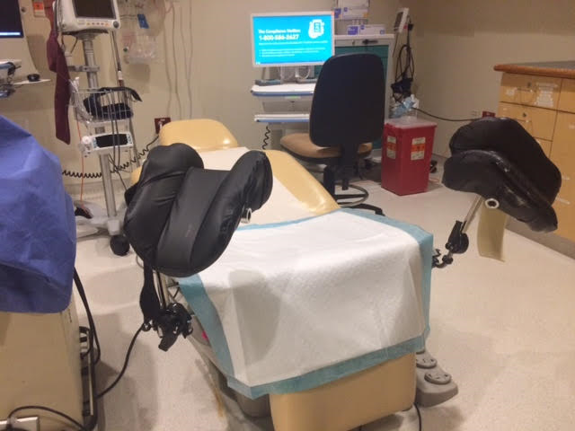
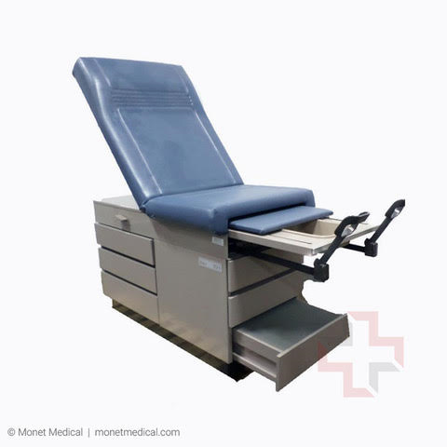
Accessible and Inaccessible exam tables
Inaccessible Exam Table
Accessible Exam Table

Slide 5
Pregnant woman getting on an inaccessible examination table

Slide 6
Psychosocial needs
According to a comprehensive 2002 study, “Women with disabilities had significantly lower self-cognition and self-esteem, and greater social isolation than the women without disabilities, as well as significantly less education, more overprotection during childhood, poorer quality of intimate relationships, and lower rates of salaried employment.”3
More recent research shows that at a minimum, women with disabilities experience abuse the same rate as nondisabled individuals.
Risk factors leading to abuse and neglect include " increased risk of isolation, abuse by multiple potential perpetrators, dependency as a result of disability, difficulties identifying and naming disability related abuse, and cultural/societal barriers.” 4
Notes:
3 Social Science & Medicine Volume 56, Issue 8, April 2003, Pages 1737-1747
Self-esteem and women with disabilities Author links open overlay pane l Margaret Anosekª Rosemary Bhughes ªNancySwedlund ªHeather Btaylorª PaulSwank^{b}
4 Women With Disabilities’ Experience With Physical and Sexual Abuse: Review of the Literature and Implications for the Field, Sara-Beth Plummer and Patricia A. Findley. Trauma, Violence, & Abuse, Vol 13, Issue 1, pp. 15 - 29

Slide 7
The connection between body image and isolation.
A woman with a prosthetic limb was unable to get an appropriate stocking to cover her prosthetic. As a result, she stopped attending her church because she felt self conscious when she went out in public.
Notes:
This story had a happy and name because the plan provided with stocking needed.

Slide 8
Barriers to reproductive healthcare for people with psychiatric diagnoses
Women with psychiatric diagnoses are:
Less likely to receive prenatal care.⁵
Less likely to receive pap smears, breast exams, and mammograms.⁶
Notes:
MGH Center for Women’s Mental Health (2018). Psychiatric disorders during pregnancy. https://womensmentalhealth.org/specialty-clinics/psychiatric-disorders-during-pregnancy/?doing_wp_cron=1513351515.8253760337829589843750. Accessed 6/25/18.
Treatment Advocacy Center Office of Research & Public Affairs (2018). http://www.treatmentadvocacycenter.org/storage/documents/women-and-smi.pdf. Accessed 6/25/18.

Slide 9
Recommendations for the Implementation Council
We urge the Implementation Council to make a motion requesting that MassHealth clarify the ability of One Care enrollees to utilize their personal care attendant, certified peer specialists, and other supports as needed, to ensure access to services.

Slide 10
Recommendations for the Implementation Council
The implementation Council create a time-limited work group charged with the task of developing policies, practices and procedures that will increase the capacity and competency of plans to meet the needs of women. The workgroup should include representatives from:
Council members/One care members
MassHealth
Plans
The field of women’s health and disability

Slide 11
Recommendations for the Implementation Council
The Implementation Council should encourage MassHealth to raise awareness about trainings for providers that will help providers become more educated about the unique healthcare needs of women with disabilities.
Some existing resources for providers include
Relationships Matter!: Webinar series that educates providers about how to help female patients who have behavioral needs, form more positive relationships.⁷
MDPH Healthy Relationships, Sexuality and Disability Resource Guide. (Information for providers and people with disabilities.⁸
Notes:
https://www.samhsa.gov/women-children-families/trainings/relationships-matter
http://www.mass.gov/eohhs/docs/dph/com-health/prevention/hrhs-sexuality-and-disability-resource-guide.pdf

Slide 12
Research from the Disability Policy Consortium (DPC)
The DPC has been conducting research on this topic and has published brief reports on:
Violence against people with disabilities,
Access barriers faced by women with disabilities who seek reproductive healthcare services.
The DPC has also published a resource guide to help people with disabilities who are, or may be, experiencing violence.
All of these documents can be found here: http://www.dpcma.org/dpc-call-to-action/

Slide 13
Discussion
For more resources about the intersection of women's health and disability contact
Maggie Sheets MSheets@myombudsman.org

