Slide 1
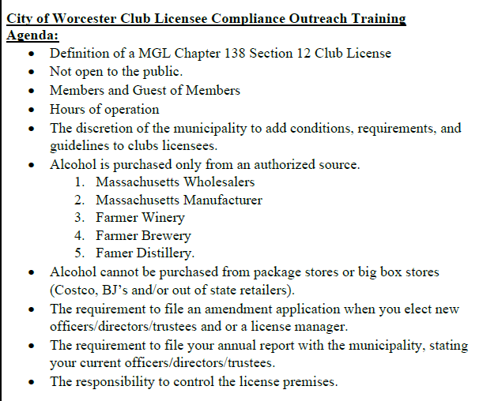

Slide 2
Definition of a Club
''Club'', a corporation chartered for any purpose described in section two of chapter one hundred and eighty, whether under federal or state law, including any body or association lawfully operating under a charter granted by a parent body so chartered, and including also any organization or unit mentioned in clause twelfth of section five of chapter forty, owning, hiring, or leasing a building, or space in a building, of such extent and character as may be suitable and adequate for the reasonable and comfortable use and accommodation of its members; provided, that its affairs and management are conducted by a board of directors, executive committee, or similar body chosen by the members at its annual meeting.

Slide 3
Club Regulations
MGL 138 Section 12: Any club in any city or town wherein the granting of licenses to sell alcoholic beverages, or only wines and malt beverages, as the case may be, is authorized under this chapter may be licensed by the local licensing authorities, subject to the approval of the commission, to sell such beverages to its members only, and also, subject to regulations made by the local licensing authorities, to guests introduced by members, and to no others.
204 CMR 10.00:
10.01: General Provisions No holder of a club license issued pursuant to M.G.L. c. 138, § 12, other than a club that is distinctly private, may make any distinction, discrimination, or restriction on account of race, color, religious creed, national origin, sex, sexual orientation, physical or mental disability or ancestry relative to the admission of any person to membership in the club or to admission to the premises as a guest or relative to the treatment of any member or guest at the club premises.
10.02: Criteria Evidence that a club is a public accommodation and not distinctly private may include, but is not limited to, the following: (1) The extent to which the club facilities, the alcoholic beverages license or both are used for commercial purposes.
(2) The extent to which club membership exceeds 200 persons.
(3) The extent to which regular meal and beverage service are available at the premises.
4) The degree to which the club receives payment for dues, fees, use of space, facilities, services, meals or beverages directly or indirectly from or on behalf of nonmembers for the furtherance of trade or business or professional interests.
(5) The frequency with which the premises or any part of the premises are used for conferences and meetings sponsored by or on behalf of trade or business or professional enterprises.
(6) The degree to which club facilities, including, but not limited to, meal and beverage service, are utilized by non-members.
(7) The degree to which persons are selected for membership in the club on the basis of trade or business or professional associations or achievement.
(8) The number of members who are partners, officers, directors, or trustees of trade or business or professional enterprises. (9) The club's holding, by lease or otherwise, of any interest in real property owned by a governmental entity or municipality.

Slide 4
Guidelines for Operation of the Premise
204 CMR 2.00: REGULATIONS OF THE ALCOHOLIC BEVERAGES CONTROL COMMISSION
Slot machines or any other devices which furnish anything besides merchandise of a quantity and quality commensurate with the price deposited therein are prohibited on licensed premises. Gambling of any sort, except those games of chance authorized by the Legislature and/or local licensing authorities, shall not be permitted on any license premises.
No Club licensed to sell alcoholic beverages shall use any signs, printed matter or other means publicly to advertise the sale of alcoholic beverages. This shall not prohibit the use of reasonable and proper signs relating to alcoholic beverages within the licensed premises.
All pipes, coils, hose, faucets and other appliances used in the drawing of drought beer shall be thoroughly cleansed and flushed at least twice in each week, and shall be kept in a clean and sanitary condition at all times.
Substitution of Beverages: The substitution of any alcoholic beverages of a kind or brand different from that ordered by a purchaser is prohibited unless it is done with the consent of the person or licensee making the purchase.

Slide 5
Purchasing of Alcohol from Authorized Sources
MGL 138 Section 23: Club licensees may only purchase alcohol from:
Massachusetts Wholesalers
Massachusetts Farmer Breweries
Massachusetts Wineries
Massachusetts Distilleries
Cannot purchase from package stores, such as Costco and BJ’s.
Massachusetts Manufacturers

Slide 6
Amending Officers and Directors
MGL 138 Section 15A
All officers, Directors, and LLC Managers must be approved by both the local board and ABCC.
The license manager must be approved by the local board and ABCC.
The club would submit an amendment to update the officers and change the manager.
The amendment application can be found on the ABCC website under Alcoholic Beverages Retail Licenses, Amend a Retail License.
https://www.mass.gov/guides/amending-your-alcoholic-beverages-retail-license-abcc

Slide 7
Annual Report
Per MGL 138 Section 1:
Such club shall file with the local licensing authorities and the commission annually within three months after January first in each year a list of the names and residences of its officers, together with the amount of salary or compensation received by each employee engaged in the handling or selling of alcoholic beverages.
This does not take the place of the required approval by both the ABCC and local licensing board of the officers and directors of the licensed club.

