Slide 1
Rate Review and Rate Development for Workers’ Compensation Payments
Commonwealth of Massachusetts
Executive Office of Health and Human Services (EOHHS)
Listening Session
April 11, 2018

Slide 2
Agenda
Overview and Introductions
Objectives
Discussion Topics
Programmatic Issues
Consumer Access
Quality of Care
Utilization
Provider Differences
Other Programs
Questions
Contact Information

Slide 3
Overview and Introductions

Slide 4
Project Overview
Public Consulting Group, Inc. (PCG) is working with EOHHS and DIA to review and develop rates for the Massachusetts workers’ compensation program.
This includes:
A review of the current regulations establishing rates for healthcare services under the Massachusetts Workers’ Compensation Act
The evaluation and development of rate setting methodologies
Development of proposed rates for health care services

Slide 5
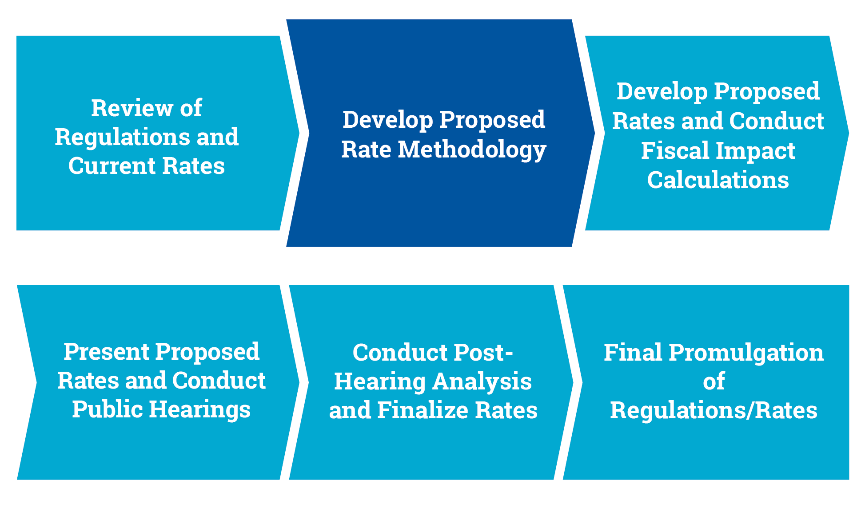
Project Timeline
PCG is currently developing the proposed rate methodology for EOHHS and DIA

Slide 6
Objectives

Slide 7
Stakeholder Engagement
Opportunities for comment built into the project workplan
In addition to todays session, PCG is speaking with stakeholders from:
EOHHS
Department of Industrial Accidents
Department of Public Health
Massachusetts Human Resource Division
Health Care Services Board
Best Doctors Occupational Health Institute

Slide 8
Listening Session Objectives
The general objective of this session is to identify existing benefits and barriers related to:
The overall workers’ compensation program
Current applicable regulations
The existing fee schedule
Reimbursement related to specific service settings (inpatient/outpatient hospital, ASCs, professional services)
Reimbursement related to specific service types (orthopedics, anesthesia, laboratory)
Please do not hesitate to share any information you believe to be relevant.

Slide 9
Discussion Topics

Slide 10
Discussion Topics
PCG is interested in hearing your thoughts on the following broad topics:
Programmatic issues of the current program
Consumer access
Quality of care
Utilization
Provider differences
Other workers’ compensation programs
For each topic, we have developed some questions to initiate the dialogue, but please feel free to share any relevant information.

Slide 11
Programmatic Issues
Are there any fundamental revisions that need to be made to the current Workers’ Compensation reimbursement system?
How are Workers’ Compensation rates affected by external network negotiations?

Slide 12
Consumer Access
Is reimbursement adequate across provider types to ensure injured workers have access to primary care and specialists?

Slide 13
Quality of Care
Are there quality issues related to adverse selection?
Are there other quality of care concerns stemming from the current rates, and how can a change in the rate scheme address those concerns?

Slide 14
Utilization
Are there any services or service settings that exhibit inappropriate utilization?
In what way does the current reimbursement structure encourage or discourage network participation?

Slide 15
Provider Differences
Are there concerns related to the current reimbursement structure for particular providers or types of providers?
Are there care settings that have been historically under-utilized?

Slide 16
Other Workers’ Compensation Programs
Are there any innovative methodologies or program characteristics found in peer states, or pilot programs that could be implemented in Massachusetts?
What is the impact of out-of-state hospitals or out-of-state consumers on Massachusetts Workers’ Compensation system?

Slide 17
Questions?

Slide 18
Contact Information
Coy Jones
Senior Consultant
Project Manager
coyjones@pcgus.com (512) 287 - 4691
Lauren Rodrigues
Senior Consultant
Physician Services Lead
lrodrigues@pcgus.com (617) 717 -1333

Slide 19
Thank You

