Slide 1
Commonwealth of Massachusetts
Overview of Workforce System
Jennifer James
Undersecretary for Workforce
Executive Office of Labor and Workforce Development
Draft for Policy Development Purposes Only

Slide 2
EOLWD State-Regional Workforce System
The front door for job seekers is the One-Stop Career Center system statewide. The system is governed and operated by:
EOLWD – DCS state oversight
16 Workforce Investment Boards - 51%+ business members
Map out labor market need for region
Organize businesses with workforce needs
Set policy and performance goals for services in region
Ensure Career Center accountability
32 MA One Stop Career Centers
Provide services to job seekers and employers in the region
Customers: On Average, 10,000+ businesses and 160,000+ job seekers work with One-Stop Career Centers
Draft for Policy Development Purposes Only

Slide 3
Regional Governance
JOINT LOCAL
GOVERNANCE
Lead Elected Official (LEO) (Grant Recipient)
LOCAL
WORKFORCE
INVESTMENT BOARD
(LWIB)
(51% Private Sector
Majority- Required)
WIB
Oversight
One-Stop Career Center
(DCS & PARTNER LEAD OPERATOR)
APPOINTS
MOU with other Local Partners
Business
Other Agencies (MOBD, DTA, MRC)
Community Based
Organizations
Adult Education (ABE/ESOL)
Higher Ed Voc Ed
The 16 Workforce Investment Boards (WIB) charter their respective One Stop Career Centers (OSCC) and build partnerships with the other entities represented in their regions through a Memorandum of Understanding (MOU) or informal relationships.
Draft for Policy Development Purposes Only

Slide 4
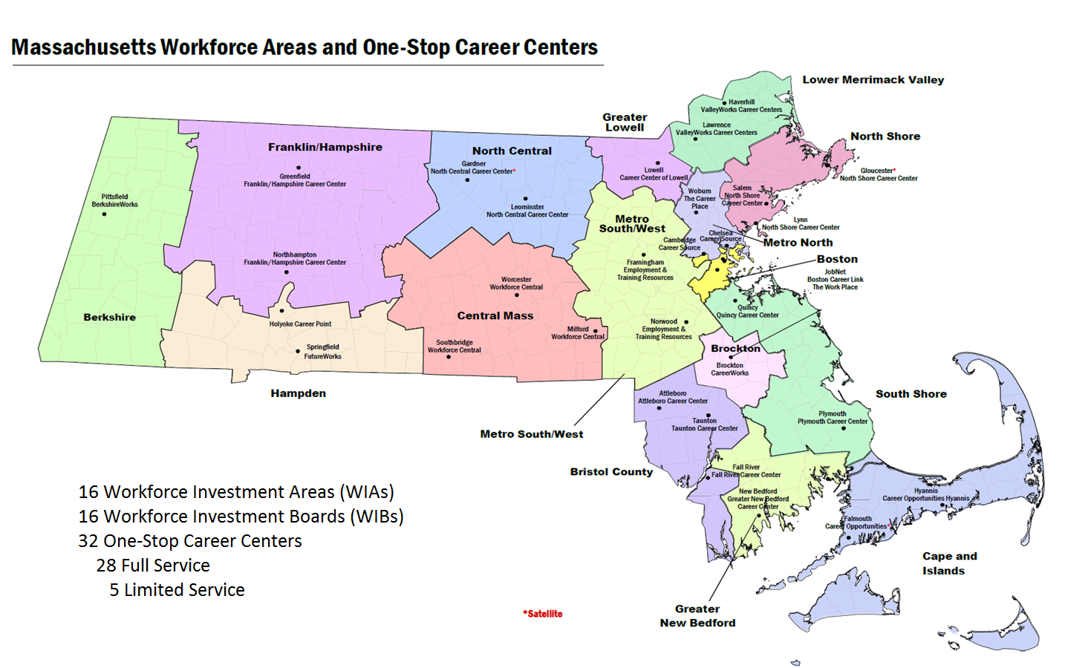
MA WORKFORCE REGIONS AND CAREER CENTERS
16 Workforce Investment Areas (WIBs)
16 Workforce Investment Boards (WIBs)
33 One-Stop Career Centers
Draft for Policy Development Purposes Only

Slide 5
Job Seeker Resources
Career Preparation - The MA Career Centers prepare job seekers for their next job.
Review of effective work search techniques
Career counseling, support services, and exploration of training opportunities
Access to UI Online services
Instruction on utilization of work search tools such as: JobQuest, MassCIS, TORQ, CareerReady 101
On-Site or off-site employer recruitments/job fairs
Workshops
Basic Computer Classes (Word, Using computers etc)
Resumes, Cover Letters, Interviewing
Career Exploration
Labor Market Trends
Social Networking Classes
Using Age to Your Advantage
Job Clubs
And others (see “upcoming events” www.mass.gov/jobquest)
Draft for Policy Development Purposes Only

Slide 6
Funding Source
MA Workforce System funded primarily through Federal Funds
Local allocations are determined by Federal Formula
WIA Title I
Adult
REA
WIA
Title I Youth
Locally
Obtained
Funding
WIA Title I Dislocated Worker
WIB
Career Center
State Funding
Federal Discretionary Grants
NEGs
Federal Funds
State Career Center Line Item
Locally Obtained Funding
Jobs for
Veteran
State Grant
(JVSG)
Wagner
Peyser
Draft for Policy Development Purposes Only

Slide 7
Major Funding Programs
Workforce Investment Act Title I Adult, Youth and Dislocated Worker (WIA) WIA supports intensive and training services through Career Centers.
Rapid Response (RR) Layoff Aversion RR Set-Aside
Trade Adjustment Assistance (TAA)
National Emergency Grants (NEG)
Disability Employment Initiative (DEI)
Offender Reentry and Reemployment
Wagner Peyser – Employment Service WP supports universal access to job seekers and employer services through Career Centers.
Work Opportunity Tax Credit (WOTC)
Foreign Labor Certification (FLC)
Reemployment Eligibility Assessment (REA)
Reemployment Services
Jobs for Veterans State Grant (JVSG)
Discretionary Grants The state pursues special grant resources to provide more intensive services for specific populations.
Draft for Policy Development Purposes Only

Slide 8
Employment for Special Target Populations: Individuals with Disabilities
Disability Employment Initiative Grants (III, V, & VII)
Disability Employment Initiative Round III Grant
Funding: $ 4,899,606
Period of Performance: October 1, 2012 – March 31, 2016
The goal of MA DEI III is to improve both opportunities and outcomes for adults with disabilities who may be unemployed, underemployed and/or receiving SSI/SSDI benefits. Enrollment goal of 320 participants. Actual participants were 666, 130 received training and 394 entered employment.
The grant supports the initiative in 7 Massachusetts One-Stop Career Centers – Future Works in Springfield, Career Point in Holyoke, Franklin Hampshire Career Centers (Offices in Greenfield and Northampton), Career Center of Lowell and North Shore Career Centers (Offices in Lynn and Salem).

Slide 9
Employment for Special Target Populations: Individuals with Disabilities
Disability Employment Initiative Grants (III, V, & VII)
Disability Employment Initiative Round V Grant
Funding $2,500,000
Period of Performance: October 1, 2014 – March 31, 2017
The goal of the grant is to improve the job placement outcomes for adults with disabilities through expanded access to credential-based education and training pathways offered through the community college system in areas of manufacturing, healthcare and hospitality. Enrollment goal of 165. Participants completing career pathways training was 140, attainment of certificates 123, and 116 entered employment
The grant is operating in three major workforce development areas: Metro North (Cambridge), North Central (Leominster) and Central Mass (Worcester).

Slide 10
Employment for Special Target Populations: Individuals with Disabilities
Disability Employment Initiative Grants (III, V, & VII)
Disability Employment Initiative Round VII Grant
Funding $2,500,000
Period of Performance: October 1, 2016 thru April 1, 2020
The DEI VII Pathways to Employment Project will serve 285 youth with disabilities, improving the job placement outcomes for these individuals through the use of career pathways strategies that prepare them and support them for employment success that includes access to credential-based education and training pathways. 196 expected to participate in career pathway programs, 85 projected to attain a credential.
The grant is operating in two major workforce development areas: Hampden County (Future Works Career Center, Springfield and Career Point, Holyoke) and Greater Lowell.

Slide 11
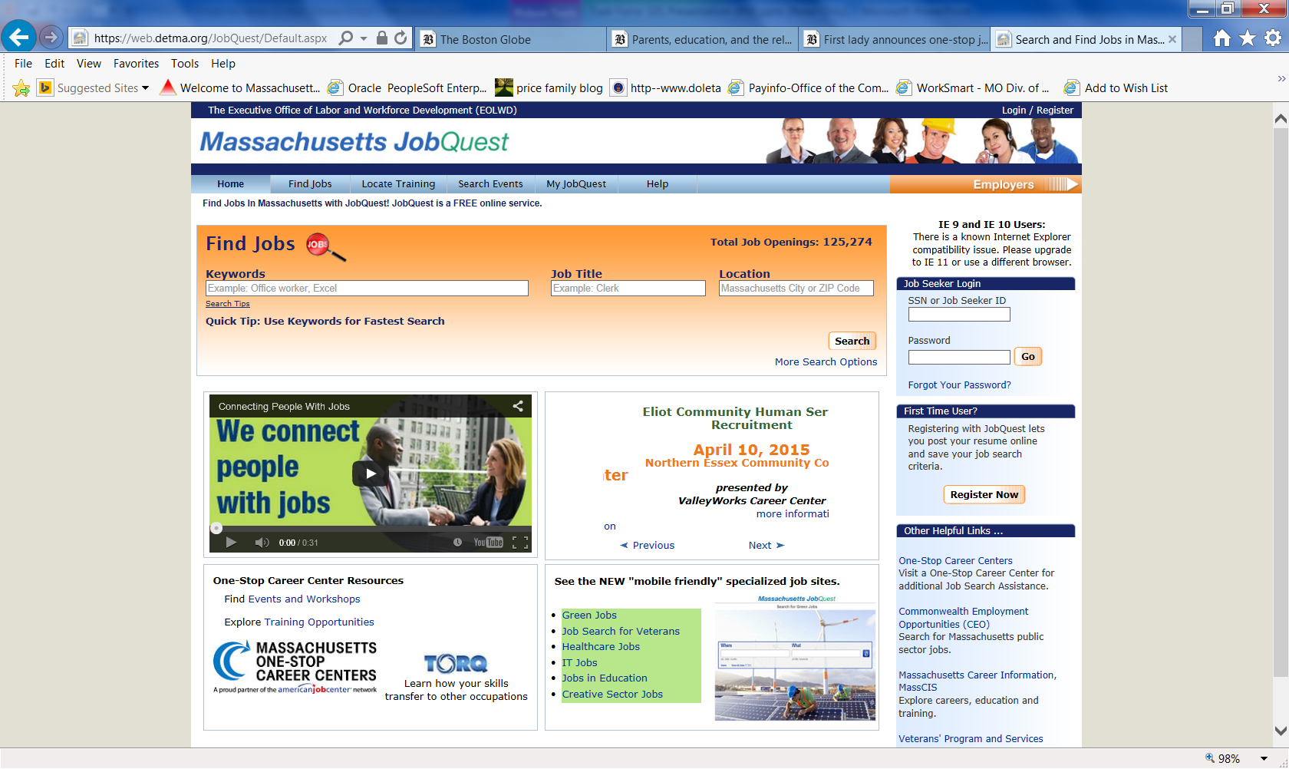

Slide 12
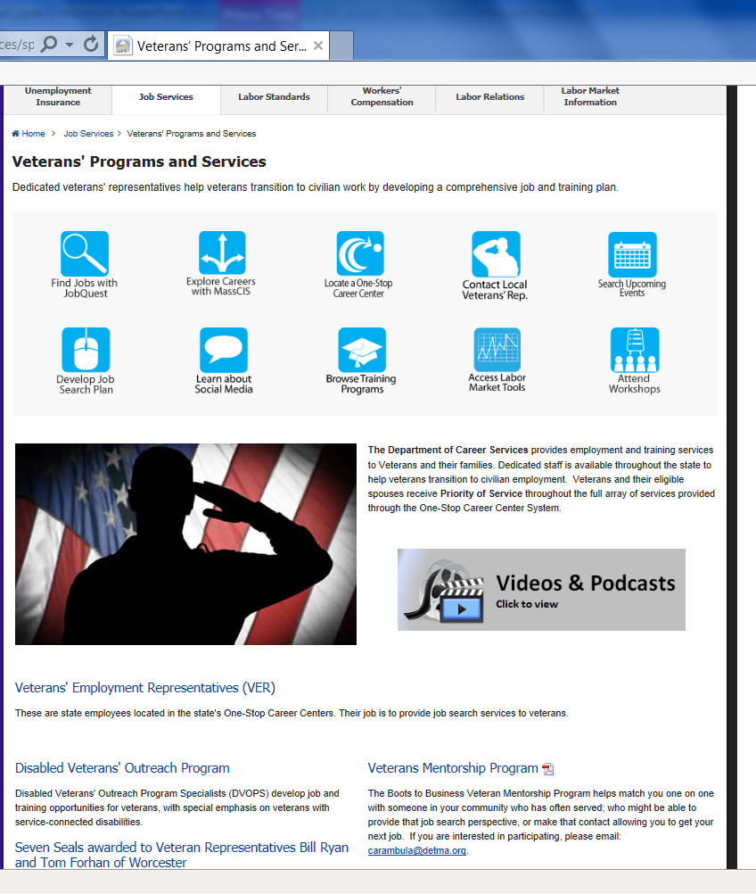
Career Center Veteran’s Services
Veteran’s Employment Representatives, dedicated staff in Career Center system, assist with workshops, tools and job counseling
TORQ
ebenefits.va.gov
Coordinate with cities/towns and Department of Veteran’s programs

Slide 13
Business Outreach and Services
Call 800-252-1591

Slide 14
Customers served FY11 – FY14
Draft for Policy Development Purposes Only

Slide 15
Career Center Customer Data – FY14
EMPLOYERS AND CUSTOMERS SERVED BY WORKFORCE AREA IN FISCAL YEAR 2014
Workforce Area | Total Employers Served | Individuals Entered Employment
Berkshire | 454 | 2,139
Boston | 538 | 9,860
Bristol | 784 | 7,265
Brockton | 679 | 3,314
Cape Cod & Islands | 529 | 1,765
Central Mass | 2,333 | 8,243
Franklin Hampshire | 886 | 2,529
Greater Lowell | 453 | 4,189
Greater New Bedford | 328 | 4,001
Hampden | 1,104 | 12,050
Merrimack Valley | 922 | 7,160
Metro North | 996 | 9,288
Metro South West | 636 | 6,077
North Central Mass | 698 | 3,438
North Shore | 1,058 | 6,503
South Shore | 632 | 7,000
TOTAL - Statewide All Offices | 10,980 | 104,294

Slide 16
Major Resources for Individuals with Barriers to Employment
Connections to Community-Based, Human Service & Education Resources:
Disability Employment
Massachusetts Commission for the Blind
Massachusetts Rehabilitation Commission
Department of Developmental Services
Veterans Training and Job Placement, Department of Veterans’ Services
Employment for TANF recipients, Department of Transitional Assistance
Public Housing Authorities and low-income residents, Department of Housing and Community Development (Community Development Block Grants, etc.)
Limited Education/ ESOL, Department of Adult and Community Learning Services, Department of Elementary and Secondary Education
Refugees and Immigrants, Massachusetts Office of Refugees and Immigrants

Slide 17
Talent Pipelines and Incumbent Worker Training

Slide 18
Workforce Training Fund
Upgrade workers within companies to improve productivity and results:
General Program - $250,000 to eligible businesses for grants of up to two years to train incumbent workers
Express Program – 50% reimbursement for training employee at small business
Employment Incentive Pilot - $5,000 payment to business that retains individual with disability for 4 months
Regional Training Capacity Pilot – grants to 10 training vendors to provide recurring training in high demand areas

Slide 19
Workforce Training Fund – Train from Within
This program works to close skill gaps in our state economy by providing grants to companies that support education and training activities for existing employees to improve their skills sets and the company’s ability to compete in the global marketplace.
Since January 2007:
$86.8 million has been awarded through the Workforce Training Fund in General Program Training Grants
1,126 projects
1,187 businesses
105,584 workers
Workforce Training Fund General Program: Grant Total Awarded by Industry FY14
Industry | FY14 Sum of Award
Accommodation and Food Services | $ 529,635
Arts, Entertainment, and Recreation | $ 65,500
Construction | $ 264,678
Finance and Insurance | $ 990,660
Health Care and Social Assistance | $ 766,374
Information | $ 278,870
Manufacturing | $ 8,234,314
Other Services (except Public Administration) | $ 595,074
Professional, Scientific, and Technical Services | $ 640,834
Real Estate and Rental and Leasing | $ 204,565
Retail Trade | $ 149,392
Transportation and Warehousing | $ 102,736
Wholesale Trade | $ 618,655
Grand Total | $ 13,441,287

Slide 20
Training Unemployed for Jobs in Demand
Workforce Competitiveness Trust Fund supports regional partnerships of employers, education and workforce organizations to train unemployed for jobs in demand
Employment for Special Target Populations – 7 projects training individuals with disabilities and 7 projects training individuals who are homeless

Slide 21
Workforce Competitiveness Trust Fund: Programs
15 active partnerships training unemployed and underemployed for jobs in advanced manufacturing, health care, construction, energy efficiency, early childhood education, financial services and transportation
$5 million in Workforce Competitiveness Trust Fund (programs will end June 2016)
Bring together 2 or more employers, community college, career and technical high school, workforce partners
Leads are workforce boards, community-based organizations and municipal authorities

