Slide 1
WorkKeys Curriculum Admin Quick Start Guide
Please access audio using either your computer speakers/headphones OR conference call
Conference Call Info:
Call-In: (866) 714-3255
Participant Code: 3114620
Please MUTE your phone if you are on conference call
Tuesday, December 12, 2017 3PM-4PM
Thursday, December 14, 2017 11AM-12PM
Executive Office of Labor & Workforce Development
December 2017

Slide 2
Webinar Instructions
This webinar will be recorded
Please keep your phone on MUTE during the presentation
Use the CHAT BOX to communicate during the presentation. In general, send chats to EVERYONE
Moderators will be keeping track of the questions
You can UNMUTE phone lines during Q & A
You can directly speak to the presenters/audience
Use the RAISE HAND function to get the presenters/moderator’s attention
Please MUTE your phone if you are not speaking

Slide 3
Welcome!
Please mute your phones.

Slide 4
Agenda
Reviewing terminology and WorkKeys Curriculum updates
Permission structure changes
Guidance on coordinator/teacher set-up for WorkKeys Curriculum
WorkKeys 2.0 exam contract

Slide 5
Which tools were updated?
Career Ready 101* → ACT WorkKeys Curriculum
“New curriculum”
“WorkKeys preparation”
“New CR101”
*CR101 will still be available to license holders through Aug 2018
WorkKeys → WorkKeys 2.0
Applied Mathematics → Applied Math
Reading for Information → Workplace Documents
Locating Information → Graphic Literacy
Notes:
Add note that CR101 will be available to license-holders through Aug 2018

Slide 6
Terminology
WorkKeys Curriculum = “new CR101”
WorkKeys 2.0 = “new WorkKeys”

Slide 7
WorkKeys Curriculum Components
INCLUDED
Applied Math*
Graphic Literacy*
Workplace Documents*
*Offered in levels 3-7*
NOT INCLUDED
Finding Your Career
Applied Technology
Business Writing
Listening for Understanding
Workplace Observation
Teamwork
Soft Skills Suite
Job Profile Database
Resume Builder
Career Exploration, link to O*NET, and career quiz
Continued access to these learning modules and tools are available through using CR101

Slide 8
Comparing Terms in CR101 and WorkKeys Curriculum
Career Ready 101 | WorkKeys Curriculum
Pre-test | Placement Quiz
Course = KeyTrain, Applied Mathematics, Locating Information, Reading for Information | Course = Applied Math, Graphic Literacy, Workplace Documents
[no equivalent] | Task: Things to do within a lesson (answering questions, exercises)
Notes:
Discuss in Part II

Slide 9
WorkKeys Curriculum Terms
Group = a means of linking instructors to more than one student or more than one class of students.
e.g., “Class of 2019”, “HiSET Winter”
Class = a course in WorkKeys Curriculum
Course = a set of lessons in one of the subject areas
Task = things to do in a lesson
Core subjects = Applied Math, Workplace Documents, & Graphic Literacy
Placement quiz = initial assessment measuring an individual’s grasp of a subject. Does not automatically route a student into a level
Notes:
Save for Part II? Appendix?

Slide 10
Hierarchy of WorkKeys Curriculum Terms
WorkKeys Curriculum
Course/Class in Levels 3-7 (e.g., “Drawing Conclusions & Making Decisions from Incomplete Legal Information” in Level 7 of Workplace Documents)
Lessons (e.g., Identifying the Main Idea & Key Details; Reading Emails, Memos, and Policies; Using Documents to Make Decisions)
Tasks (e.g. Placement Quiz, End-of-Level Quiz, or multiple choice questions)

Slide 11
Signing Into WorkKeys Curriculum

Slide 12
You CANNOT access WorkKeys Curriculum by logging into CR101
WorkKeys Curriculum and CR101 are totally separate systems located on totally separate platforms.

Slide 13
Therefore, logging into CR101 is NOT the correct way to access WorkKeys Curriculum. However…..

Slide 14
CR101 Notifies Users about the new system in the Announcements section
What does this include?

Slide 15
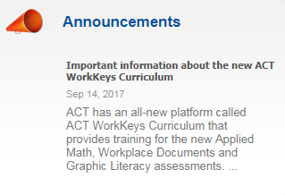

Slide 17
Where do I go to access WorkKeys Curriculum?
https://workkeyscurriculum.act.org/

Slide 18
Signing Into WorkKeys Curriculum
https://workkeyscurriculum.act.org/

Slide 19
Roles and Account Types
Student = learner, participant, customer
Instructor = assigns lessons and tracks progress of students & groups
Institutional Admin = creates students, instructors, & groups
Institutional Supervisor = assigns lessons and tracks progress of institution

Slide 20
What type of account do I need as an administrator and/or instructor?

Slide 21
Institution Supervisor/Admin
NEW!
Institution Supervisor
Institution Admin
Institution Admin
Assign lessons to users
View/export user progress
View/export progress for groups of users
View/export progress for institution
Create students
Create instructors
Create groups
Request additional Institution Admin accounts from ACT
Role 1
Role 2
(1 account, 2 roles)

Slide 22
Institution Supervisor/Admin Abilities
Create students
Create instructors
Create groups
Assign lessons to users
View/export progress for individual users, groups, and institution
Request additional Institution Supervisor/Admin accounts from ACT

Slide 23
The institution admin and institution supervisor roles combine into one account.
Function | Instructor | Institution Admin | Institution Supervisor
Create students |  | ✓
Create instructors |  | ✓
Create groups |  | ✓
Request additional Institution Admin accounts from ACT |  | ✓
Assign lessons to students | ✓ |  | ✓
View/export user progress | ✓ |  | ✓
View/export progress for groups of users | ✓ |  | ✓
View/export progress for institution |  |  | ✓

Slide 24
Who should get instructor accounts and who should get institutional admin/supervisor accounts?
Staff who need to assign lessons should get instructor accounts
Staff who need to create students AND assign lessons need institutional admin/supervisor accounts

Slide 25
Setting Up in WorkKeys Curriculum

Slide 26
Can I transfer student data from CR101 to WorkKeys Curriculum?
A data transfer is not possible because the systems operate out of different platforms
Please send a spreadsheet showing each student’s name, username, and password to careerreadiness@state.ma.us
EOLWD can upload new accounts to WorkKeys curriculum if you notify us as to which students accounts you want created

Slide 27
Creating Multiple Groups with Students

Slide 28
Creating multiple groups with students (1 of 4)
Create an Excel spread sheet with the following 5 headers:
Group name
User name
User email
User password
User type

Slide 29
Creating multiple groups with students (2 of 4)
Field | Required? | Notes
Group Name | REQUIRED | If left blank, the users will be imported, but NOT added to the group. You shouldn’t leave it
Users’ names | REQUIRED | First & last name
Users’ emails | REQUIRED | REAL email addresses
Users’ passwords | OPTIONAL | If left blank, user will be emailed a registration email automatically. If present, admin will need to distribute login information manually.
User type | REQUIRED | Type ‘student’

Slide 30
Creating multiple groups with students (3 of 4)
Save the spreadsheet as a CSV (not an .xls file)

Slide 31
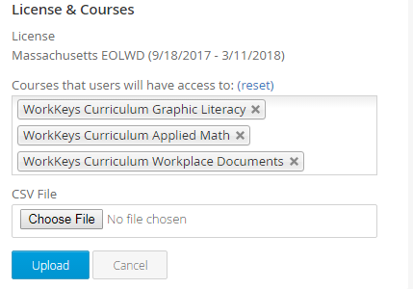
Creating multiple groups with students (4 of 4)
Choose classes to assign
Upload your CSV file
Click “Upload”

Slide 32
Why should participants use WorkKeys Curriculum?
Preparation and practice for WorkKeys 2.0
Remediation for numeracy/literacy
High school equivalency practice
Screening tool for program/training placement
Baseline skills assessment of basic workplace competencies
Graphic Literacy
Workplace Documents
Applied Math
Replacement for TABE testing *NOT NRS approved*
Same uses as 3 core pre-tests of CR101

Slide 33
How should the CRI liaisons set up accounts?
Students remediating literacy, numeracy, and critical thinking skills should have an account in WorkKeys Curriculum
Students preparing for WorkKeys should have an account in WorkKeys Curriculum
Students enhancing soft skills or receiving training in KeyTrain modules not available in WorkKeys Curriculum should have an account in CR101
It’s recommended that students have an account in each system, both CR101 and WorkKeys Curriculum

Slide 34
Next Steps

Slide 35
Next Steps for Program Leaders
Meet with frontline staff to debrief them about the updates to the CRI
Confirm that your organization can login to WorkKeys Curriculum
Designate staff to coordinate the inclusion of WorkKeys Curriculum into existing programming alongside CR101
Provide frontline staff with training checklist and set-up checklist (see next two slides)

Slide 36
WorkKeys Curriculum Set-Up Checklist (for frontline staff)
Request further Institution Admin/Supervisor accounts through EOLWD
Email careerreadiness@state.ma.us with full names and emails of relevant staff
Any staff who need to create students AND assign lessons require a dual role account
Use multi-step process outlined in slides 29-32 to create groups & students and assign courses to those students
Email careerreadienss@state.ma.us with full names and email address of existing students in CR101, if you want help creating student accounts
Begin tracking participant progress using reporting tools

Slide 37
WorkKeys Curriculum Training Checklist (for frontline staff)
Review the CRI Updates webinar (November 2017) from EOLWD https://www.mass.gov/service-details/updates-to-the-cri-tools
Log in to WorkKeys curriculum and create a student account for yourself. Assign all 3 courses to yourself (Applied Math, Graphic Literacy, & Workplace Documents)
Complete the 3 placement quizzes for all 3 courses

Slide 38
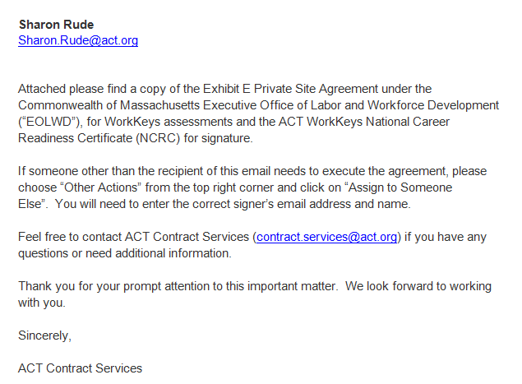
IF your organization is a WorkKeys 2.0 testing site…
DOCUSIGN CONTRACT TO GRANT ACCESS TO WORKKEYS 2.0

Slide 39
Opportunities for Feedback
Questions/suggestions to pass along to ACT
Use of CR101 (basing future support on this!)
Ideas for training, guidance, meetings, & CRI events, especially as ACT is building out new software
Request for materials/training/conversations
Notes:
Keep this slide

Slide 40
Support & Q/A
Allison McIntyre and Pahola DeLeon
careerreadiness@state.ma.us
(617) 626-7109
EOLWD Career Readiness Initiative Website
http://www.mass.gov/massworkforce/careerready/
Career Readiness Initiative Update Webinar (slides & webinar recording) https://www.mass.gov/service-details/updates-to-the-cri-tools
ACT support
WorkKeys Curriculum Manual http://www.act.org/content/dam/act/unsecured/documents/WorkKeysCurriculumAdmin-UserGuide.pdf
WorkKeys 2.0 training resources http://www.act.org/content/act/en/products-and-services/workkeys-for-educators/assessments/administration/training.html
CR101 webinar training http://www.keytrain.com/training.asp
Notes:
We should start funneling people to the Career Ready email, especially in preparation for your departure. All of your email will be lost.

