Slide 1

WORKSHOP
REVIEW

Slide 2


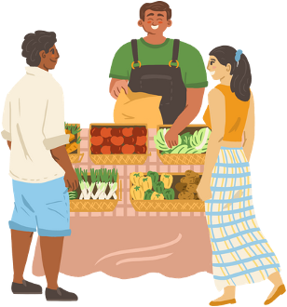
PROGRESS CHECK
WHAT TASKS SHOULD WE BE ABLE TO COMPLETE?
Greet customers and make them feel welcome by asking questions like “Have you been here before?”, “First time here?, etc.
Repair conversations when they break down and provide pleasant closure even when communication is irreparable.

Slide 3
PROGRESS CHECK
WHAT TASKS SHOULD WE BE ABLE TO COMPLETE?
Answer customer questions about hours of operation, where to pay, vendor locations (directional), and bathroom locations.
Answer customer questions about the availability of the foods most sought after for Caribbean and Central American cuisine, and direct them to a vendor who sells that/those food(s).

Slide 4


UNIT I: GREETINGS
Listen to the audio
Read the audio scripts
📄

Slide 5

UNIT II: RECOVERY
Listen to the audio
Read the audio scripts
📄

Slide 6

UNIT III: DIRECTIONS AND TIME
Listen to the audio
Read the audio scripts
📄

Slide 7

UNIT IV: PRODUCE
Listen to the audio
Read the audio scripts
📄

Slide 8

REVIEW-INTERACTION I
PROGRESS CHECK
Listen to the audio.
What tasks were successfully completed during this interaction?
Did the manager employ any survival phrases to reestablish communication?
Was the conversation formal or informal?
Unit I: Greetings
Unit II: Recovery
Unit III: Directions and Time
Unit IV: Produce

Slide 9
REVIEW-INTERACTION II
PROGRESS CHECK
Listen to the audio.
Did she say cómo está or cómo estás?
Is this a new customer?
Did she say sabe, sabes, or sabemos?
What specific item is he looking for?
What directions did the manager give to the customer?

Slide 10
ACTIVITY
Students will create a script for each progress check task and practice performing. As students become more and more comfortable with their scripts, they should try to perform the tasks from memory. If need help recalling the scripts, you can find them in this folder: 📁
Students should try their best to recall each unit. The teacher can also replay the recordings on the previous slides if needed. You can work on your script here: 📄
*Make sure to create your own copy.

Slide 11
ACTIVITY
The instructor assigns each pair a target task, and that pair should try to perform the task without a script. If needed, they can use a script. Students who are listening should try to identify which task is being performed and what is being said.
You can find the script for each unit here: 📁

