Slide 1
Workforce Planning Initiative Pilot Launch:
Joint Meeting of HR Advisory Council and
Pilot Agency Chiefs of Staff, HR, and Business Leads
Wednesday, February 12, 2014

Slide 2
Agenda
Welcome and Introductions Paul Dietl Chief Human Resources Officer
The War for Talent and the Need for Workforce Planning Paul Dietl
Need for Workforce Planning in the Commonwealth Chief Human Resources Officer
The Workforce Challenge: Information Technology Ellen Wright
HR Director, ITD
Workforce Planning in the Executive Departments Renée Fullem
Deputy Chief Human Resources Officer
Pilot Activities and Timelines Jean Comparetti
Agency Teams reconvene in Room 211, 2nd Floor Director, Commonwealth Collaborative Training

Slide 3
State of the Nation’s Workforce
The nation is on the brink of a workforce crisis due to megatrends we cannot control. We will be in fierce competition with the private and non-profit sectors to recruit and retain the talent needed for us to fulfill our mission.
Baby boomers are poised to exit the workforce in dramatic numbers
      According to the Bureau of Labor Statistics, 18% of the current workforce could retire within 5 years. Across the country, baby boomers are expected to leave the workforce at the rate of 10,000 per day between now and 2020.
+
A pent up demand to change jobs will result in large numbers of employees leaving their jobs as the economy improves
    70% of Millennial workers are expected to switch jobs in the next few years
A Critical Workforce Shortage
It will take two generations to fill the knowledge gap left by baby boomers (today there are 70 million baby boomers and 43 million Generation Xers)
Even if workers aged 55 years and older were to delay their retirement by five years, this would only fill roughly 40 % of the gap between the projected demand of middle skill workers
Fewer than 6% of college students said they plan to work in government after graduation, compared to 35 % who prefer the private sector and 18% who are interested in teaching and in the nonprofit sector.
=

Slide 4

The Commonwealth’s Challenge
Available data suggests that the challenge in New England, Massachusetts, and Boston in particular may be even greater than the challenge facing the nation at large.
  While the U.S. population will grow by a projected 8.2% from 2010 to 2020, the Massachusetts population will grow by only 3.2%
  Since 1990, the number of working-age adults in New England with any postsecondary
                education has been growing more slowly than in most other regions of the country.
                From 1990 to 2000, metropolitan Boston lost 15.8 % of its young people between the ages of 20 and 34, at a time when that demographic group declined nationally by just 5.4%. Furthermore, during the same period, Massachusetts – which had been ranked among the leading states in expanding their educated work forces – fell below the national average.
Half of Greater Boston’s graduates leave the area after receiving their degrees. Thirty percent of the departing graduates leave because they have better job opportunities elsewhere, while 27 % leave because the area is not affordable.

Slide 5
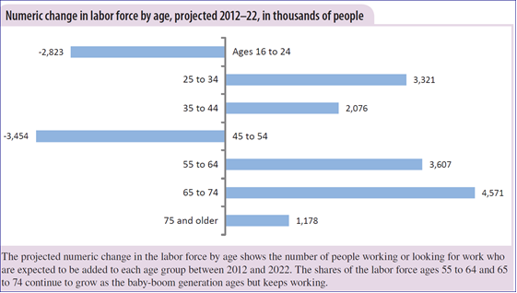
The Changing Face of Tomorrow’s Workforce
Tomorrow’s workforce will be different than yesterday’s; we will need new tools to recruit and retain our workforce.
The workforce will continue to get greyer in the years to come
By 2018, almost 40 million working Americans will be 55 years or older, an
increase of 5.8 % in a decade. Workers aged 16 to 24, by contrast, are
expected to make up only 12.7 % of the labor force
Workers will be “short-timers”
The era of the 40-year job is becoming an anachronism; the average person spends only 4.4 years at one job and can expect to work at 11 companies in the span of a career. And this trend is accelerating; the average mid-20s employee changes jobs every 16 months
A decade ago, a 16- or 17-year old boy was twice as likely to have a job as his 70-year-old grandfather. Today, the grandfather is actually more likely to have a job than the boy. That’s an amazing shift in so short a period of time.
Source: Wall Street Journal article August 13, 2013, “Elderly More Likely to Be Employed Than Teens

Slide 6

The Nature of Work is Changing
The competencies required to fill tomorrow’s jobs are changing, and current and future employees will not have the requisite skills.
Jobs are changing
            The top 10 in-demand jobs in 2010 did not exist in 2004
          Within the Commonwealth, the nature of our work is also changing.
            Examples include:
            The movement towards Community First in Health and Human Services, as agencies increasingly move towards providing care in the community rather than in institutions
            Traditional IT roles are evolving and new roles are emerging, many of which increasingly require a blend of skills and competencies across business disciplines and various domains of expertise in IT. The movement to Cloud computing will be necessary to meet the every-changing demands of our businesses.
Competencies attained through post-secondary education will quickly become obsolete
The amount of new technical information is doubling every 2 years. For students starting a 4 year technical degree, this means that half of what they learn in their first year of study will be outdated by their third year of study.
Leaders identify skill gaps in a range of areas, including
Soft skills such as communication, critical thinking, creativity and collaboration
Technical skills
Computer skills
Leadership skills

Slide 7
State of the Executive Department Workforce: Retirement
The Commonwealth’s recession has resulted in pent up demand for retirement. The improving economy is likely to bring about the often mentioned “silver tsunami”.
Today, 40% of the workforce is retirement eligible.
  The criteria for eligibility include 55 years of age with 10 years of service (for employees hired before 4/1/12), OR any age with 20 years of service.
  The increase in retirement eligibility has been accelerating in recent years.
  50% of all managers are eligible
More concerning is the anticipated increase in the number of “retirement likelies”, based on the average age and service years of actual retirees (age 60 and 25 years of service based on retirements from 2000-2008). Today 8% of the workforce (3600 employees) is “retirement likely”; this number is projected to increase to 20% in the next 5 years.
  Managers are reaching retirement likely status more rapidly than bargaining unit staff. Nearly 19% of managers will be retirement likelies 3 years from now, and over 25% 5 years out.
Actual retirements have dipped in FY 11 and 12, but started to increase in FY13.

Slide 8
State of the Executive Department Workforce:
Turnover
The improving economy will also open the valve on employees seeking new job opportunities outside of state employment.
In the private sector nationally, in November 2013, there were 2.3 million quits, still well below the 2.7 million quits at the beginning of the recession in December 2007. (BLS, Turnover)
Turnover rates among state employees seem
to be creeping upward steadily. States are
beginning to lose their younger workers as well.
(Barrett and Greene, February 2014)
Commonwealth turnover rates are expected
to spike northward in the next 2 years, given
that economic recovery in state government
lags behind overall recovery
Turnover data may understate the problem.
“Poaching” by departments isn’t reflected in
statewide turnover statistics, but has the same
impact.
We have 8600 employees with between 1 and
5 years of service. Based on the trend towards
short term service, these employees may leave before they become vested in our retirement system.
Turnover isn’t an easy problem to address. But ignoring the trend can be perilous. It’s like relaxing in a seaside house even as the weather reports show rising tides.
(Barrett and Greene, 3 Ways to Keep Public Employees from Leaving, February 2014.)

Slide 9
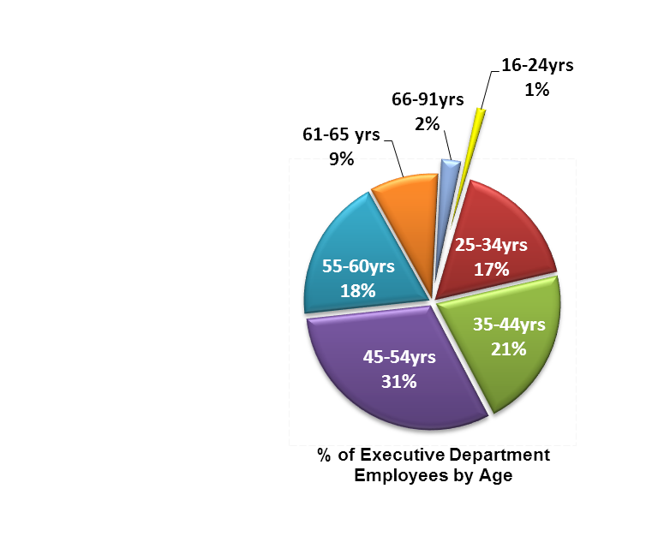
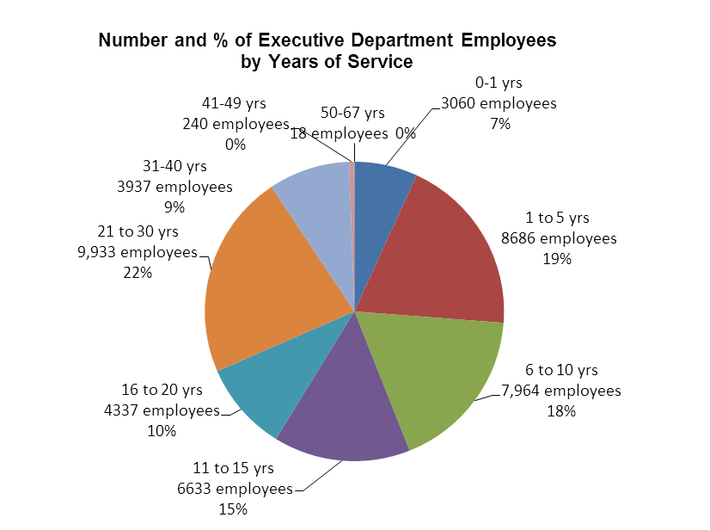
State of the Commonwealth Workforce: Stagnation
While many will employees will retire or separate from the workforce, others will stay on beyond retirement eligibility. Employees who make up our veteran /mature populations, may be challenged to keep up with the changing nature of work.
  Our workforce has been getting older over the last 10 years, from an average age of 45 in FY04 to nearly 48 today
  We have 1500 employees between the ages of 66 and 91, including nearly 200 over the age of 75
  There are 4200 employees who have more than 30 years of service
Although the average age at which current United States retirees say they stopped working is 61, up from 59 in 2003 and 57 in 1993, a January Gallup poll found that 49% of that generation didn’t expect to retire until age 66 or older. One respondent in 10 expected never to clock out for good – assuming they had the choice. (New York Times, January 31, 2014)

Slide 10

National Trends for the IT Workforce
The nation has a critical shortage of IT professionals needed to fill job openings, and the available talent does not have the competencies and skills needed in the new world of IT.
Compuware estimates that as many as 40% of the world’s mainframe programmers will be retiring in the near future. Mainframe computers have become more important than ever in an increasingly data-driven world. Banks, insurance companies, auto makers and government agencies rely heavily on mainframe computing. Most colleges and universities stopped teaching mainframe programming years ago. Many computer science students don’t even know what mainframes are. (USA today)
“Traditional IT roles are evolving and new roles are emerging, many of which increasingly require a blend of skills and competencies across business disciplines and various domains of expertise in IT. These new profiles of talent aren’t easy to find…, and the rising demand will only intensify the risk of a new war for the new talent.” (Gartner, August 2012)
Many students are not graduating with the skills or background employers are looking for. This mismatch between what students are interested in doing, and what employers are willing to pay for, may be the biggest impediment to a rewarding career for the newest generation of American workers. For example, every one of the top 10 trends on job-search website Indeed.com involves technology or social media yet only 2.4% of students received Computer Science degrees in 2012. Job growth in E-commerce, Internet publishing, and other information-technology fields is expected to be far stronger than average for the foreseeable future.’ (US News May 2012)

Slide 11
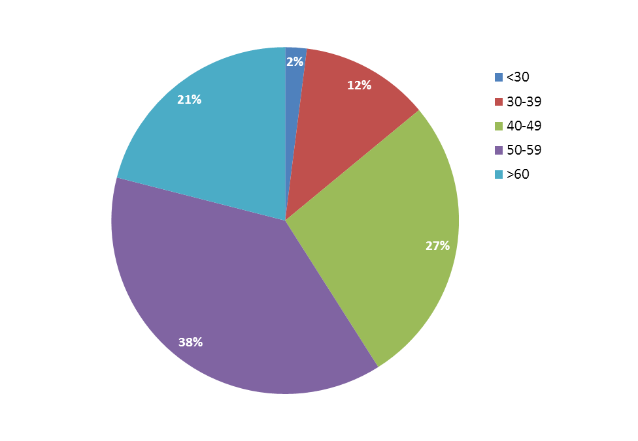
Commonwealth IT Resources:
A Reality Check
If we do nothing, we can expect our IT organizations to be critically understaffed, over-stressed, insufficiently skilled and too rigid to meet the existing and future demands and expectations of government and constituents.
Age range | # of employees
<30 | 32
30-39 | 170
40-49 | 393
50-59 | 555
>60 | 310
Total IT employees: | 1460
  Almost 60% of our staff are over 50
  A mere 32 of our IT employees are under the age of 30 – that’s ~2%
The talent pipeline and pool necessary to replace our
retiring workforce does not currently exist.

Slide 12

What Keeps HR Professionals Up at Night
Given the overall outlook of jobs in Massachusetts, all Executive Departments face near term challenges in recruiting and retaining talent. Several of the most critical workforce concerns include those listed below.
Stiff competition for talent in Massachusetts: The Massachusetts economy should expand by
6.3%, generating 216,650 net new jobs by 2016. An additional 768,330 job openings will result from
          the need to replace workers who retire or change careers. In total, nearly 1 million jobs will need to be filled by 2016. (EOLWD, Career Moves)
          By 2018, it is estimated there will be some 1.4 million tech-related job
          openings in the US, but the country will have only about 400,000 college grads to fill them. The long term scarcity springs from a deficient educational system and a lack of emphasis in the US on tech
          educations. 67% of students in graduate school technology/engineering, studies are foreign born. (Computerworld March 2012)
          The relative inexperience of those who will move into supervisory and management roles: 44% of working Millennials have only three to five
          years of work experience, yet 41% have four or more direct reports. The vast majority of Millennial professionals do not feel ready for these roles.

Slide 13
What Keeps HR Professionals Up at Night
Given the overall outlook of jobs in Massachusetts, all Executive Departments face near term challenges in recruiting and retaining talent. Several of the most critical workforce concerns include those listed below.
Within the Commonwealth:
At Holyoke Soldiers Home, a move towards new living arrangement's requires a new staffing pattern using Certified Nursing Assistants. Only 3 of the Home’s current facilities workers, who will no longer be needed after the transition to the new living arrangement, have taken advantage of a career ladder training program to skill them up for CNA positions.
EOHHS has been challenged in its efforts to fill management-level front line supervisors of social workers with existing social workers
The Department of Elementary and Secondary Education is losing knowledgeable and seasoned staff to school districts and assessment companies. At the same time, they are unable to recruit sufficiently skilled staff to fill vacancies as salaries are not competitive with municipal school departments. This has led to critical positions going unfilled for upwards of 6 months.
Fewer than half of 154 Department of Correction employees who had previously applied for management positions between 2009 and 2012 have reapplied for more recent management openings. The absence of a pool of experienced candidates is a serious concern, given that nearly 70% of DOC’s managers are baby boomers who are expected to retire in the coming years.
At Massachusetts State Police, the last of three Digital Evidence Examiners resigned because he could not do work that commanding officers promised he would do due to the limitations of his Program Coordinator I classification. Since populating the Commonwealth Fusion Center staff with 14 Analysts in 2005, we have lost six (6) Analysts to more engaging, robust opportunities in the intelligence analysis field.
EOEA is challenged in its ability to maintain mission-critical operations due to its inability to recruit candidates with the needed skill. The challenge is especially difficult in relation Biologists, Animal Health/Dairy and Pesticides Inspectors
In FY12, the turnover rate of Bank Examiners at the Division of Banks was 14%, double that of the workforce at large.
The Department of Labor Standards has advertised multiple times for Industrial Safety and Health Inspector Is to investigate lead and asbestos worksites in Western MA and have found very few qualified candidates in the applicant pool. Among those that were qualified, several dropped out of the process because of the salary being too low.
The Department of Unemployment Assistance struggles with recruiting managers who possess both solid management experience and superior writing skills. Additionally, with the recent implementation of UI Online, they need business analysts with a unique combination of skill sets (technical skills and knowledge of unemployment insurance) to support the system.

Slide 14

Workforce Planning:
The First Step in Addressing the Challenge
The bottom line: The impending war for talent is going to multiply the challenges we already face in recruiting and retaining the right talent.
Workforce planning consists of a four-step process: (1) analyzing the current workforce, (2) identifying future workforce needs, (3) establishing the gap between the present and future, and (4)implementing solutions to address the gaps between the present and future workforce needs.
The Commonwealth will use an incremental and standardized approach, with the emphasis on meaningful planning over extensive documentation. Resources and support will be available to agencies.
Expected outcomes for 2014:
  Workforce Plans for all Executive Departments by October 2014. In addition to agency-based plans, a comprehensive plan identifying common themes and recommendations will be submitted to A&F.
  Progress on needed remedies – some needed remedies are already known, such as updating outdated job specifications and expanding the availability of skills training. Work is scheduled to begin on the priorities in July 2014, and job specifications for prioritized IT, 509, and SEIU titles will be implemented in December 2014. Other enterprise-wide solutions will be identified through the process, and HRD will develop recommendations for these through a collaborative process with agency input.
  Shared knowledge regarding innovative remedies being implemented across the Commonwealth

Slide 15
Commonwealth Workforce Planning:
Overview of 2014 Activities
Goal: The Commonwealth will have a comprehensive workforce plan identifying mission critical talent gaps and including actionable solutions to effectively recruit and retain staff in these functions.
Business Specific
Information Technology
Pilot – 8 Agencies across 8 Secretariats will pilot a workforce planning process and tools, submitting a workforce plan in April 2014
Executive Departments (All) - All Executive Departments will submit a workforce plan addressing at least one mission critical talent gap with actionable solutions in October 2014.
Secretariats - 8 Secretariats will submit a workforce plan addressing a mission critical talent gap in April 2014
Enterprise – Working collaboratively, ITD and Secretariats will submit an enterprise-wide IT workforce plan with actionable solutions in October 2014
Comprehensive Plan
HRD will submit a comprehensive workforce plan to ANF in December 2014, identifying common themes across business talent gaps, including enterprise-wide IT needs and an action plan.
Implementation of Solutions
Update 30 year old job specifications**
Design and deliver training**
Develop and implement other solutions as identified
** Work to begin in Summer 2014

Slide 16
Workforce Planning:
The Pilot
Goals of the Pilot
  To determine the extent to which the workforce planning process results in a meaningful, actionable plan in the eyes of leadership
  To receive feedback on the workforce planning process, tools and resources in order to finalize the materials to be used during Executive Department Workforce Planning
Our Ask of You
  Champion the initiative with leadership, seeking active support and participation in a meaning process
  Identify staff to lead workforce planning and support development and implementation of job specifications
Pilot Agencies
Administration and Finance
Human Resource Division
Education
Early Education and Care
Energy and Environmental Affairs
Public Utilities
Health and Human Services
MassHealth
Housing and Economic Development
Division of Insurance
Labor and Workforce Development
Division of industrial Accidents
Public Safety and Security
Department of Corrections
Massachusetts Department of Transportation
MassDOT

Slide 17
Workforce Planning Pilot:
Agency Teams

Slide 18
Workforce Planning Initiative:
2014 Work Streams and Responsibilities
 | Workforce Planning |  | Enterprise Solution Work
 | Workforce Planning: Pilot and Agency Critical Functions | Workforce Planning: Secretariat IT | Enterprise Solution Planning Workgroups | Job Specifications Negotiate Existing
FEB – APR | Pilot ACoS – Gain leadership support; sign off on critical mission function to be targeted Agency – develops workforce plan, participating in meetings; submits plan to HRAC HRAC – reviews Agency plans; obtains Secretariat sign off; submits to HRD HRD – conducts lessons learned | SIT – Gain leadership support; sign off on critical IT function to be targeted SIT – develops and submits workforce plan ITD, HRAC HRAC – reviews Secretariat IT plan; obtains Secretariat sign off; submits to HRD | HRD – convenes workgroups to develop resource guide, including creative recruitment and retention programs in place across agencies | HRD/HRAC – Identify critical job specs for IT functions, as well as for 509 and SEIU. HRAC/Agencies - identify resources to work on development of job specifications
MAY – JUN |  | ITD – compiles consolidated plan, working with SIT. | HRD – convenes workgroups to support needed solutions | HRD/Agencies –work on development of titles continues HRAC – Provide feedback on job specs
JUL | All Executive Depts. A&F – Launches initiative HRD – Provides tools | ITD – workgroups on IT solutions convened | HRAC/HRD/Agencies – participate in workgroups to develop solutions | HRD – Onboard new staff to support job spec project HRAC/Agencies – ID staff to support negotiation
AUG | ACoS/HR – submits functions/titles to HRAC/HRD HRAC – reviews | ITD – workgroups continue | HRAC/HRD – workgroups continue | HRD/Agencies – negotiate implementation of critical job specs for IT, 509 and SEIU.
SEP | ACoS/HR – submit plan to HRAC; solutions built into spending plan HRAC – review plans; obtain sign off | ITD – presents consolidated plan to SCIOs, SCOS, HRAC; solutions incorporated into spending plan | HRAC/HRD – workgroups continue; solutions incorporated into spending plan | HRD/Agencies - Negotiation continues
OCT | HRAC – submits agency plans to HRD HRD – compiles CMW plan | ITD – submits plan to HRD |  | HRD/Agencies - Negotiate
NOV | HRD – presents plan to SCOS |  |  | HRD/Agencies - Negotiate
DEC | HRD – FINAL PLAN SUBMITTED TO A&F and Governor |  |  | HRD/Agencies - Implement!
Key
ACoS – Agency Chiefs of Staff
Agency – Agency-based Workforce planning team, including an HR representative and a business partner
HR – HR supporting WP teams at the agency level
HRAC – HR Advisory Council
SCOS – Secretariat Chiefs of Staff
SIT – Senior Secretariat IT professionals

Slide 19
Thank you!

