Slide 1
Health Safety Net Annual Report
January, 2013
Deval Patrick, Governor Commonwealth of Massachusetts
Timothy P. Murray Lieutenant Governor
Dr. JudyAnn Bigby, Secretary Executive Office of Health and Human Services
Julian Harris, Director Office of Medicaid

Slide 2
Table of Contents
Introduction 2
Payments and Volume 5
Service Patterns 13
User Demographics 23
Financing 28
Demonstration Projects 34
Notes:
1

Slide 3
About the Health Safety Net
Introduction
HSN Overview
The Health Safety Net (HSN), created by Chapter 58 of the Acts of 2006, makes payments to hospitals and community health centers for health care services provided to low-income Massachusetts residents who are uninsured or underinsured.
This report reflects HSN utilization and payments for twelve months (October 1, 2011 through September 30, 2012) of Health Safety Net fiscal year 2012 (HSN12). In HSN12, payments and volume were reported by the month in which the claim was paid by the HSN.
During HSN12, the Division of Health Care Finance and Policy (Division) administered the HSN. Chapter 224 of the Acts of 2012 transitioned management of the HSN to the Office of Medicaid within the Executive Office of Health and Human Services (EOHHS) as of November 5, 2012.
HSN Payments
As mandated by Chapter 58, the HSN pays hospitals based on claims, which are adjudicated to verify that the patient is eligible and the services are covered. HSN payment rates are based on Medicare payment principles. Inpatient medical services are paid using diagnosis-related group (DRG) specific rates, which incorporate adjustments for variations in patient acuity, teaching status, and percent of low-income patients. Inpatient psychiatric and rehabilitation cases are paid using per diem rates. Outpatient services are paid using a per-visit rate developed by estimating the amount Medicare would have paid for comparable services. Additional outpatient adjustments are made for disproportionate share and community hospitals. HSN payments cannot exceed available funding for a given year. If a projected shortfall in payments is anticipated, hospital payments are subject to reduction using the greater proportional need method of shortfall distribution.
Community health centers (CHCs) are paid by the HSN using the federally qualified health center (FQHC) medical visit rate. Ancillary services provided by CHCs are paid at MassHealth payment rates and include all applicable rate enhancements.
Outpatient prescription drugs for eligible providers are priced using the pharmacy online payment system (POPS) employed by the MassHealth program.
HSN Claims
As required by the Chapter 68 of the Acts of 2011, Health Safety Net medical claims processing transitioned from the Division’s claims adjudication system to MassHealth’s Medicaid Management Information System (MMIS) in July of 2012.
In order to prepare for the transition, the Division stopped accepting medical claims as of May 1, 2012. Claims submitted through the end of April were paid in June 2012. For the remaining three months of the HSN12, providers received interim payments based on their claims history.
Because no claims were collected after April, claims data from the fourth quarter of HSN12 (July-September 2012) are unavailable. In many analyses shown in this report, claim volume and demand are estimated for the full year based on claims experience from the first three quarters. In some cases this methodology is not appropriate, and only nine months of claims data are reported.
As of the publication of this report, providers have begun submitting claims from the interim period to MMIS. Interim payments will be recovered as these claims are adjudicated and paid by the HSN.
Notes: Diagnosis-related groups (DRGs) are a classification system that groups patients according to diagnosis, type of treatment, age, and other relevant criteria. Providers are paid a set fee for treating patients in a single DRG category.
Source: Centers for Medicare and Medicaid Services Online Glossary Tool as of 12/04/12.

Slide 4
About the Health Safety Net (continued)
Introduction
HSN Eligibility
Massachusetts residents who are uninsured or underinsured and have income up to 200% of the Federal Poverty Level (FPL) are eligible for full HSN primary or HSN secondary coverage. If residents have income between 201% and 400% of the FPL, they are eligible for partial HSN or partial HSN secondary coverage, which includes a sliding scale deductible.
Residents who are enrolled in private health insurance, MassHealth, or Commonwealth Care may be eligible for HSN secondary for certain services not covered by their primary insurance. In order to support enrollment in Commonwealth Care, individuals are eligible for the HSN during the Commonwealth Care enrollment process. Individuals who have been determined eligible for Commonwealth Care but do not complete the enrollment process lose their HSN eligibility.
Chapter 65 of the Acts of 2009 eliminated Commonwealth Care eligibility for Aliens with Special Status (AWSS). AWSS are generally legal immigrants who have resided in the United States for fewer than five years. This change resulted in the transition of approximately 30,000 individuals from Commonwealth Care to a new program called Commonwealth Care Bridge. During the transition process, these individuals were eligible for the HSN. Additionally, any new AWSS applying for benefits were determined eligible only for the HSN or MassHealth Limited instead of Commonwealth Care or Commonwealth Care Bridge through March 2012, when Commonwealth Care eligibility was restored for this population.
In July 2010, MassHealth and Commonwealth Care dental benefits were restructured. In certain instances, the HSN pays for certain dental services for individuals enrolled in MassHealth and Commonwealth Care who are not otherwise eligible for HSN services.
As of December 2010, MassHealth only pays for the first 20 days of an inpatient stay for adult members. The HSN pays for the portion of the stay exceeding 20 days for these individuals. These changes to MassHealth dental policy and inpatient payment policy have resulted in an overall increase in the number of individuals eligible for HSN funded services.
HSN Funding
HSN12 funding included the following sources: an assessment on acute hospitals’ private sector charges; a surcharge on payments made to hospitals and ambulatory surgical centers by HMOs, insurers, third party administrators, and individuals; an annual appropriation from the Commonwealth’s General Fund; and offset funding for uncompensated care from the Medical Assistance Trust Fund.

Slide 5
Major Findings
Introduction
The major findings for Health Safety Net Fiscal Year 2012 (HSN12) include:
Demand for Health Safety Net (HSN) payment exceeded the amount of HSN funding available in HSN12. Demand represents the amount that providers would have been paid in the absence of a funding shortfall. During HSN12, hospital providers experienced an $130 million shortfall. Demand increased 11% when compared to the prior fiscal year.
Total HSN volume in HSN12 increased by 7% compared to the prior fiscal year. Hospital volume in HSN12 increased by 2% compared to the prior fiscal year.
Inpatient hospital volume for HSN12 increased by 0% compared to the prior fiscal year. Outpatient hospital volume in HSN12 increased by 2% compared to the prior fiscal year.
HSN community health center (CHC) volume increased by 17% in HSN12 when compared to the prior fiscal year. CHC payments increased by 15% when compared to the prior fiscal year.
Total unique HSN users increased by 17% in HSN12 compared to the prior fiscal year.
HSN12 Compared to HSN11
 | Hospital | CHC | Total
Demand Oct 2011–Sep 2012 compared to Oct 2010–Sep 2011 |  11% |  15% |  11%
Payments Oct 2011–Sep 2012 compared to Oct 2010–Sep 2011 |  1% |  15% |  3%
Total Volume Oct 2011–Sep 2012 compared to Oct 2010–Sep 2011 |  2% |  17% |  7%
Users Oct 2011–Sep 2012 compared to Oct 2010–Sep 2011 | N/A | N/A |  17%

Slide 6
Payments and Volume
HSN Total Demand and Payment Trends
Demand represents the amount that providers would have been paid in the absence of a funding shortfall. Because Health Safety Net fiscal year 2012 (HSN12) demand exceeded HSN12 funding, hospital providers experienced a $130 million shortfall during HSN12, an 11% increase compared to the prior fiscal year.
Total Health Safety Net (HSN) payments increased by 3% in HSN12 compared to the prior fiscal year.
Due to a financial adjustment made during HSN12, October and November 2011 CHC payments were made using HSN11 funding. These payments account for $10.2 million of the $65 million HSN12 CHC payment reported to the left.
Demand
+11%
$554 M
Demand
+5%
Payments
$403M
+2%
Payments
$412M
+3%
Payments
$424M
Notes: The Health Safety Net fiscal year runs from October 1 through September 30 of the following year. Hospital and community health center payments are reported in the month in which payment was made. HSN12 hospital payments include an HSN12 payment adjustment transacted in October 2012. Due to the transition of HSN claims processing to MMIS, providers received interim payments based on historical claims data from July through September 2012. HSN12 shortfall amount is based on spending assumptions in place during HSN12 and may differ from year-end shortfall estimates reported elsewhere. Numbers are rounded to the nearest million and may not sum due to rounding; percent changes are calculated prior to rounding.
Source: Health Safety Net Data Warehouse as of 10/26/12.

Slide 7
HSN Shortfall Overview
Payments and Volume
The Health Safety Net (HSN) has a limited amount of funding available to pay providers. When the anticipated payment for services provided is greater than the funding available, the amount of the difference is known as the shortfall. As required by M.G.L. Chapter 118E, Section 69(6)(b), the shortfall is distributed solely among hospital providers. The statute also requires that the shortfall be distributed “in a manner that reflects each hospital's proportional financial requirement for reimbursements from the fund.” The distribution methodology is further defined by regulation in 114.6 CMR 14.03(2)(b)(2) to be based on each hospital’s share of statewide patient care costs (PCC), including the cost of caring for Medicare and Medicaid patients. Thus, larger hospitals are responsible for a greater share of the shortfall than smaller facilities.
This method of allocating the shortfall is known as the “Greater Proportional Need” (GPN) method. It is intended to distribute the financial burden in a way that does not disadvantage those hospitals providing a larger amount of HSN services.* The effects of the GPN method are illustrated in the chart below, which shows hypothetical hospitals of equal overall size (measured in terms of a hospital’s PCC) that provide different levels of services to HSN patients and receive different levels of HSN payment. In this example, facilities A and B experience the same dollar amount of the shortfall. However, because hospital B provides more HSN services, its shortfall allocation is less as a proportion of its HSN payments than is hospital A’s shortfall allocation as a proportion of its HSN payments.
Additionally, disproportionate share hospitals (DSH) receive additional protection from the shortfall. DSH hospitals are always paid for at least 85% of their HSN demand in a shortfall situation. In this example, hospital C, a DSH hospital, experiences less of the shortfall than hospitals A or B, despite having the same patient care costs.
$150 K
(15%)
$300 K
(38%)
Shortfall Allocation
$300 K
(60%)
$500 K
$850 K
$200 K
PCC
HSN Demand
PCC
HSN Demand
PCC
HSN Demand
Hospital A (Non-DSH)
Hospital B (Non-DSH)
Hospital C (DSH)
*The GPN method avoids distributing the shortfall proportionally to a hospital's HSN demand, which would cause hospitals that provide more HSN services to experience more shortfall dollars. In this example, Hospital C would experience the most shortfall dollars if the distribution were proportional to a provider’s HSN demand, because Hospital C has the most HSN demand. The GPN method allocates the shortfall based primarily on the hospital’s size, which is more indicative of the provider’s ability to experience a shortfall in funding.

Slide 8
Payments and Volume
HSN Total Service Volume Trends
Health Safety Net (HSN) total volume for hospitals and community health centers increased 7% in Health Safety Net fiscal year 2012 (HSN12) compared to the prior fiscal year.
Hospital volume is the sum of inpatient discharges and outpatient visits for which payments were made to hospital providers in the years shown. Community health center volume is the sum of visits for which payments were made to community health center providers in the years shown.
+7%
+7%
Notes: The Health Safety Net fiscal year runs from October 1 through September 30 of the following year. Hospital and community health center volume exclude pharmacy claims. HSN10 and HSN11 hospital and CHC volume reflects updated hospital and CHC claims activity and may differ from data previously published. Due to the transition of HSN claims processing to MMIS, providers were unable to submit claims during the last quarter of HSN12. Therefore, volume in payment months July through September 2012 is estimated based on year-to-date HSN12 claims experience. Numbers are rounded to the nearest thousand and may not sum due to rounding; percent changes are calculated prior to rounding.
Source: Health Safety Net Data Warehouse as of 10/19/12.

Slide 9
Payments and Volume
HSN Hospital Demand and Payment Trends
Hospital payments increased by 1% between Health Safety Net fiscal year 2011 (HSN11) and Health Safety Net fiscal year 2012 (HSN12), while hospital demand increased by 11%.
Demand represents the amount that providers would have been paid in the absence of a funding shortfall.
Demand
+11%
Demand
+4%
Payments
$359 M
Payments
$356 M
+0%
Payments
$356 M
+1%
Notes: The Health Safety Net fiscal year runs from October 1 through September 30 of the following year. HSN12 hospital payments include an HSN12 payment adjustment transacted in October 2012. Other HSN Payments include payment adjustments that are not attributable to a service category. Hospital payments are reported in the month in which payment was made. Due to the transition of HSN claims processing to MMIS, providers received interim payments based on historical claims data from July through September 2012. Shortfall allocations are distributed proportionally by service type. HSN12 shortfall amount is based on spending assumptions in place during HSN12 and may differ from year-end shortfall estimates reported elsewhere. Numbers are rounded to the nearest million and may not sum due to rounding; percent changes are calculated prior to rounding.
Source: Health Safety Net Data Warehouse as of 10/26/12.

Slide 10
Payments and Volume
HSN Hospital Service Volume Trends
Hospital volume increased by 2% in Health Safety Net fiscal year 2012 (HSN12) compared to the prior fiscal year.
During HSN12, total inpatient volume showed no change and total outpatient volume increased 2% compared to the prior fiscal year.
+3%
+2%
Notes: The Health Safety Net fiscal year runs from October 1 through September 30 of the following year. Hospital volume is the sum of inpatient discharges and outpatient visits for which payments were made to hospital providers in the months shown. HSN10 and HSN11 volume reflects updated hospital claims activity and may differ from data previously published. Due to the transition of HSN claims processing to MMIS, providers were unable to submit claims during the last quarter of HSN12. Therefore, volume in payment months July through September 2012 is estimated based on year-to-date HSN12 claims experience.. Numbers are rounded to the nearest thousand and may not sum due to rounding; percent changes are calculated prior to rounding.
Source: Health Safety Net Data Warehouse as of 10/19/12.

Slide 11
Payments and Volume
HSN Community Health Center Payment Trends
Community health center (CHC) payments increased by 15% in Health Safety Net fiscal year 2012 (HSN12) compared to the prior fiscal year.
Due to a financial adjustment made during HSN12, October and November 2011 CHC payments were made using HSN11 funding. These payments account for $10.2 million of the $65 million HSN12 CHC payment reported to the left.
+15%
+20%
Notes: The Health Safety Net fiscal year runs from October 1 through September 30 of the following year. Community health center payments are reported in the month in which payment was made. Due to the transition of HSN claims processing to MMIS, providers received interim payments based on historical claims data from July through September 2012. Numbers are rounded to the nearest million and may not sum due to rounding; percent changes are calculated prior to rounding.
Source: Health Safety Net Data Warehouse as of 11/02/12.

Slide 12
Payments and Volume
HSN Community Health Center Volume Trends
Community health center (CHC) volume increased 17% in Health Safety Net fiscal year 2012 (HSN12) compared to the prior fiscal year.
+17%
+20%
Notes: The Health Safety Net fiscal year runs from October 1 through September 30 of the following year. Community health center volume is the sum of visits for which payments were made to community health center providers in the months shown. Community health center volume excludes pharmacy claims. CHCs have been moving from a voucher-based to a claims-based adjudication and payment system since April 2009; this transition may result in shifts in volume that are expected to stabilize once all CHCs have transitioned to the new system. HSN10 and HSN11 volume reflect updated CHC claims activity and may differ from data previously published. Due to the transition of HSN claims processing to MMIS, providers were unable to submit claims during the last quarter of HSN12. Therefore, volume in payment months July through September 2012 is estimated based on year-to-date HSN12 claims experience. Numbers are rounded to the nearest thousand and may not sum due to rounding; percent changes are calculated prior to rounding.
Source: Health Safety Net Data Warehouse as of 10/19/12.

Slide 13
Payments and Volume
HSN Total User Trends
Medical expenses for an estimated 380,155 individuals were billed to the Health Safety Net (HSN) in Health Safety Net fiscal year 2012 (HSN12).
The number of users increased by 17% in HSN12 compared to HSN11.
+17%
+3%
Notes: The Health Safety Net fiscal year runs from October 1 through September 30 of the following year. Users who receive a service in more than one setting (hospital, community health center or emergency room bad debt) are counted only once. Users are reported on claims for which payments were made to hospital and community health center providers in the months shown. Due to the transition of HSN claims processing to MMIS, providers were unable to submit claims during the last quarter of HSN12. Therefore, volume in payment months July through September 2012 is estimated based on historical claims experience. Total users in HSN10 and HSN11 reflect updated claims activity and may differ from data previously reported. Numbers are rounded to the nearest thousand; percent changes are calculated prior to rounding.
Source: Health Safety Net Data Warehouse as of 11/08/12.

Slide 14
Service Patterns
Hospital Utilization and Payments
by Service Type and Age
Seventy-eight percent of inpatient payments in Health Safety Net fiscal year 2012 (HSN12) were for services provided to adults ages 27 to 64.
Inpatient volume for this same population accounted for 63% of discharges in HSN12.
Because the Health Safety Net (HSN) is a secondary payer for low-income Medicare patients, adults ages 65 and older accounted for 25% of inpatient discharges but only 7% of inpatient payments during HSN12.
 | Inpatient |  | Outpatient
Age Groups for HSN11 | Inpatient Discharges | Inpatient Payments | Outpatient Visits | Outpatient Payments
Ages 0 to 18 | 1% | 1% | 3% | 3%
Ages 19 to 26 | 11% | 13% | 15% | 17%
Ages 27 to 44 | 26% | 33% | 36% | 39%
Ages 45 to 64 | 37% | 45% | 34% | 34%
Ages 65 and Older | 25% | 7% | 13% | 8%
All Ages | 100% | 100% | 100% | 100%
Notes: The Health Safety Net fiscal year runs from October 1 through September 30 of the following year. Due to the transition of HSN claims processing to MMIS, providers were unable to submit claims during the last quarter of HSN12. Therefore, utilization and payment data reflect claims paid from October 2011 through June 2012. Hospital volume is the sum of inpatient discharges and outpatient visits for which payments were made to hospital providers in the months shown. Hospital volume excludes pharmacy claims. Hospital payments are reported in the month in which payment was made. Hospital payments exclude pharmacy payments. Numbers are rounded to the nearest percent and may not sum to 100% due to rounding.
Source: Health Safety Net Data Warehouse as of 11/01/12.

Slide 15
Service Patterns
Hospital Utilization and Payments
by Eligibility Group
During Health Safety Net fiscal year 2012 (HSN12), approximately half of both hospital volume and payments were for individuals who were eligible only for the Health Safety Net (HSN) and had no other coverage.
HSN temporary users were the most costly, accounting for only 11% of volume, but 22% of payments.
HSN temporary coverage includes patients awaiting enrollment in Commonwealth Care, MassHealth Basic, and MassHealth Essential.
Temporary users were the most costly due to higher use of inpatient services, which are more costly than outpatient services.
Eligibility Not Reported
Emergency Room Bad Debt
Temporary Coverage
HSN Secondary: Other
HSN Secondary: MassHealth
HSN Partial (200.1% to 400% FPL)
HSN Primary (0% to 200% FPL)
Notes: The Health Safety Net fiscal year runs from October 1 through September 30 of the following year. Due to the transition of HSN claims processing to MMIS, providers were unable to submit claims during the last quarter of HSN12. Therefore, utilization and payment data reflect claims paid from October 2011 through June 2012. Hospital volume is the sum of inpatient discharges and outpatient visits for which payments were made to hospital providers in the months shown. Hospital volume excludes pharmacy claims. Hospital payments are reported in the month in which payment was made. Hospital payments exclude pharmacy payments. HSN Secondary: Other includes coverage for both Medicare and private insurance patients. Numbers are rounded to the nearest percent and may not sum to 100% due to rounding. Numbers less than 1% are not displayed.
Source: Health Safety Net Data Warehouse as of 11/01/12.

Slide 16
Service Patterns
Hospital Inpatient Utilization and Payments
by Admission Type
Ninety-one percent of inpatient discharges and 88% of inpatient payments were for emergency and urgent care during Health Safety Net fiscal year 2012 (HSN12).
Nine percent of inpatient discharges and 12% of inpatient payments in HSN12 were for scheduled or elective procedures.
Scheduled
Urgent
Emergency
Notes: The Health Safety Net fiscal year runs from October 1 through September 30 of the following year. Due to the transition of HSN claims processing to MMIS, providers were unable to submit claims during the last quarter of HSN12. Therefore, utilization and payment data reflect claims paid from October 2011 through June 2012. Hospital inpatient volume is inpatient discharges for which payments were made to hospital providers in the months shown. Hospital inpatient volume excludes pharmacy claims. Hospital inpatient payments are reported in the month in which payment was made. Hospital inpatient payments exclude pharmacy payments. Numbers are rounded to the nearest percent and may not sum to 100% due to rounding. Numbers less than 1% are not displayed.
Source: Health Safety Net Data Warehouse as of 11/01/12.

Slide 17
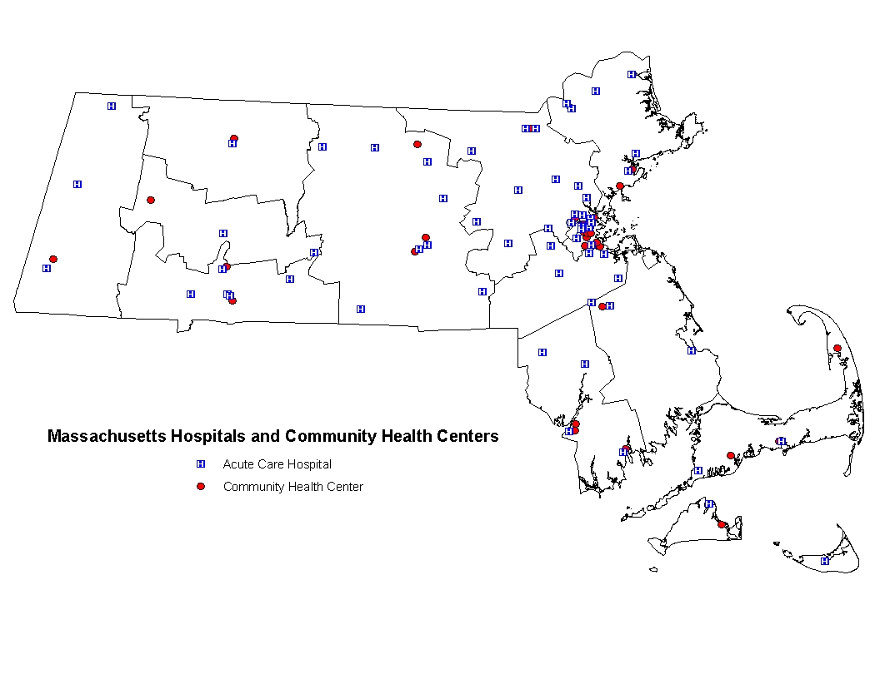
Geographic Distribution
HSN Hospital and Community Health Center Locations
Low-income individuals who are eligible for Health Safety Net (HSN) services can seek care at any of the 65 acute hospitals and 36 community health centers (CHCs) located throughout Massachusetts.
This map shows only the main locations for each hospital and CHC provider. Some HSN providers also offer services at health centers separate from their main location.
Source: Health Safety Net Data Warehouse as of 12/20/10.

Slide 18
Geographic Distribution
HSN Hospital Payment Level by Provider
Twenty-five Health Safety Net (HSN) hospital providers received less than $1 million in HSN payments in Health Safety Net fiscal year 2012 (HSN12).
Twenty-six HSN hospital providers received between $1 million and $5 million in HSN payments in HSN12.
Six HSN hospital providers received between $5 million and $10 million in HSN payments in HSN12.
Six HSN hospital providers received between $10 million and $30 million in HSN payments in HSN12.
Boston Medical Center and Cambridge Health Alliance received over $30 million in HSN payments in HSN12.
Notes: The Health Safety Net fiscal year runs from October 1 through September 30 of the following year. Payments include an HSN12 payment adjustment transacted in October 2012. Hospital payments are reported in the month in which payment was made. Source: Health Safety Net Data Warehouse as of 11/2/12.

Slide 19
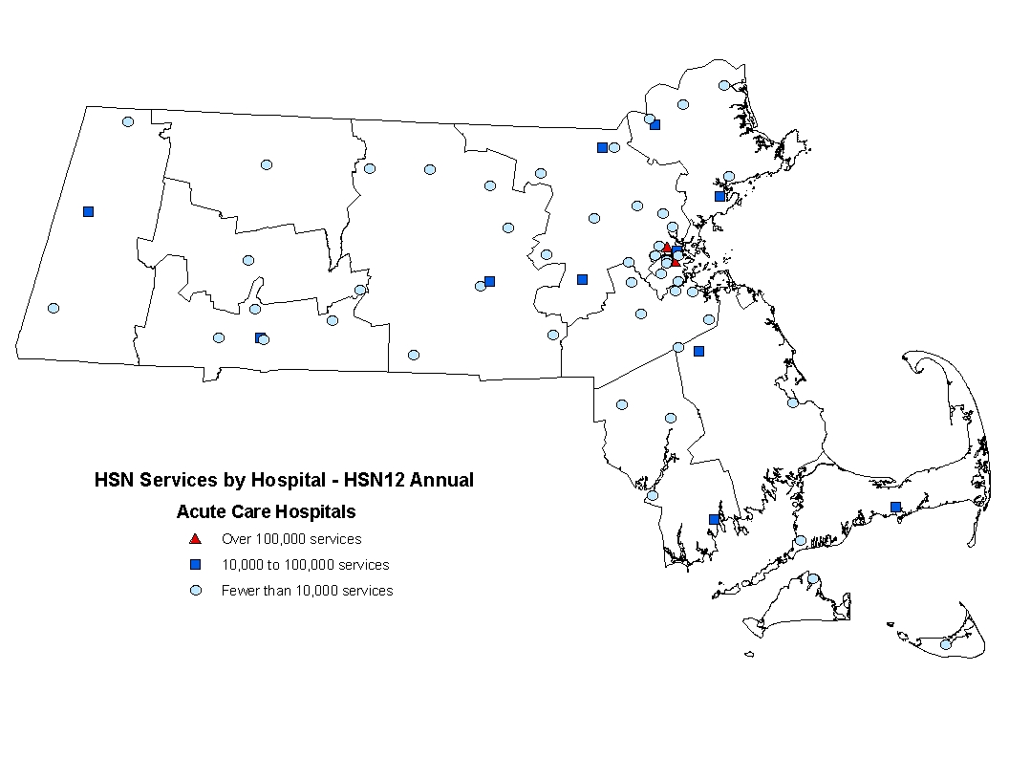
Geographic Distribution
HSN Hospital Service Volume by Provider
Five Health Safety Net (HSN) hospital providers experienced fewer than 1,000 discharges and visits in Health Safety Net fiscal year 2012 (HSN12).
Forty-five HSN hospital providers experienced between 1,000 and 10,000 discharges and visits in HSN12.
Twelve HSN hospital providers experienced between 10,000 and 50,000 discharges and visits in HSN12.
One hospital experienced between 50,000 and 100,000 discharges and visits in HSN12.
Boston Medical Center and Cambridge Health Alliance experienced over 100,000 discharges and visits in HSN12.
Notes: The Health Safety Net fiscal year runs from October 1 through September 30 of the following year. Hospital volume is the sum of inpatient discharges and outpatient visits for which payments were made to hospital providers in the months shown. Due to the transition of HSN claims processing to MMIS, providers were unable to submit claims during the last quarter of HSN12. Therefore, volume in payment months July through September 2012 is estimated based on year-to-date HSN12 claims experience.
Source: Health Safety Net Data Warehouse as of 7/22/11.

Slide 20
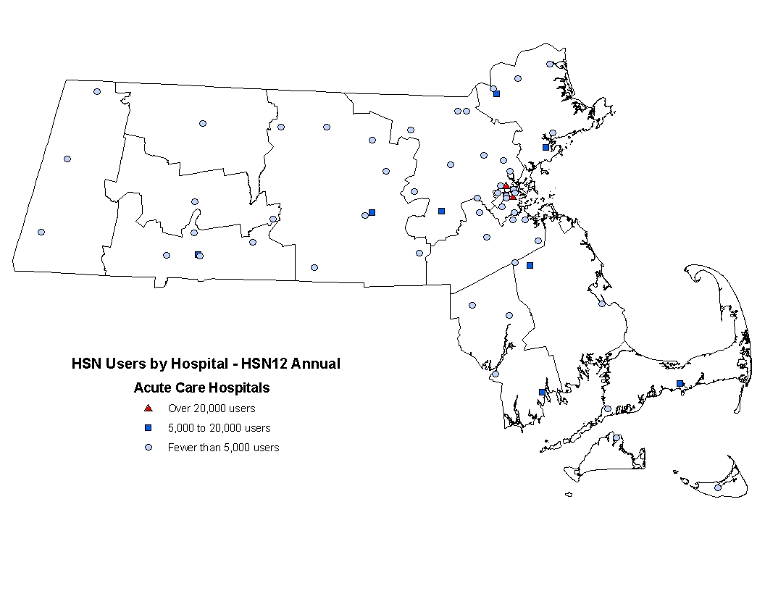
Geographic Distribution
HSN Users by Hospital
Twelve Health Safety Net (HSN) hospital providers saw fewer than 1,000 HSN users in Health Safety Net fiscal year 2012 (HSN12).
Forty HSN hospital providers saw between 1,000 and 5,000 HSN users in HSN12.
Seven HSN hospital providers saw between 5,000 and 10,000 HSN users in HSN12.
Four HSN hospital providers saw between 10,000 and 20,000 HSN users in HSN12.
Boston Medical Center and Cambridge Health Alliance saw over 20,000 users in HSN12.
Notes: The Health Safety Net fiscal year runs from October 1 through September 30 of the following year. Due to the transition of HSN claims processing to MMIS, providers were unable to submit claims during the last quarter of HSN12. Therefore, user data reflect claims paid from October 2011 through June 2012. Users who receive a service in more than one setting (hospital, community health center, or emergency room bad debt) are counted only once. Hospital providers for each user is based on data from their most recent claim. Users are reported on claims for which payments were made to hospital and community health center providers in the months shown.
Source: Health Safety Net Data Warehouse as of 10/24/12.

Slide 21
Service Patterns
Top Ten Inpatient Major Diagnostic Categories
In Health Safety Net fiscal year 2012 (HSN12), the top ten diagnostic categories accounted for 73% of inpatient discharges and 69% of inpatient payments.
Circulatory, digestive, and respiratory system diseases and disorders were the top three diagnostic categories among inpatient claims.
These three diagnostic categories comprised 35% of inpatient discharges and 33% of inpatient payments.
Inpatient Major Diagnostic Categories (MDC) for HSN11 | Percent Inpatient Discharges | Percent Inpatient Payments
Circulatory Diseases and Disorders | 14% | 15%
Digestive Diseases and Disorders | 11% | 11%
Respiratory System Diseases and Disorders | 10% | 7%
Mental Diseases and Disorders | 9% | 7%
Musculoskeletal Diseases and Disorders | 6% | 7%
Nervous System Diseases and Disorders | 6% | 7%
Hepatobiliary and Pancreatic Diseases and Disorders | 5% | 6%
Alcohol/Drug Use and Induced Organic Mental Disorders | 4% | 3%
Kidney and Urinary Tract Diseases and Disorders | 4% | 3%
Skin, Subcutaneous Tissue, and Breast Diseases and Disorders | 4% | 3%
Total for Top Ten | 73% | 69%
Notes: The Health Safety Net fiscal year runs from October 1 through September 30 of the following year. Due to the transition of HSN claims processing to MMIS, providers were unable to submit claims during the last quarter of HSN12. Therefore, utilization and payment data reflect claims paid from October 2011 through June 2012. Inpatient claims are grouped into major diagnostic categories (MDC) using versions 24, 25, 26, 27, or 28 of the MS-DRG grouper, depending on the date of service on the claim. Hospital inpatient volume is inpatient discharges for which payments were made to hospital providers in the months shown. Hospital inpatient volume excludes pharmacy claims. Hospital inpatient payments are reported in the month in which payment was made. Hospital inpatient payments exclude pharmacy payments. Numbers are rounded to the nearest percent.
Source: Health Safety Net Data Warehouse as of 11/02/12.

Slide 22
Service Patterns
Top Ten Outpatient Clinical Classification Diagnosis Categories
In Health Safety Net fiscal year 2012 (HSN12), the top ten clinical classification (CCS) diagnosis categories accounted for 83% of outpatient claims and 83% of outpatient payments.
Symptoms, signs, and ill-defined conditions and factors influencing health status; musculoskeletal system and connective tissue diseases; and diseases of the circulatory system were the top three CCS diagnosis categories among outpatient claims.
These three CCS diagnosis categories comprised 33% of outpatient claims and 34% of outpatient payments.
Outpatient CCS Diagnosis Categories for HSN11 | Percent Outpatient Claims | Percent Outpatient Payments
Symptoms; signs; and ill-defined conditions and factors influencing health status | 15% | 16%
Diseases of the musculoskeletal system and connective tissue | 10% | 10%
Diseases of the circulatory system | 8% | 8%
Diseases of the genitourinary system | 8% | 8%
Diseases of the nervous system and sense organs | 8% | 8%
Injury and poisoning | 7% | 9%
Endocrine; nutritional; and metabolic diseases and immunity disorders | 7% | 6%
Mental Illness | 7% | 6%
Diseases of the digestive system | 6% | 6%
Diseases of the respiratory system | 6% | 6%
Total for Top Ten | 83% | 83%
Notes: The Health Safety Net fiscal year runs from October 1 through September 30 of the following year. Due to the transition of HSN claims processing to MMIS, providers were unable to submit claims during the last quarter of HSN12. Therefore, utilization and payment data reflect claims paid from October 2011 through June 2012. Outpatient 837I claims are grouped using the Clinical Classification Software (CCS) from the Agency for Healthcare Research and Quality (AHRQ). Hospital outpatient claims are claims for which payments were made to hospital providers in the months shown. Hospital outpatient claims excludes UB92 and pharmacy claims. Hospital outpatient payments are reported in the month in which payment was made. Hospital outpatient payments exclude pharmacy payments. Numbers are rounded to the nearest percent.
Source: Health Safety Net Data Warehouse as of 11/02/12.

Slide 23
Case Mix of the Inpatient HSN Population
The case mix index represents the relative complexity, severity of illness, and amount of resources required to treat a given patient population.
The case mix index increased from Health Safety Net fiscal year 2011 (HSN11) to Health Safety Net fiscal year 2012 (HSN12).
The average length of stay for HSN users has decreased 0.257 days compared to the prior fiscal year.
 | HSN11 | HSN12
Case Mix Index | 1.269 | 1.306
Average Length of Stay (days) | 4.254 | 3.997
Notes: The Health Safety Net fiscal year (HSN) runs from October 1 through September 30 of the following year. Case mix data based on Medicare severity diagnostic related groups (MS-DRGs), version 28 for HSN11 and version 29 for HSN12. The analysis includes all primary inpatient claims paid during HSN11 and HSN12.
Source: Health Safety Net Data Warehouse as of 1/03/13.

Slide 24
User Demographics
Hospital Utilization and Payments
by Gender
In Health Safety Net fiscal year 2012 (HSN12), men used fewer services than women, but had higher payments for their care.
During this period, men accounted for 43% of volume and 53% of payments.
Female
Male
Notes: The Health Safety Net fiscal year runs from October 1 through September 30 of the following year. Due to the transition of HSN claims processing to MMIS, providers were unable to submit claims during the last quarter of HSN12. Therefore, utilization and payment data reflect claims paid from October 2011 through June 2012. Hospital volume is the sum of inpatient discharges and outpatient visits for which payments were made to hospital providers in the months shown. Hospital volume excludes pharmacy claims. Hospital payments are reported in the month in which payment was made. Hospital payments exclude pharmacy payments. Numbers are rounded to the nearest percent and may not sum to 100% due to rounding. Numbers less than 1% are not displayed.
Source: Health Safety Net Data Warehouse as of 11/01/12.

Slide 25
User Demographics
Hospital Utilization and Payments
by Age
In Health Safety Net fiscal year 2012 (HSN12), the non-elderly adult population (ages 19 to 64) accounted for 84% of hospital volume and 90% of hospital payments.
Because the Health Safety Net (HSN) is a secondary payer for low-income Medicare patients, adults ages 65 and older accounted for 14% of hospital volume but only 8% of hospital payments.
Ages 65 and Older
Ages 45-64
Ages 27-44
Ages 19-26
Ages 0-18
Notes: The Health Safety Net fiscal year runs from October 1 through September 30 of the following year. Due to the transition of HSN claims processing to MMIS, providers were unable to submit claims during the last quarter of HSN12. Therefore, utilization and payment data reflect claims paid from October 2011 through June 2012. Hospital volume is the sum of inpatient discharges and outpatient visits for which payments were made to hospital providers in the months shown. Hospital volume excludes pharmacy claims. Hospital payments are reported in the month in which payment was made. Hospital payments exclude pharmacy payments. Numbers are rounded to the nearest percent and may not sum to 100% due to rounding. Numbers less than 1% are not displayed.
Source: Health Safety Net Data Warehouse as of 11/01/12.

Slide 26
User Demographics
Hospital Utilization and Payments
by Family Income
In Health Safety Net fiscal year 2012 (HSN12), users with no income received the most costly services, comprising 35% of service volume that generated 42% of payments.
Users with income between 100.1% and 200% of the federal poverty level (FPL) used the least costly service mix, accounting for 34% of volume and 23% of payments.
Individuals with income less than 200% of the FPL received services accounting for 81% of volume and 75% of payments.
Income data is reported on the patient’s Medical Benefit Request (MBR) application. There is no MBR information for emergency room bad debt (ERBD) claims.
Income Not Reported
Emergency Room Bad Debt
200.1% to 400% FPL
100.1% to 200% FPL
Up to 100% FPL
No Income
Notes: The Health Safety Net fiscal year runs from October 1 through September 30 of the following year. Due to the transition of HSN claims processing to MMIS, providers were unable to submit claims during the last quarter of HSN12. Therefore, utilization and payment data reflect claims paid from October 2011 through June 2012. Hospital volume is the sum of inpatient discharges and outpatient visits for which payments were made to hospital providers in the months shown. Hospital volume excludes pharmacy claims. Hospital payments are reported in the month in which payment was made. Hospital payments exclude pharmacy payments. Numbers are rounded to the nearest percent and may not sum to 100% due to rounding. Numbers less than 1% are not displayed.
Source: Health Safety Net Data Warehouse as of 11/01/12..

Slide 27
User Demographics
Hospital Utilization and Payments
by Family Size
Single adults accounted for 54% of hospital volume and 57% of hospital payments during Health Safety Net fiscal year 2012 (HSN12).
Family size data are reported on the patient’s Medical Benefit Request (MBR) application. There is no MBR information for emergency room bad debt (ERBD) claims.
Family Size Not Reported
Emergency Room Bad Debt
Family Size of 4 or More
Family Size of 3
Family Size of 2
Family Size of 1
Notes: The Health Safety Net fiscal year runs from October 1 through September 30 of the following year. Hospital volume is the sum of inpatient discharges and outpatient visits for which payments were made to hospital providers in the months shown. Hospital volume excludes pharmacy claims. Hospital payments are reported in the month in which payment was made. Hospital payments exclude pharmacy payments. Numbers are rounded to the nearest percent and may not sum to 100% due to rounding. Numbers less than 1% are not displayed.
Source: Health Safety Net Data Warehouse as of 11/01/12.

Slide 28
HSN12 Hospital Payment Rates
Payment Category | Median Payment Rate | Mean Payment Rate
Services for HSN Eligible Individuals
Inpatient Medical Primary (per discharge) | $8,701.27 | $12,511.63
Inpatient Psychiatric Primary (per discharge) | $5,307.59 | $6,273.91
Inpatient Rehabilitation Primary (per day) | $1,778.25 | $1,648.85
Outpatient Primary (per visit) | $288.64 | $303.63
Payment on Account Factor (percentage used for secondary claims) | 30.00% | 28.37%
Services for Emergency Room Bad Debt
Inpatient Medical Emergency Room Bad Debt (per discharge) | $7,192.82 | $11,930.70
Inpatient Psychiatric Emergency Room Bad Debt (per discharge) | $3,215.14 | $4,403.75
Outpatient Emergency Room Bad Debt (per visit) | $346.42 | $359.12
Payments are based on Medicare payment principles.
Payment rates range according to the variation in case mix among hospitals. Hospitals that treat a greater number of complex cases are paid higher rates reflective of this complexity.
The table shows the median and mean payment rates during Health Safety Net fiscal year 2012 (HSN12) for each payment category across all hospitals that provide services in each payment category.
Notes: The Health Safety Net fiscal year runs from October 1 through September 30 of the following year. Due to the transition of HSN claims processing to MMIS, providers were unable to submit claims during the last quarter of HSN12. Therefore, data reflect claims paid from October 2011 through June 2012. Payment rates are effective October 1, 2011 for Health Safety Net fiscal year 2012 (HSN12). Payment on Account factor is used for secondary claims and inpatient physician services provided by hospital-based physicians. Hospital payment rates are the median or mean payment amount for all claims paid in HSN12. Rates for these cases vary by diagnosis. Dental services are paid according to the fees established in 114.3 CMR 14.00: Dental Services.
Source: Health Safety Net Data Warehouse as of 10/31/12

Slide 29
HSN12 Hospital Payment to Cost Ratios (PCRs)
Financing
Hospitals by Group | Pre-Shortfall PCR | Actual Payment PCR
Disproportionate Share Hospitals
Athol Memorial Hospital | 98% | 83%
Baystate Medical Center | 120% | 101%
Berkshire Medical Center | 92% | 78%
Boston Medical Center | 88% | 77%
Cambridge Health Alliance | 82% | 81%
Cape Cod Hospital | 91% | 77%
Clinton Hospital | 63% | 16%
Falmouth Hospital | 80% | 68%
Holyoke Medical Center | 111% | 94%
Lawrence General Hospital | 113% | 96%
Mercy Medical Center | 109% | 92%
Merrimack Valley Hospital | 94% | 80%
Morton Hospital and Medical Center | 97% | 82%
Noble Hospital | 104% | 88%
North Adams Regional Hospital | 117% | 99%
North Shore Medical Center, Inc. | 88% | 75%
Quincy Medical Center | 97% | 82%
Saint Vincent Hospital | 119% | 101%
Saints Medical Center | 117% | 100%
Signature Healthcare Brockton Hospital | 113% | 96%
Southcoast Hospitals Group | 106% | 90%
Steward Carney Hospital, Inc. | 104% | 89%
Steward Good Samaritan Medical Center | 89% | 75%
Steward Saint Anne's Hospital | 110% | 93%
Steward St. Elizabeth's Medical Center | 102% | 86%
Wing Memorial Hospital and Medical Centers | 94% | 80%
All Others
Anna Jaques Hospital | 107% | 56%
Baystate Franklin Medical Center | 103% | 88%
Baystate Mary Lane Hospital | 89% | 30%
Beth Israel Deaconess MedlCtr Hospital - Needham | 88% | 0%
Cooley Dickinson Hospital | 90% | 22%
Emerson Hospital | 102% | 0%
Hospitals by Group | Pre-Shortfall PCR | Actual Payment PCR
Fairview Hospital | 75% | 51%
Faulkner Hospital | 100% | 32%
Hallmark Health | 83% | 29%
Harrington Memorial Hospital | 93% | 56%
Health Alliance Hospitals, Inc. | 100% | 67%
Heywood Hospital | 113% | 70%
Jordan Hospital | 120% | 8%
Lowell General Hospital | 108% | 65%
Marlborough Hospital | 95% | 64%
Martha's Vineyard Hospital | 110% | 77%
MetroWest Medical Center | 92% | 64%
Milford Regional Medical Center | 92% | 41%
Milton Hospital | 104% | 27%
Nantucket Cottage Hospital | 41% | 18%
Nashoba Valley Medical Center | 116% | 24%
New England Baptist Hospital | 43% | 0%
Newton-Wellesley Hospital | 93% | 0%
Northeast Health System | 103% | 41%
South Shore Hospital | 70% | 6%
Steward Holy Family Hospital | 108% | 63%
Steward Norwood Hospital | 96% | 37%
Sturdy Memorial Hospital | 81% | 45%
Winchester Hospital | 78% | 0%
Teaching Only
Beth Israel Deaconess Medical Center | 106% | 62%
Brigham and Women's Hospital | 78% | 30%
Children's Hospital Boston | 190% | 115%
Dana-Farber Cancer Institute | 112% | 5%
Lahey Clinic | 106% | 0%
Massachusetts Eye and Ear Infirmary | 86% | 21%
Massachusetts General Hospital | 78% | 45%
Mount Auburn Hospital | 76% | 20%
Tufts-New England Medical Center | 116% | 29%
UMass Memorial Medical Center | 89% | 55%
Notes: Health Safety Net fiscal year 2012 (HSN12) measures payments made in the months of October 2011 through September 2012. Due to the transition of HSN claims processing to MMIS, providers were unable to submit claims during the last quarter of HSN12. Therefore, payment and cost data reflect claims paid from October 2011 through June 2012. Hospital payments exclude pharmacy payments. Costs are determined using a total cost-to-charge ratio derived from the fiscal year 2011HCF-403 data. Source: Health Safety Net Data Warehouse as of 11//2/12.

Slide 30
Sources and Uses
Financing
Sources
The Health Safety Net (HSN) is primarily funded from three sources: an assessment on acute hospitals’ private sector charges; a surcharge on payments made to hospitals and ambulatory surgical centers by HMOs, insurers, third party administrators, and individuals; and an annual appropriation from the Commonwealth’s General Fund.
Hospital Assessments
The total amount paid by hospitals into the HSN is established by the Legislature. The fiscal year 2012 (FY12) state budget established a total hospital assessment of $160.0 million. Each hospital’s assessment is calculated by multiplying its private sector charges by the uniform percentage, which is calculated by dividing the total assessment ($160.0 million) by the total private sector charges from all hospitals statewide. Since each hospital’s liability is based on its private sector charges, hospitals that treat more private patients make larger payments to the HSN.
Surcharge Collections
The total amount collected through the surcharge is established by the Massachusetts Legislature. The Health Safety Net Office sets the surcharge percentage at a level to produce the total amount specified by the Legislature. For Health Safety Net fiscal year 2012 (HSN12), that amount totaled $160.0 million.
General Fund
The Commonwealth also makes a General Fund contribution to the HSN. In HSN12, the total General Fund contribution was $30 million.
Offsets for Uncompensated Care
In HSN12, $70.0 million from the Medical Assistance Trust Fund was used to offset uncompensated care costs for allowable HSN services to Boston Medical Center ($20.0 million) and Cambridge Health Alliance ($50.0 million).
Uses
Projected uses of HSN funds include estimated hospital demand, estimated community health center payments, and $6 million for demonstration projects.

Slide 31
HSN12 Sources and Projected Uses
Financing
Funding Sources
Hospital Assessment | $160.0
Surcharge Payers | $160.0
General Fund Contribution | $30.0
MATF Offset to Hospital Demand* | $70.0
Total Sources | $420.0
Projected Uses
Estimated Hospital Demand | ($489.2)
Estimated Community Health Center Payments** | ($64.7)
Community Health Center HSN11 Credit** | $10.2
Demonstration Projects | ($6.0)
Projected Uses | ($549.7)
Projected Shortfall | ($129.7)
Notes: Dollars in millions. Estimated hospital payments include allowance of $18.0 million for denied claims that may remediate. Based on hospital and CHC data submitted through September 2012.
*Up to $70.0 million is available from the Medical Assistance Trust Fund to offset uncompensated care costs for allowable HSN services to Boston Medical Center ($20.0 million) and Cambridge Health Alliance ($50.0 million).
**Prior to FY12, the Community Health Center (CHC) fiscal year included payments made from December through November. For example, HSN11 funding was used to make payments from December 2010 through November 2011. In order to align the CHC fiscal year with the HSN fiscal year (October through September), the last HSN12 CHC payment was made in September 2012, and CHCs received only 10 months of payments from HSN12 funding; October 2012 payments were made out of HSN13 funding. “Estimated Community Health Center Payments” above represent all payments made from October 2011 through September 2012. “Community Health Center HSN11 Credit” represents payments made in October and November 2011. These payments were made out of HSN11 funding and do not affect the HSN12 shortfall.

Slide 32
Financing
HSN12 Surcharge Collections
The total surcharge amount for Health Safety Net fiscal year 2012 (HSN12) was set by the Massachusetts Legislature at $160 million.
In order to produce the total amount specified by the Legislature, the Health Safety Net Office set the surcharge percentage at 1.75% for HSN12.
Approximately 829 registered surcharge payers made payments in HSN12. The table lists the top ten surcharge payers and their contributions.
Surcharge Payer | Collections HSN12 | Percent of Total HSN12
Blue Cross Blue Shield Ma | $67,690,398 | 44%
Harvard Pilgrim Health Care | $24,661,673 | 16%
United Health Care Services Corp. | $9,345,766 | 6%
Tufts Health Maintenance | $7,246,262 | 5%
Aetna, Inc. | $7,195,560 | 5%
Connecticut General Life | $6,339,620 | 4%
Tufts Benefit Administrators | $5,158,675 | 3%
Unicare Life and Health Insurance | $3,868,450 | 3%
Tufts Total Health Plan | $3,149,829 | 2%
Fallon Community Health | $3,242,561 | 2%
All Others | $16,165,670 | 10%
Total HSN12 Collections | $154,064,463 | 100%
Notes: Payment rates effective 10/1/12 for Health Safety Net fiscal year 2012. Totals may not add to 100% due to rounding.

Slide 33
HSN12 Hospital Assessments and Payments
Financing
Hospitals | Assessment To HSN A | Payment From HSN B | Net Payment To/ (From) HSN C = A – B
Anna Jaques Hospital | $658,950 | $954,621 | ($295,671)
Athol Memorial Hospital | $178,631 | $152,203 | $26,428
Baystate Franklin Medical Center | $537,066 | $1,300,501 | ($763,435)
Baystate Mary Lane Hospital | $207,181 | $147,101 | $60,079
Baystate Medical Center | $4,368,723 | $13,297,891 | ($8,929,168)
Berkshire Medical Center | $1,541,651 | $4,392,431 | ($2,850,780)
Beth Israel Deaconess Hospital - Needham | $548,354 | $0 | $548,354
Beth Israel Deaconess Medical Center | $8,557,406 | $12,730,264 | ($4,172,858)
Boston Children's Hospital | $8,173,053 | $3,849,996 | $4,323,057
Boston Medical Center | $4,344,635 | $85,200,911 | ($80,856,277)
Brigham and Women's Faulkner Hospital | $2,012,943 | $678,957 | $1,333,987
Brigham and Women's Hospital | $18,245,473 | $10,427,147 | $7,818,326
Cambridge Health Alliance | $1,604,745 | $53,183,472 | ($51,578,726)
Cape Cod Hospital | $1,865,135 | $5,790,016 | ($3,924,880)
Clinton Hospital | $207,345 | $104,526 | $102,819
Cooley Dickinson Hospital | $1,226,412 | $536,170 | $690,242
Dana-Farber Cancer Institute | $7,280,480 | $544,726 | $6,735,754
Emerson Hospital | $2,130,118 | $0 | $2,130,118
Fairview Hospital | $189,636 | $715,687 | ($526,051)
Falmouth Hospital | $716,476 | $1,484,569 | ($768,093)
Hallmark Health | $1,924,848 | $1,163,148 | $761,699
Harrington Memorial Hospital | $613,249 | $1,156,395 | ($543,146)
HealthAlliance Hospital | $1,100,378 | $2,540,141 | ($1,439,763)
Heywood Hospital | $673,097 | $1,182,377 | ($509,280)
Holyoke Medical Center | $479,225 | $1,955,182 | ($1,475,957)
Jordan Hospital | $1,520,726 | $270,207 | $1,250,519
Kindred Boston | $113,941 | $0 | $113,941
Kindred Boston - North Shore | $111,661 | $0 | $111,661
Lahey Clinic | $5,193,697 | $0 | $5,193,697
Lawrence General Hospital | $1,036,747 | $6,698,329 | ($5,661,582)
Lowell General Hospital | $1,876,514 | $2,713,630 | ($837,117)
Marlborough Hospital | $632,143 | $1,364,425 | ($732,282)
Martha's Vineyard Hospital | $374,303 | $961,504 | ($587,202)
Massachusetts Eye and Ear Infirmary | $1,362,514 | $244,973 | $1,117,541
Massachusetts General Hospital | $21,302,763 | $27,066,768 | ($5,764,005)
Hospitals | Assessment To HSN A | Payment From HSN B | Net Payment To/ (From) HSN C = A – B
Mercy Medical Center | $1,042,016 | $3,921,937 | ($2,879,922)
Merrimack Valley Hospital, A Steward Family Hospital, Inc. | $269,370 | $711,225 | ($441,855)
MetroWest Medical Center | $1,906,379 | $5,302,249 | ($3,395,870)
Milford Regional Medical Center | $1,675,180 | $1,152,612 | $522,568
Beth Israel Deconess Hospital - Milton | $542,914 | $168,873 | $374,041
Morton Hospital, A Steward Family Hospital, Inc. | $653,804 | $2,058,974 | ($1,405,171)
Mount Auburn Hospital | $2,262,863 | $724,723 | $1,538,140
Nantucket Cottage Hospital | $215,454 | $202,795 | $12,660
Nashoba Valley Medical Center, A Steward Family Hospital, Inc. | $479,195 | $105,289 | $373,907
New England Baptist Hospital | $1,624,098 | $0 | $1,624,098
Newton-Wellesley Hospital | $5,566,771 | $0 | $5,566,771
Noble Hospital | $340,001 | $476,430 | ($136,429)
North Adams Regional Hospital | $425,311 | $253,156 | $172,155
North Shore Medical Center | $3,173,100 | $8,925,277 | ($5,752,177)
Northeast Hospital | $2,200,851 | $1,762,917 | $437,935
Quincy Medical Center, A Steward Family Hospital, Inc. | $477,306 | $1,701,026 | ($1,223,719)
Saint Vincent Hospital | $1,836,976 | $5,448,588 | ($3,611,613)
Saints Medical Center | $854,496 | $2,214,489 | ($1,359,993)
Shriners Hospitals for Children Boston | $119,371 | $0 | $119,371
Shriners Hospitals for Children Springfield | $43,692 | $0 | $43,692
Signature Healthcare Brockton Hospital | $1,374,628 | $8,698,388 | ($7,323,760)
South Shore Hospital | $2,919,375 | $171,374 | $2,748,001
Southcoast Hospitals Group | $3,401,652 | $12,966,342 | ($9,564,690)
Steward Carney Hospital, Inc. | $365,111 | $2,531,126 | ($2,166,015)
Steward Good Samaritan Medical Center | $852,368 | $4,834,280 | ($3,981,912)
Steward Holy Family Hospital, Inc. | $1,026,418 | $1,957,921 | ($931,503)
Steward Norwood Hospital, Inc. | $1,111,763 | $1,058,635 | $53,128
Steward Saint Anne's Hospital, Inc. | $1,024,232 | $2,211,017 | ($1,186,784)
Steward St. Elizabeth's Medical Center | $1,564,204 | $4,943,722 | ($3,379,518)
Sturdy Memorial Hospital | $787,415 | $1,504,085 | ($716,670)
Tufts Medical Center | $4,886,374 | $1,630,766 | $3,255,608
UMass Memorial Medical Center | $9,461,676 | $19,075,681 | ($9,614,005)
Winchester Hospital | $2,129,032 | $0 | $2,129,032
Wing Memorial Hospital | $476,382 | $1,477,832 | ($1,001,450)
All Hospitals | $160,000,000 | $340,999,997 | ($180,999,997)
Notes: Payment amounts do not include offset payments from the Medical Assistance Trust Fund, or reserves for remediated claims of approximately $18 million. Payment amounts reflect the shortfall amount withheld as of October 2012, which may differ from the projected year-end calculated shortfall. The annual hospital assessment is calculated by multiplying each hospital’s private sector charges (PSC) by the uniform assessment rate of 0.82%. Private sector charges are derived from the fiscal year 2011 HCF-403 Cost Reports filed by hospitals for the period from October 2010 through September 2011. All hospital reported data are unaudited and subject to change with future updates and calculations. Based on data as of 11/21/12.

Slide 34
HSN11 and HSN12 Community Health Center Payments
Financing
Community Health Centers | HSN11 | HSN12 | Difference | Percent Change
Boston Health Care for the Homeless Program | $1,339,021 | $1,390,137 | $51,116 | 4%
Brockton Neighborhood Health Center | $5,446,891 | $6,541,387 | $1,094,496 | 20%
Caring Health Center, Inc. | $1,105,354 | $952,967 | ($152,387) | -14%
CHP Health Center | $474,448 | $641,073 | $166,625 | 35%
Community Health Center of Cape Cod | $833,088 | $1,033,125 | $200,037 | 24%
Community Health Center of Franklin County, Inc. | $1,152,752 | $1,106,897 | ($45,855) | -4%
Community Health Connections Family Health Center | $3,438,569 | $2,574,164 | ($864,405) | -25%
Dimock Community Health Center | $627,856 | $573,633 | ($54,223) | -9%
Duffy Health Center | $183,513 | $195,446 | $11,933 | 7%
Edward M. Kennedy Community Health Center, Inc. | $6,063,446 | $7,471,117 | $1,407,671 | 23%
Family Health Center of Worcester | $2,385,359 | $2,350,833 | ($34,526) | -1%
Fenway Community Health Center | $411,169 | $793,580 | $382,411 | 93%
Geiger Gibson Community Health Center | $909,180 | $871,481 | ($37,699) | -4%
Greater Lawrence Family Health Center, Inc. | $3,854,003 | $5,038,776 | $1,184,773 | 31%
Greater New Bedford Community Health Center, Inc. | $2,188,813 | $1,954,040 | ($234,773) | -11%
Harvard Street Neighborhood Health Center | $779,704 | $765,369 | ($14,335) | -2%
HealthFirst Family Care Center, Inc. | $742,136 | $1,010,419 | $268,283 | 36%
Hilltown Community Health Centers, Inc. | $481,691 | $569,873 | $88,182 | 18%
Holyoke Health Center | $2,210,356 | $3,244,943 | $1,034,587 | 47%
Community Health Centers | HSN11 | HSN12 | Difference | Percent Change
Island Health Care | $157,917 | $168,118 | $10,201 | 6%
Joseph M. Smith Community Health Center | $3,515,036 | $3,857,605 | $342,569 | 10%
Lowell Community Health Center | $738,401 | $926,479 | $188,078 | 25%
Lynn Community Health Center | $4,695,017 | $5,843,640 | $1,148,623 | 24%
Manet Community Health Center, Inc. | $130,857 | $484,014 | $353,157 | 270%
Mattapan Community Health Center | $788,876 | $501,104 | ($287,772) | -36%
Mid-Upper Cape Community Health Center | $1,284,986 | $2,311,737 | $1,026,751 | 80%
Neponset Health Center | $408,851 | $507,514 | $98,663 | 24%
North End Community Health Center | $302,139 | $323,377 | $21,238 | 7%
North Shore Community Health, Inc. | $1,723,703 | $2,165,585 | $441,882 | 26%
Outer Cape Health Services, Inc. | $330,252 | $516,194 | $185,942 | 56%
Roxbury Comprehensive Community Health Center | $200,994 | $166,541 | ($34,453) | -17%
South Cove Community Health Center | $4,018,179 | $4,070,760 | $52,581 | 1%
South End Community Health Center | $740,272 | $1,138,125 | $397,853 | 54%
Stanley Street Treatment and Resources (SSTAR) | $157,420 | $136,740 | ($20,680) | -13%
Upham's Corner Health Center | $1,038,673 | $1,051,251 | $12,578 | 1%
Whittier Street Health Center | $1,562,652 | $1,457,532 | ($105,120) | -7%
All CHCs | $56,421,574 | $64,705,576 | $8,284,002 | 15%
Notes: HSN11 payments reflect updated CHC claims activity and may differ from data previously published. Based on data as of 11/2/12.

Slide 35
HSN12 Demonstration Projects
October 2011 – September 2012
34

Slide 36
Table of Contents
Demonstration Projects
Demonstration Project Background 36
Massachusetts Fisherman’s Partnership 37
The Patient-Centered Medical Homes Initiative 38
Catastrophic Illness in Children Relief Fund 40
Demonstration Projects Financial Summary 41
Notes:
35

Slide 37
Background
Demonstration Projects
M.G.L. c.118E §65 authorizes the Health Safety Net Office to allocate up to $6 million per fiscal year from the Health Safety Net Trust Fund for Health Safety Net (HSN) demonstration projects that use case management and other methods to reduce the liability of the fund to acute hospitals. Each project should demonstrate the potential to save the HSN at least $1 for every dollar received in funding.
This report presents the three demonstration projects that were active during HSN fiscal years 2011 (HSN11) and 2012 (HSN11) from October 1, 2010 to September 30, 2012, providing a full description of each grant program. Additionally, the report provides the history for each program where appropriate.

Slide 38
Massachusetts Fisherman’s Partnership
Demonstration Projects
Through June 2011, the Fishing Partnership Health Plan (FPHP) offered fishermen and their families the opportunity to purchase health insurance at a reduced rate, made possible through subsidized premiums provided by the Health Safety Net (HSN). The FPHP is a freestanding trust fund that operates separately from its primary sponsoring organization, the Massachusetts Fishermen’s Partnership. In state fiscal year 2002 (FY02), the Legislature allocated increased funding from $2 million to $3 million per year, effective state FY03 through state FY07. In state FY08, funding was increased to $4 million.
The FPHP contracted with Harvard Pilgrim Health Plan to offer fishermen and their families a comprehensive benefit package that included access to Harvard Pilgrim’s network of providers, mental health services, and pharmacy coverage. All fishermen, regardless of health status or current insurance coverage, could enroll in the plan. FPHP offered four tiers of membership depending on the income of the fishermen; as of June 2011, 1,545 fishermen and their family members were enrolled.
Due to the availability of other subsidized health insurance programs in Massachusetts as a result of the 2006 Health Care Reform, the FPHP transitioned their members to other lower cost options as of July 1, 2011. The Partnership notified their members of the transition in February 2011 and assisted the members in transitioning to MassHealth, Commonwealth Care, and Commonwealth Choice. FPHP both doubled representatives staffing local offices throughout the Commonwealth and assigned each FPHP member to a designated coordinator. These measures helped ensure that every member received individual attention during this transition.
In state fiscal year 2012, funding for the FPHP was reduced to $1 million per year as a result of these changes. The FPHP corporation continues to perform outreach services to Massachusetts fishermen to assist them in accessing health insurance coverage. It also provides services such as health screenings, wellness programs, and safety trainings to the Massachusetts fishing community.
The FPHP defines an active member as an individual who has interacted with Fishing Partnership Support Services within the last 36 months. As of the fourth quarter of 2012, the FPHP had 1,449 active members.

Slide 39
The Patient-Centered Medical Homes Initiative
Demonstration Projects
In August 2008, the Legislature directed the Medicaid program (MassHealth) to carry out a medical home demonstration. Secretary JudyAnn Bigby, M.D. of the Executive Office of Health and Human Services (EHS) further directed the use of the Patient-Centered Medical Home (PCMH) model as the centerpiece in a statewide strategy to improve quality of care for chronically ill patients, reduce costs, and reform primary care.
EHS has developed a PCMH design to test a new model to transform the quality of and payment for certain primary care practices in the Commonwealth. The design involves implementing a demonstration at primary care practices across Massachusetts, with the intent to roll out the model more broadly in the future based on evaluation results. Other payers also support this initiative in order to maximize the potential for practice-wide change at the sites. In addition, this design reflects the shared responsibility of supporting and redesigning primary care practices in the Commonwealth with financial and infrastructure support provided by payers, and with commitment of resources and dedication to the guiding principles of the PCMH Initiative from primary care practices.
Other participating payers include Blue Cross Blue Shield of Massachusetts, Boston Medical Center HealthNet Plan, CeltiCare, Fallon Community Health Plan, Harvard Pilgrim Health Care, Health New England, the MassHealth Primary Care Clinician Plan, Neighborhood Health Plan, Network Health, Senior Whole Health, Tufts Health Plan, and UniCare.
Thirty-two practices were selected to receive funding to participate in the demonstration. Twenty-four of these practices are Health Safety Net (HSN) provider sites. An additional 14 practices were selected to receive unpaid technical assistance as part of the PCMH Initiative. Twelve of these practices are HSN provider sites.
As one of many payers participating in this initiative, the HSN designated $2 million in HSN09 demonstration funding to support HSN eligible providers in this initiative. HSN staff participated in creating the evaluation criteria used for choosing demonstration sites, and will participate in creating the criteria for evaluation of demonstration goals and benchmarks.
Approximately 32,000 HSN patients are patients of one of the 24 participating practices that are HSN provider sites. In HSN12, the HSN paid $940,000 to practices for their participation in the demonstration.

Slide 40
Patient-Centered Medical Homes Sites
Demonstration Projects
The Executive Office of Health and Human Services (EHS) selected a total of 46 sites to participate in the Patient-Centered Medical Home Initiative (PCMHI). Of those selected, 32 practices were selected to participate as Technical Assistance Plus (TAP) sites and 14 practices were selected to participate as Technical Assistance Only (TAO) sites. Both TAP and TAO practices receive technical assistance provided by EHS and its partners to support the transformation to a medical home. TAP practices also receive special PCMHI payments for performing certain start-up activities, various medical home activities, and Clinical Care Management services.
The 32 TAP sites, of which 24 are HSN providers:
Barre Family Health Center*
Baystate Mason Square Neighborhood Health Center*
Boston Health Care for the Homeless*
Boston Medical Center – Family Medicine Center*
Brockton Neighborhood Health Center*
Codman Square Health Center*
Dorchester House*
Drum Hill Primary, LLC
East Boston Neighborhood Health Center*
Fairview Pediatrics
Family Health Center of Worcester*
Family Practice Group, P.C.
Fitchburg Community Health Center*
Foley Family Practice, P.C.
Geiger Gibson Community Health Center*
Greater Lawrence Family Health Center - Haverhill St.*
Grove Medical Associates, P.C.
Harvard Vanguard Medical Associates, Medford
Hilltown Community Health Center – Worthington*
Holyoke Health Center*
Joseph Smith Community Health Center – Allston*
Joseph Smith Community Health Center – Waltham*
Lee Family Practice, P.C.
Lynn Community Health Center*
Mid Upper Cape Community Health Center*
Neponset Health Center*
Pediatric Associates of Hampden County – Westfield
Revere Family Health Center*
South End Associates (of Fenway CHC)*
UMass Memorial Pediatric Primary Care Associates*
Union Square Family Health Center*
Whittier Street Health Center*
The 14 TAO sites, of which 12 are HSN providers, are:
Baystate High Street Health Center, Adult Medicine
Baystate High Street Health Center, Pediatric Medicine
Bowdoin Street Health Center*
Broadway Health Center*
Cambridge Family Health*
Edward M. Kennedy Community Health Center*
Greater Gardner Community Health Center*
Greater New Bedford Community Health Center*
Malden Family Medicine Center*
Manet Community Health Center*
South Boston Community Health Center*
South End Community Health Center*
Southern Jamaica Plain Health Center*
Tufts Medical Center*
Notes: * indicates Health Safety Net providers

Slide 41
Catastrophic Illness in Children Relief Fund
Demonstration Projects
Chapter 68 of the Acts of 2011 required the Health Safety Net Office to allocate $2,000,000 for the Catastrophic Illness in Children Relief Fund, established in section 2ZZ of chapter 29 of the General Laws.
The Catastrophic Illness in Children Relief Fund (CICRF) helps families bear the excessive financial burdens associated with the care of children with special health care needs and disabilities. CICRF is a payer of last resort that provides financial assistance for Massachusetts families with children aged 21 or younger experiencing a medical condition requiring services that are not covered by a private insurer, federal or state assistance, or any other financial source.
In order to be eligible for the Catastrophic Illness in Children Relief Fund, a family's out-of-pocket expenses related to their child’s medical condition must be more than 10% of the family's gross annual income up to $100,000 and 15% of any portion of the annual family income that is above $100,000, in a given twelve month period.

Slide 42
Demonstration Projects
Demonstration Projects
Demonstration Projects | HSN11 | HSN12
Fishing Partnership Health Plan | $4,000,000 | $1,000,000
Patient-Centered Medical Homes Initiative |  | $800,000
Catastrophic Illness in Children Relief Fund |  | $2,000,000
Unallocated Health Safety Net Demonstration Funding | $2,000,000 | $2,200,000
Total | $6,000,000 | $6,000,000
M.G.L. c.118E s.65 authorizes the Health Safety Net Office to allocate up to $6 million per fiscal year for projects designed to demonstrate alternative approaches to improve health care and reduce costs for the uninsured and underinsured.
Each project should demonstrate the potential to save the Health Safety Net at least $1 for every dollar received in funding.
Notes: Fishing Partnership Health Plan demonstrations was statutorily required per Chapter 47 of the Acts of 1997. Catastrophic Illness in Children Relief Fund demonstration was legislatively required per Chapter 68 of the Acts of 2011. Funding for other demonstrations was awarded based on criteria determined by the Health Safety Net Office. Based on data from 10/09/12.

