Slide 1
MA Residential Solar Loan Program Updated Draft Design Lender Working Group Meeting Boston, MA August 20, 2014 (amended August 21, 2014)

Slide 2
Review of Stakeholder Comments on Preliminary Program Design
Financial:
For federal tax credit, allow borrower a no-cost re-amortization within 18 months instead of basing original loan on assumption that tax credit will be used to reduce loan amount.
Reconsider effectiveness of interest rate buy-down (IRB) in addressing lender risk, borrower cash flows, and sustaining loan market post DOER program.
Minimize credit enhancement for higher FICO score borrowers
Set minimum FICO threshold at 600, and include other credit attributes such as Debt to Income
Provide more flexibility for lenders to offer differentiated loan terms
Enable different types of lenders to engage in the program
Better explain UCC-1 filing
Technical:
Ease estimated annual energy output requirement from at least 80% to at least 70% of the default optimal output
Revise proposed 1/3, 2/3 installer payment schedule
Assure homeowners effectively consider energy efficiency opportunities as part of solar investment
Program Structure:
Maintain MLP eligibility
Eliminate or minimize default loan facilitator role

Slide 3
Substantive Changes in Draft Design
Financial
Allow borrower a no-cost re-amortization within 18 months
Credit enhancement value dependent on borrower and interest rate
Integrate both FICO and DTI in borrower eligibility sectors
Provide more flexibility for lenders to offer differentiated loan terms
UCC-1 explanatory document for review
Consider SREC-II pre-buy for lower FICO score borrowers
Technical
Relax technical eligibility from 80% to 70% of the optimal output
Require borrower schedule a Mass Save energy audit to promote EE
Propose installer payment schedule for ½ at contract signing and ½ at interconnection
Program Structure
MLP’s are eligible for the loan program
Remove need for default loan facilitator and clarify role of Central Administrator
DOER will contract with entity(ies) that will 1) act as Technical Reviewer, 2) administer SREC-II default claims, and 3) administer SREC-II pre-buy.

Slide 4
Lender Participation
KEY CHALLENGES | SOLUTIONS
Mitigating market and regulatory risk | Loan loss reserve Interest rate buy down Asset provides revenue generation Optional UCC-1 filing SREC-II assignment upon default
Providing Lenders with attractive business opportunity and confidence in MA solar market | Substantial Solar Loan volume Regulatory support for 1600 MW Robust residential solar market

Slide 5
Lender Eligibility and Loan Parameters
REQUIRED
Lender offer loans to borrowers with a minimum 640 FICO score and DTI <= 45%
Lender offer a 10 year loan term (credit enhancement may be adjusted for other terms)
Unsecured consumer loans
No penalties for early pay-off
No-cost, one-time re-amortization within first 18 months of loan
Lender disburse ½ of loan amount upon borrower signing contract with installer, ½ upon project interconnection
Loan must not have recourse to any other state or government funding
SUGGESTED BEST PRACTICES
Lender offer loans to borrowers with a minimum 600 FICO score and DTI <= 43%
Lender offer shorter or longer terms to serve borrowers’ need
Lender consider UCC-1 filing to mitigate risk
Lender offer online pre-approval of borrower
Lender offer online loan application, preferably web-based
Lender assure 24-48 hours turnaround time between completed loan application and loan approval

Slide 6
Credit Enhancement
Committed to IRB through 2015, will reconsider IRB levels after 2015.
Program interest rate thresholds will be adjusted periodically based on prime interest rate.
Separate LLR account provided for each Lender.
DOER will pre-fund LLR accounts for value of 25 loans.
Translating to approximately $90,000 per lender in escrow

Slide 7
AMENDMENT - INSERTED SLIDE
The following slide has been added by DOER following the August 20th Lender Working Group meeting. Based on feedback during this meeting, DOER offers this alternative to the Credit Enhancement matrix on the previous slide for stakeholder comment.

Slide 8
Credit Enhancement – Additional Option
Interest Rate <=7.5% | Standard Borrower FICO < 720 | Moderate Income Borrowers Moderate Income Adder ≤ 120% of MA median income
 | 10% LLR for 80% remaining principle | 10% LLR for 80% remaining principle
 | Declining IRB (provided below) | Declining IRB (provided below)
 |  | $0.80/ watt loan amount buy-down provided to lender *subject to change based on loan volume
 | Interest Rate Buy-down (pre-paid to Lender)
Loan Closed in:
2014 or 2015 | 3.50%
2016 | 2.00%
2017 | 0%

Slide 9
Additional Risk Mitigation
By signing loan agreement, Borrower consents to assignment of SREC-II revenue to Central Administrator upon default
Central Administrator provides aggregation services for any such assigned SREC-IIs
In the case of an insolvent solar loan, SREC-II revenue first pays remaining insolvent loan principal to Lender, and then is used to replenish Lender’s LLR account

Slide 10
Potential Leverage of DOER Funds
DOER has allocated $30 million to support the credit enhancement and early mover incentives to encourage consumer solar loans.
Modeling, with conservative assumptions, demonstrates that the DOER funds may support around $130 million of loans.
Through the life of the program, DOER estimates a total loan volume of 5000 to 6000 loans can be supported with its available funds. DOER anticipates lenders can continue offering solar loans without credit enhancement afterwards.

Slide 11
Borrower Eligibility
Consumer loan available for:
Homeowner – installing solar on primary or secondary residence, including owner-occupants of residences with up to three units.
Net metering off-taker in Community Shared Solar (CSS), as defined in SREC-II, or other net metering projects that meets the following criteria:
Net metering off-taker of no more than 25 kW with ownership position in the solar project
Limited to direct ownership or ownership through an LLC, cooperative, condo association, or other collaboration wherein all owners reside in the same distribution load zone.
Participant must demonstrate a need for loan to make an up-front payment to secure an ownership position in that CSS system.
Project must meet loan program technical eligibility criteria

Slide 12
Central Administrator
DOER will establish a Central Administrator for the solar loan program that will:
Maintain loan program website with public information and listing of qualified lender participants and loan offerings
Website will offer Lenders the opportunity to post lender specific online applications and other materials
Register each loan and directly, or through a contracted LLR Agent, administer LLR accounts
Provide quarterly DOER and public reports on loan program activity and recommendations for improvement
Notes:
DAS with such capability available and/or economical versions may be developed.
Questions:
As DAS is compulsory(?) for bank, difference in cost of DAS with and without this capability is important?
Does a technician visit to cut-off system supply avoid the need for a DAS with this capability?

Slide 13
Technical Eligibility Review/Approval
DOER will partner with a Technical Reviewer to approve PV system installations as meeting technical criteria.
The Reviewer will prepare web-based on-line application to provide real-time verification of system eligibility.
The Reviewer will approve third-party loan facilitators that provide individualized technical verification services as meeting the loan program criteria.
The Reviewer will provide periodic audits and inspections to verify technical requirements are met by installers and third-party loan facilitators.
The Reviewer will provide a service to inspect non-expedited installers and qualify expedited installers.

Slide 14
Technical Eligibility
Adapted from Commonwealth Solar II
Minimum Technical Requirements (from MassCEC)
Mass Save audit must have occurred or be scheduled within one year prior to loan disbursement
Minimum design and estimated production requirements
Project designed so that estimated annual energy output is at least 70% of the default optimal output for a fixed PV project of the same capacity
Installation requirements
Electrical work performed by MA licensed electrician
Project installed according to manufacturer’s instructions and in compliance with all applicable permits, interconnection agreements, codes and standards

Slide 15
Technical Eligibility
PV project and equipment warranty requirements
Installer warranty (at least 5 year labor warranty)
Manufacturer warranty (at least 20 year production warranty on panels)
Roof condition in satisfactory shape
Service and maintenance plan for loan term
Additional solar PV equipment requirements
New panels and equipment
UL listed
Solar panels on California Energy Commission (or successor) list of eligible renewable energy equipment
Electricity production meter requirements
Data Acquisition System and automatic generation reporting

Slide 16
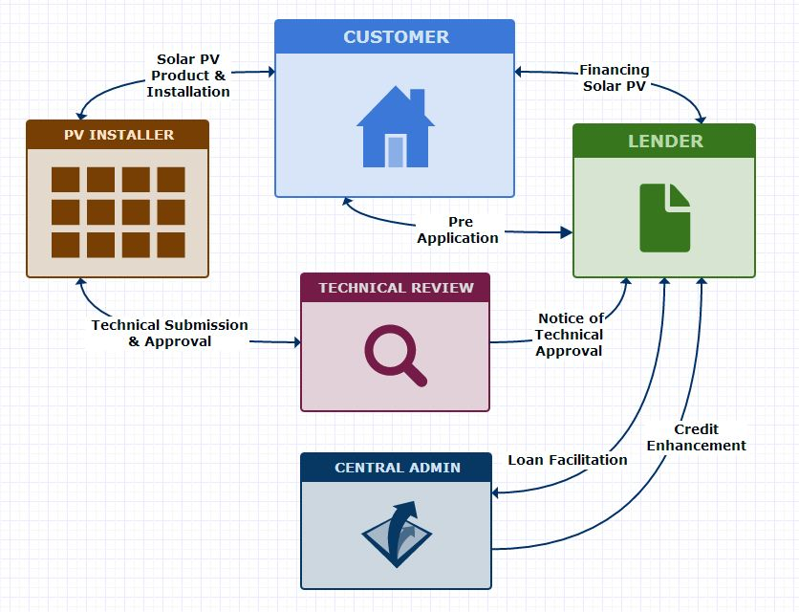
MA Solar Loan Flow Diagram

Slide 17
Schedule for Loan Program Launch
DOER will take feedback during Lender Working Group meeting on August 20, 2014
DOER will take written comments from WG members and all stakeholders through August 27. Please email your comments to Emma Krause at emma.krause@state.ma.us
DOER is working with its consultant team to draft program documents. Documents will be available for Lender WG and stakeholder review before finalizing
DOER will procure contract entities in September/October 2014
DOER expects to have a final program design in October 2014
DOER expects to secure lender agreements in October/November 2014
DOER expects to initiate loan program in November/December 2014

