Slide 1

Uncovering the Hidden Job market
Workshop Coordinators
Sharon Feeney - sfeeney@fhcareers.org
Andrea Reynolds - areynolds@fhcareers.org

Slide 2
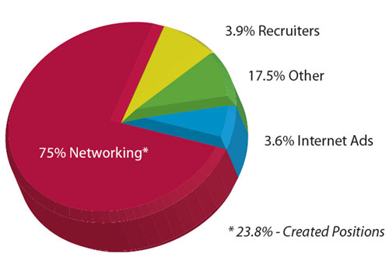
What do you think?
www.execujobs.net/job-market

Slide 3
introduction
network
research
creative job search
market

Slide 4
Get help with your job search
workshops at FHCC
prepare your resume, cover letter,
letters of recommendation, and reference list

Slide 5
Explore your career options
keep current with you profession (journals, conferences).
consider potential employers.
widen your horizons – take assessments to identify your skills, interests, values, or other traits.
talk with someone every day about your job search.

Slide 6
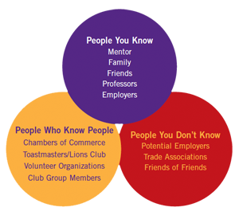
Consider. . .
evansville.edu/careercenter/stJsSocial.cfm

Slide 7
Network!
Network [net-wurk] verb
interact with other people to exchange information and develop contacts, formally or informally, especially to further one's career.
gerund or present participle: networking

Slide 8
Network!
contacts can be anyone – list 100 people and start contacting them!
talk about work, but not necessarily a job
share your expertise & learn from others
get inside information – learn about hiring practices
if not hiring now, might consider you later
maintain your network – stay in touch

Slide 9
Elevator speech (or 30-second pitch)
30-second summary about yourself
summarize your resume
talk about your interests and your skills
talk about your future
keep it simple and interesting

Slide 10
Research employers
Google business name, look at website, research people and job titles
learn about the company products/services/mission statement
understand what trends might be affecting the company
locations / # of employees
how long they’ve been in business - financial situation; downsizing or hiring?
recent news items & reputation in the community

Slide 11
Research salaries
to explore career and education options to find out:
average salaries
how much workers earn, depending on experience
how much an occupation pays
whether that salary will meet your expenses/expectations

Slide 12
Research salaries
to apply or interview for jobs to find out:
typical pay in your field
what an appropriate job offer would be for your skills & experience
how to answer questions about your salary requirements

Slide 13
Research salaries
masscis.intocareers.org
payscale.com
glassdoor.com
careeronestop.org → salary finder

Slide 14
Search for jobs
browse online job banks and newspaper job ads
attend job fairs
network

Slide 15
Use online resources
use: fhcc-onestop.com/jobseekers
job boards
company websites
social media
online periodicals
association websites
Google news alerts
make connections and learn about jobs
follow up with your network after your research

Slide 16
Informational interviews
meet with someone in your field of interest
ask questions and share information
ask who else you might speak with

Slide 17
Reverse job search
decide where you want to work - and find hidden jobs!
where would you like to work?
write a list of places where you’d like to work.
explore employers of interest.
research and network to find out how to get your foot in the door.

Slide 18
Letter of interest (letter of inquiry)
state why you are interested in that company
describe how your skills and experience would be an asset
provide potential employer with your overview and contact information
suggest how you will follow-up

Slide 19
Hiring connector program
matches local employers with FHCC-registered job seekers
create a job seeker profile
see fhcc-onestop.com/employers/connector

Slide 20
Market yourself
make your personal plan
stay positive
practice the messages you want to give people
make business cards and share them
have resume and references ready to share
record your contacts | save job descriptions
keep in touch with your network

Slide 21
What techniques will you use to uncover the hidden job market?

Slide 22
Uncovering the Hidden Job market
Workshop Coordinators
Sharon Feeney - sfeeney@fhcareers.org
Andrea Reynolds - areynolds@fhcareers.org

