Slide 1
Department of Career Services
Welcome to the Massachusetts Workforce Development System
ONE STOP CAREER CENTERS

Slide 2
Agenda
Workforce System Governance
WIOA Overview
Program Requirements
Career Center Services/Resources
Special Programs
Wrap up

Slide 3
U.S. Workforce
System Governance
U.S. President
US Department of Labor (DOL)
Employment & Training Administration (ETA) & Veteran Employment and Training Services (VETS)
Massachusetts
USDOL/ETA & VETS
U.S.
Secretary of Labor
GOVERNOR

Slide 4
MA Workforce
System Governance
GOVERNOR
MA Workforce Development Board
EXECUTIVE OFFICE OF
LABOR AND WORKFORCE DEVELOPMENT
(EOLWD)
DEPARTMENT OF CAREER
SERVICES (DCS)
DEPARTMENT OF UNEMPLOYMENT ASSISTANCE (DUA)
Regional Workforce Development System
WIBs/Career Centers

Slide 5
MA Workforce
System Governance
One-Stop Career Center
LEAD OPERATOR

Slide 6
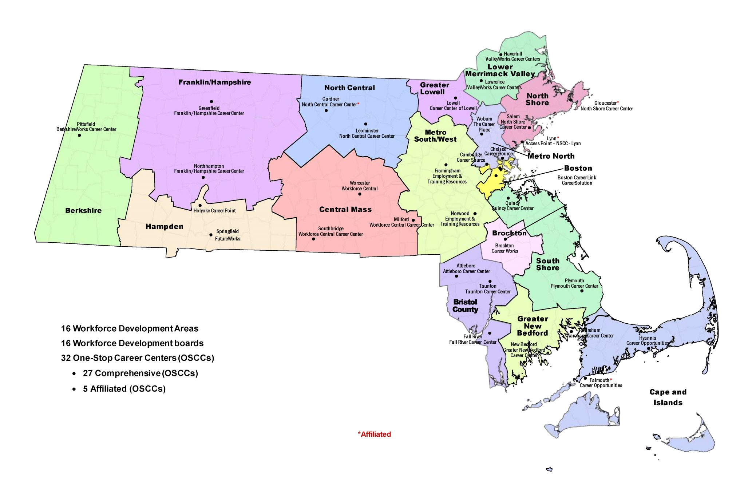
MA Workforce Development
System

Slide 7
Workforce Innovation Opportunity Act (WIOA)
Revitalized Workforce System embodies four hallmarks of excellence:
One-Stop career centers will continue providing first-rate customer service to all customers - businesses and jobseekers
Demands of businesses and workers will drive public workforce system actions and solutions (Demand 2.0, etc.)
Through strategic partnerships and regional coordination, the public workforce system will support strong regional economies and plays an active role in community and workforce development
Continuously improve through evaluation, accountability, best practice identification, and data driven decision making

Slide 8
One Stop Delivery System
Requirements:
Partners must collaborate to support seamless customer-centered service delivery network
Programs and providers must be accessible to job seekers and businesses by:
co-locating
coordinating/integrating activities & information
Partners must provide physical and electronic access to programs, activities, and services

Slide 9
One Stop Delivery System
Requirements:
Each designated area must have at least one comprehensive physical center in each workforce area
Optional supplements to comprehensive centers include:
Affiliated Site
must have at least one partner on site at least 50% of the time
Specialized Centers that do any of the following:
address specific needs
network of eligible one-stop partners

Slide 10
Career Services
One Stop Career Centers provide services to individual customers based on individual needs
No required sequence of services
Required partner services that must be provided through the one-stop delivery system :
Basic Career Services
Individualized Career Services
Follow-up Services
Business Services

Slide 11
Job Seeker Services

Slide 12
Basic Career Services
Intake/Eligibility determination
Initial Assessment of skills level
Orientation to full array of programs and services
Access to Partner Program registration
Job Search and Placement Assistance/Career Counseling
Referrals coordination with other workforce development programs
Provision of:
Eligible Training Providers
Labor Market Information (LMI)
job openings and skills required
information & navigation assistance with UI Claims

Slide 13
Individualized Career Services
Comprehensive and Specialized Assessments
Development of Individual Employment Plan
Group/Individual Employment Counseling
Career Planning
Training
Short term Pre-Vocational Services
Internships and Work Experiences
Workforce preparation activities
Financial literary services
Out-of-area job search assistance & re-location
English language acquisition and integrated education/training programs

Slide 14
Follow Up Services
Follow-up services must be provided, as appropriate, for Adult and Dislocated Worker program participants placed in unsubsidized employment for up to 12 months after the first day of employment
Local areas establish policies that define “appropriate” follow-up services for Adult and Dislocated Worker programs

Slide 15
Business Services

Slide 16
Business Services
Business Engagement in local service delivery model
Appropriate recruitment and referrals (Demand 2.0)
Clear Understanding of Hiring Needs
Provision of information on specialized services available
Local Workforce Boards promote use of industry and sector partnerships to address workforce needs of multiple employers within an industry
Promote and fund proven strategies: incumbent worker training, registered apprenticeship, OJT, customized training, transitional jobs

Slide 17
Special
Programs

Slide 18
WIOA Funded Training
Training Services include but not limited to:
Occupational Skills Training
On-the-Job-Training (OJT)
Incumbent Worker Training
Skill upgrade and training
Entrepreneurial Skills Training
Apprenticeship Training
Adult education and literacy activities
Customized Training

Slide 19
WIOA Funded Training
Eligibility Requirements for Training:
U.S. citizen or authorized to work in U.S. (Permanent resident card)
18 years of age or older
Males born after 1960 must be registered with Selective Service
Able to justify that training will enhance your current skills

Slide 20
Training Opportunities Program (TOP) Section 30
Customers may
be eligible for up to additional 26 weeks of unemployment benefits while in approved training
have work search requirements waived if attending full-time, approved training
Customers must submit application to DUA by 20th payable week of unemployment insurance benefits
Training must be approved by DUA - but they do not pay for training
Training must enhance skills for jobs that are in demand
Customers obtain information by:
visiting local Career Center
contacting the TOP unit: (617)-626-5521 or http://www.mass.gov/dua/top

Slide 21
Veteran Services
All Veteran Customers and Eligible Spouses receive Priority of Service.
Individual assistance available
Veterans’ Employment Representatives on site
Access to other Veterans’ Services & Benefits

Slide 22
Customers with Disabilities
Career Centers offer:
Adaptive equipment available on site
Information and resources for additional adaptive equipment
Individual employment counseling & assistance
Information/referrals to relevant agencies and programs
Related partners and Disability Navigators on site to assist customers with disabilities

Slide 23
Youth
Young Adults can receive specialized Youth services through age 24
Dedicated youth staff
Work readiness workshops
Peer Support
High School Equivalency programs (16-24)
Summer jobs for youth program (14-21)

Slide 24
Migrant Seasonal Farmworkers (MSFWs) & Agricultural Employers
Referrals to Support Services:
Staff Assisted:
Child Care Information
Educational Resources &
Training Programs
Healthcare Service Providers
Legal Assistance
Emergency Resources
Compliance Administrators & Enforcement Agencies
(Federal, State & Local)
Program Registration
Job Referrals
Job Development/Training
Job Placement
Career Guidance/Counseling
Complaint System
Job Order Posting
Recruitment Assistance

Slide 25
Work Opportunity Tax Credit (WOTC)
Program provides money to companies that hire jobseekers from nine targeted groups facing barriers to employment
Targeted jobseeker groups include, but not limited to:
Qualified Veterans
People with Disabilities
Qualified long-term unemployed jobseekers
Recipients of Temporary Assistance for Needy Families

Slide 26
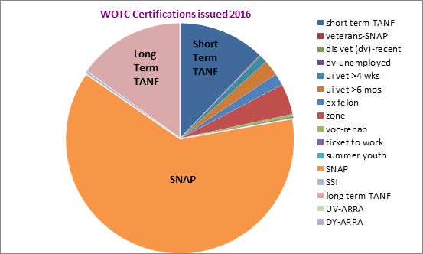
Business Services
short term TANF |  | 4,642
veterans-SNAP |  | 25
dis vet (dv)-recent |  | 5
dv-unemployed |  | 24
ui vet >4 wks |  | 401
ui vet >6 mos |  | 831
ex felon |  | 643
zone |  | 1,644
voc-rehab |  | 140
ticket to work |  | 49
summer youth |  | 21
SNAP |  | 23,726
SSI |  | 120
long term TANF |  | 5,729
UV-ARRA |  | 0
DY-ARRA |  | 0
 |  | 38,000

Slide 27
Trade Programs
For customers adversely affected by:
Service provided moved overseas
Hours reduced due to international trade
International trade caused or will cause layoffs
Lost job as a result of foreign competition
Benefits include:
Financial assistance for job training
Extension of Unemployment Benefits (TRA)
Strict Deadlines for obtaining some benefits:
Trade Readjustment Allowance (TRA) cash benefits

Slide 28
National Dislocated Worker Grants (NDWG)
National Dislocated Worker Grants (NDWGs) assist customers who affected by large scale layoffs caused by unexpected economic events
NDWGs help customers by providing
funding assistance for training
career development
job placement
What are the services that NDWGs offer?

Slide 29
Department of Unemployment Assistance (DUA)
DUA manages the Unemployment Insurance (UI) program, which provides temporary income to Massachusetts workers, claimants, who are:
• Unemployed through no fault of their own • Able to work • Available for work and looking for a job
DUA uses a web-based system called UI Online for claim processing for convenience of both claimants and employers to access services

Slide 30
ReEmployment Services and Eligibility Assessment (RESEA)
RESEA is a federally-funded program helping customers get back to work by using the services offered at career centers:
The RESEA program is managed by
career centers across the state and overseen by the
Department of Unemployment Assistance (DUA)
Assistance organizing job search
Creating or updating resumes
Assistance with Unemployment Insurance requirements
Demonstration of how labor market research can be helpful to a job search
Registration on Massachusetts’ online job bank – JobQuest
Meetings with Career Center staff meetings to review customer progress

Slide 31
Multilingual Services
Multilingual Services coordinates translation and interpretation services for multiple languages, including:
American Sign Language (ASL)
Spanish
Haitian Creole
Cantonese
Mandarin
Vietnamese
Portuguese
Russian
Khmer
Lao
Korean
French
Arabic
Multilingual Toll-free telephone line: (888) 822-3422

Slide 32
Questions
&
Wrap Up

Slide 33
Presenters
Thank you for joining us today!
Please feel free to contact us with
questions and feedback!
Rosemary Alexander
617-626-5775 Rosemary.Alexander@MassMail.State.MA.US
David Ledonne
617-626-6179
David.Ledonne@MassMail.State.MA.US
Erin Fallon
617-626-6105
Erin.Fallon@MassMail.State.MA.US
Grant Keith
617-626-6803
Grant.Keith@MassMail.State.MA.US
Kim Leonard
617-626-6467
Kim.M.Leonard@MassMail.State.MA.US

