Slide 1
Commonwealth of Massachusetts
Working together
Coordination with the Massachusetts
Department of Unemployment Assistance
Rapid Response / DUA informational sessions
UI Policy and Performance Department (severance issues)
Understanding the business side of Unemployment Assistance
TRA/TAA benefits
Workshare

Slide 2
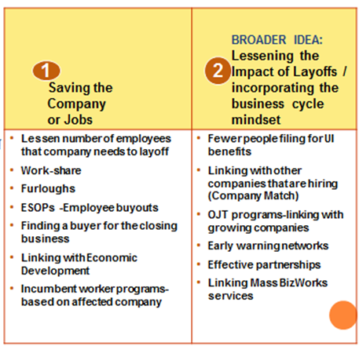

Slide 4
Thank you!
Jennifer Lavin
Director of Unemployment Policy and Performance Department
Massachusetts Department of Unemployment Insurance Assistance
Sandra Foley
Rapid Response Coordinator II
Massachusetts Department of Career Services

