Slide 1


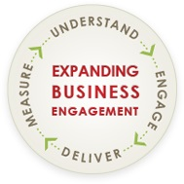
Connecting business to state and federal resources to meet business needs

Slide 2
Mission Statement
The goal of the Expanding Business Engagement (Mass BizWorks) initiative is to enhance and align the services offered to Massachusetts businesses through State Workforce Development, Economic Development and Education entities in order to help MA businesses grow and thrive.
In order to achieve this goal we will:
Build strong relationships across agencies and with businesses
Develop standard staff Business Service knowledge and competencies across relevant State agencies
Coordinate and link resources and information

Slide 3
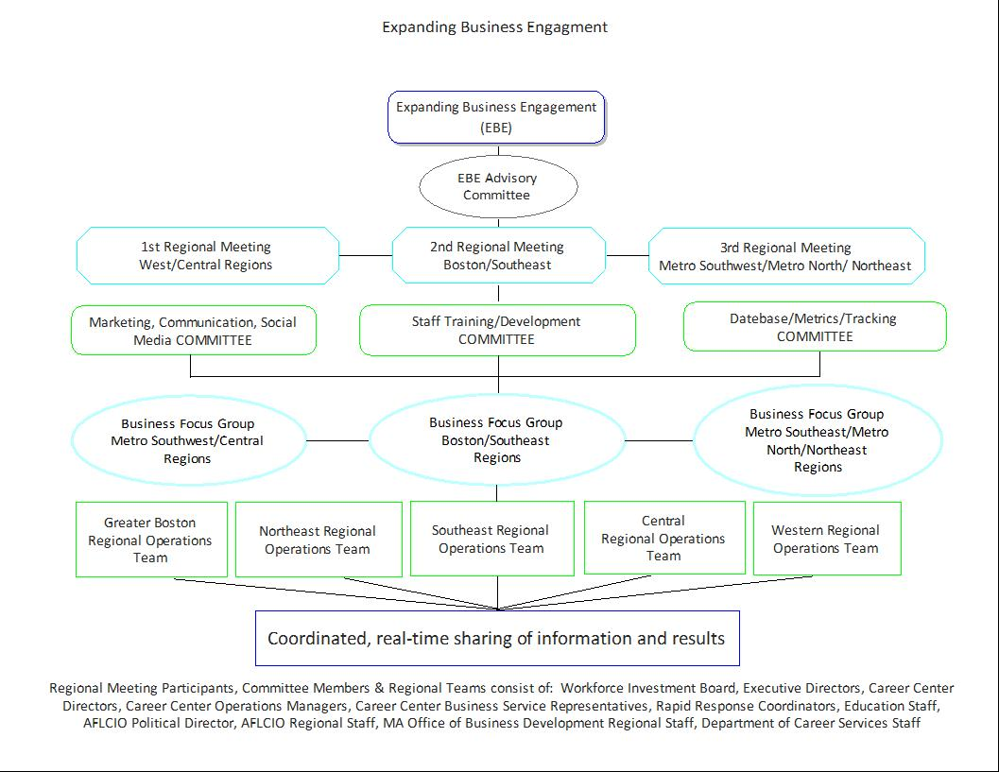

Slide 4
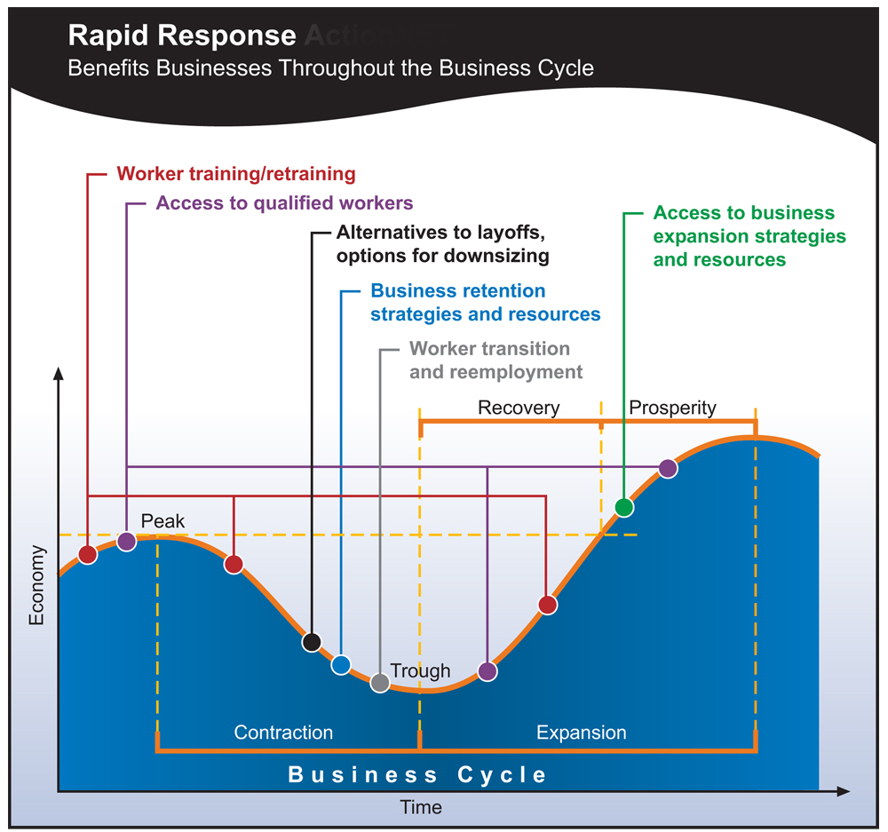
Providing Services Throughout the Business Cycle

