Slide 1
New Public Assistance Delivery Process & Grants Portal
Presented By:
MEMA Disaster Recovery Department

Slide 2
Agenda
FEMA Public Assistance (PA) Program Refresher
Key Benefits of the New PA Delivery Process
Grants Portal
New PA Delivery Process
Project Documentation Reviews & Closeouts
Grants Portal Account

Slide 3
FEMA Public Assistance Program
The FEMA Public Assistance (PA) Program provides grant funding to eligible sub-recipients (applicants) for eligible disaster recovery related activities such as:
Debris Removal
Emergency Protective Measures
Permanent Repairs or Replacement of applicant owned infrastructure
Eligible applicants typically include municipalities, state agencies, certain private non-profits, municipal light corporations, quasi-public agencies, and tribal organizations
Grant funding is awarded in the form of reimbursement as an obligated Project Worksheet (PW)

Slide 4
New FEMA Public Assistance Delivery Process
WHAT HASN’T CHANGED
Law
Policy
Regulations
Eligibility Criteria
WHAT HAS CHANGED
Process
Roles/Responsibilities
Tools/Templates
Takes effect for all disasters declared on or after 9/13/17

Slide 5
Benefits
Notes:
1.) New Delivery Process has many benefits, which fall into 3 general categories
2.) Throughout presentation, these words will be displayed to show how the new process increases transparency, accountability, and consistency over the old process

Slide 6
Grants Portal
Web-based tool through which all FEMA project documentation and determinations will flow
Track all projects, documentation, and information through portal - live site, 24/7
Upload documentation even without disaster declaration, such as:
Union pay policy, Insurance policy, Procurement policy, Equipment inventory list
Each applicant can have one or more registered users
Registered users may have different roles and rights
*Use with Firefox – Free Download!
Notes:
1.) Required to use grants portal for PA reimbursement
2.) Must be invited by grantee (recipient) to portal (which we will do after today’s session)

Slide 7
Phase I – Operational Planning Objective - Identify applicant’s disaster impacts and recovery priorities
WITHIN 21 DAYS
ESSENTIAL ELEMENTS OF
INFORMATION REQUEST (EEI)
JFO
EVENT
Declaration
WITHIN 30 DAYS
WITHIN 7 DAYS
Incomplete RSM
Initial Damage Assessment (IDA)
Preliminary Damage Assessment (PDA)
DEVELOP
INITIAL
OPERATING
PROFILE
APPLICANT
BRIEFINGS
REQUEST FOR PUBLIC ASSISTANCE
(RPA)
Program Delivery Manager (PDMG)
ASSIGNED
RECOVERY SCOPING MEETING (RSM)
EXPLORATORY
CALL (EC)
Complete RSM
CONTACT SPECIAL CONSIDERATION SPECIALISTS
AS NECESSARY
Notes:
1.) Operational Planning and Initial Operating Profile: FEMA reviews the IDA/PDA information and pulls together staff. Considerations include number of staff and experience of staff for different types of projects. (Click to circle this box)
2.) JFO still opened and FEMA staff work out of JFO
3.) Special Consideration specialists determined throughout early stages of operational planning. They will be available to all applicants who need assistance and will be inserted as part of the new model process during the very beginning stages. (click to circle this box)
4.) RPA is first look into grants portal/New PADM process (click to circle this box)

Slide 8
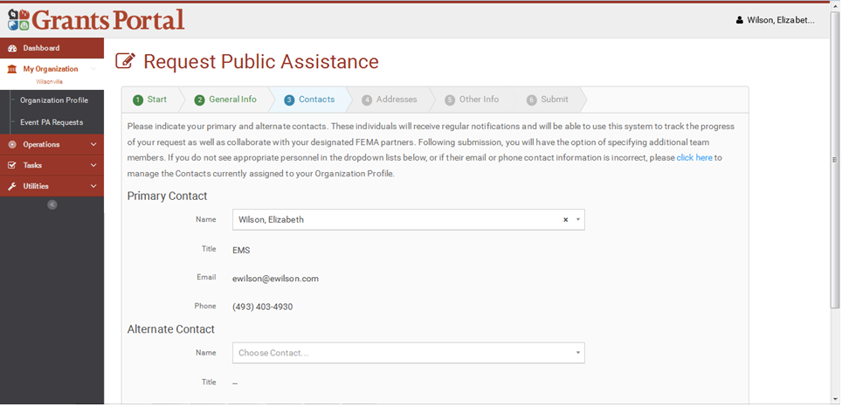
Request for Public Assistance (RPA)
RPA is formal acknowledgement of applicant’s intent to request reimbursement from the FEMA PA program
RPA’s must be completed and submitted electronically in Grants Portal within 30 days of declaration

Slide 9
The Program Delivery Manager (PDMG)
PDMG is primary FEMA POC for applicant
Works closely with state program coordinators
Each PDMG assigned 5-7 applicants*
Assigned after RPA is approved by FEMA
Works at Joint Field Office (JFO)
Key PDMG responsibilities:
Conduct Meetings
Assist with documentation upload into portal
Grants Portal troubleshooting
Coordinate between FEMA staff, state staff, and applicant
Request site inspections
Identify and troubleshoot any/all questions or concerns
Notes:
1.) State Program Coordinator works closely with PDMG
2.) 5-7 applicants dependent on size and scope of disaster

Slide 10
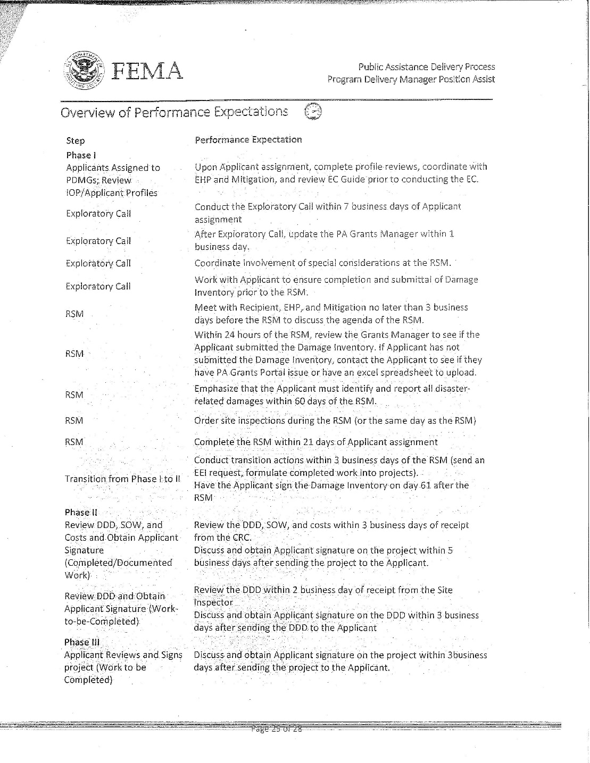
FEMA’s Position Assists
FEMA developed roles, responsibilities, and performance expectations for FEMA PDMG’s
Notes:
1.) FEMA Position Assist packet breaks down employee roles, responsibilities, and requirements.
2) Built-in performance expectations to each position, through TFL and grants manager
(Click twice to reveal “consistency” and “accountability” pics)

Slide 11
Exploratory Call (EC)
PDMG conducts Exploratory Call within 7 days of applicant assignment and it is designed to:
Introduce the PDMG to the applicant
Discuss damages at a high level
Schedule date/time for Recovery Scoping Meeting
Notes:
1.) Consistent questions/dialogue across all PDMG’s
(click once for accountability photo to display)

Slide 12
Recovery Scoping Meeting (RSM)
PDMG conducts RSM within 21 days of applicant assignment
RSM similar to ‘old model’s’ kickoff meeting
The RSM is designed to:
Be the first formal, in person meeting between PDMG, applicant, and state
Review and discuss all disaster related damages
Determine need for site inspections
Identify all potential or actual Environmental/Historic Preservation, Mitigation, and Insurance questions or concerns
Introduce the Damage Inventory spreadsheet
Determine Essential Elements of Information
Comprehensive list of required documentation for each type of damage/work
Assist with documentation upload into the Grants Portal
Develop correspondence schedule
Notes:
Many clicks to reveal all words, last click will reveal “consistency”

Slide 13
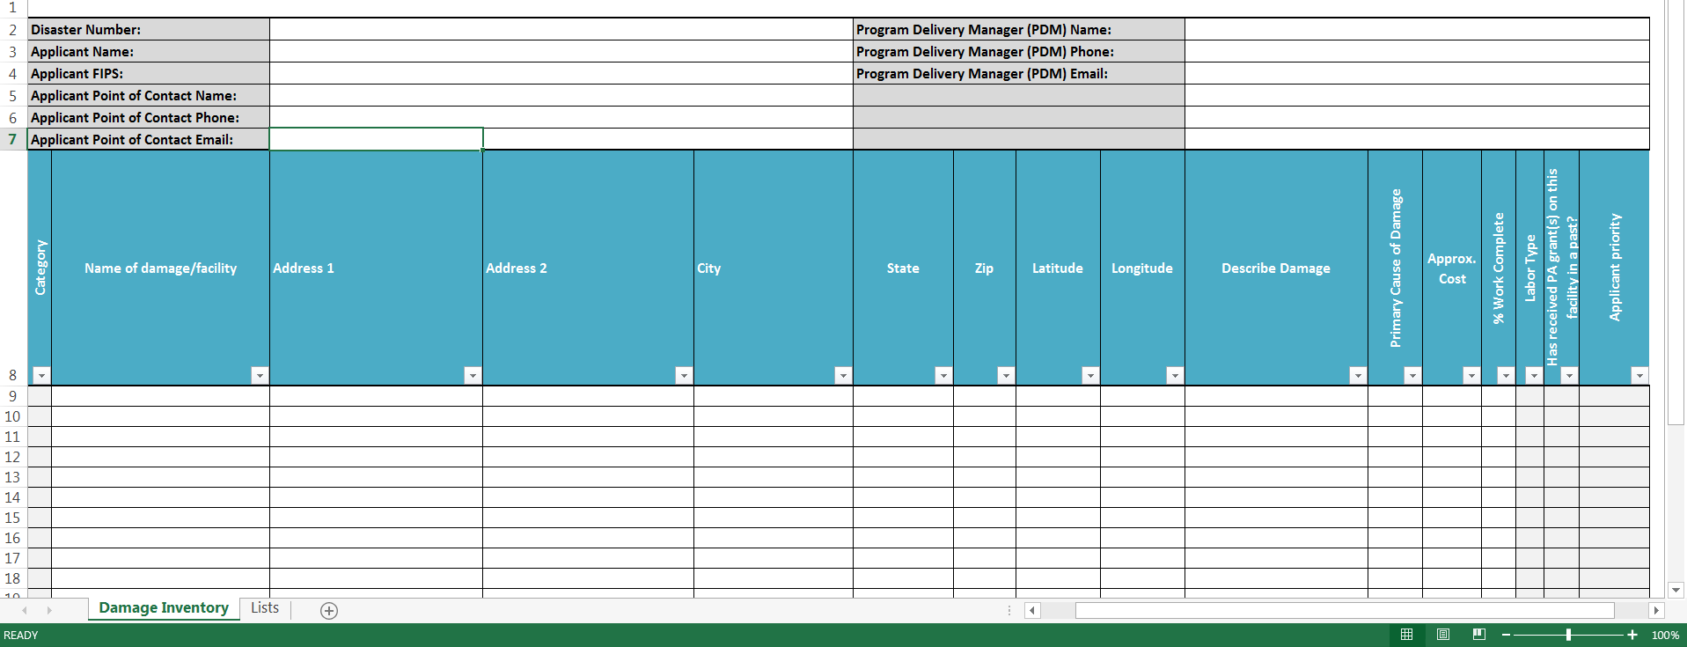
Damage Inventory (DI)
An excel spreadsheet to log all damages
Must be submitted within 60 days of RSM (no change from previous model)
DI can be updated any time within 60 day window
DI is submitted through the Grants Portal
The system knows when it was submitted!
If you try to upload after the 60 day deadline, it will not work!
Notes:
1.) No more ambiguity on what damages were submitted to FEMA
2.) Permanent record of damages
3.) 60-day clock in grants portal

Slide 14
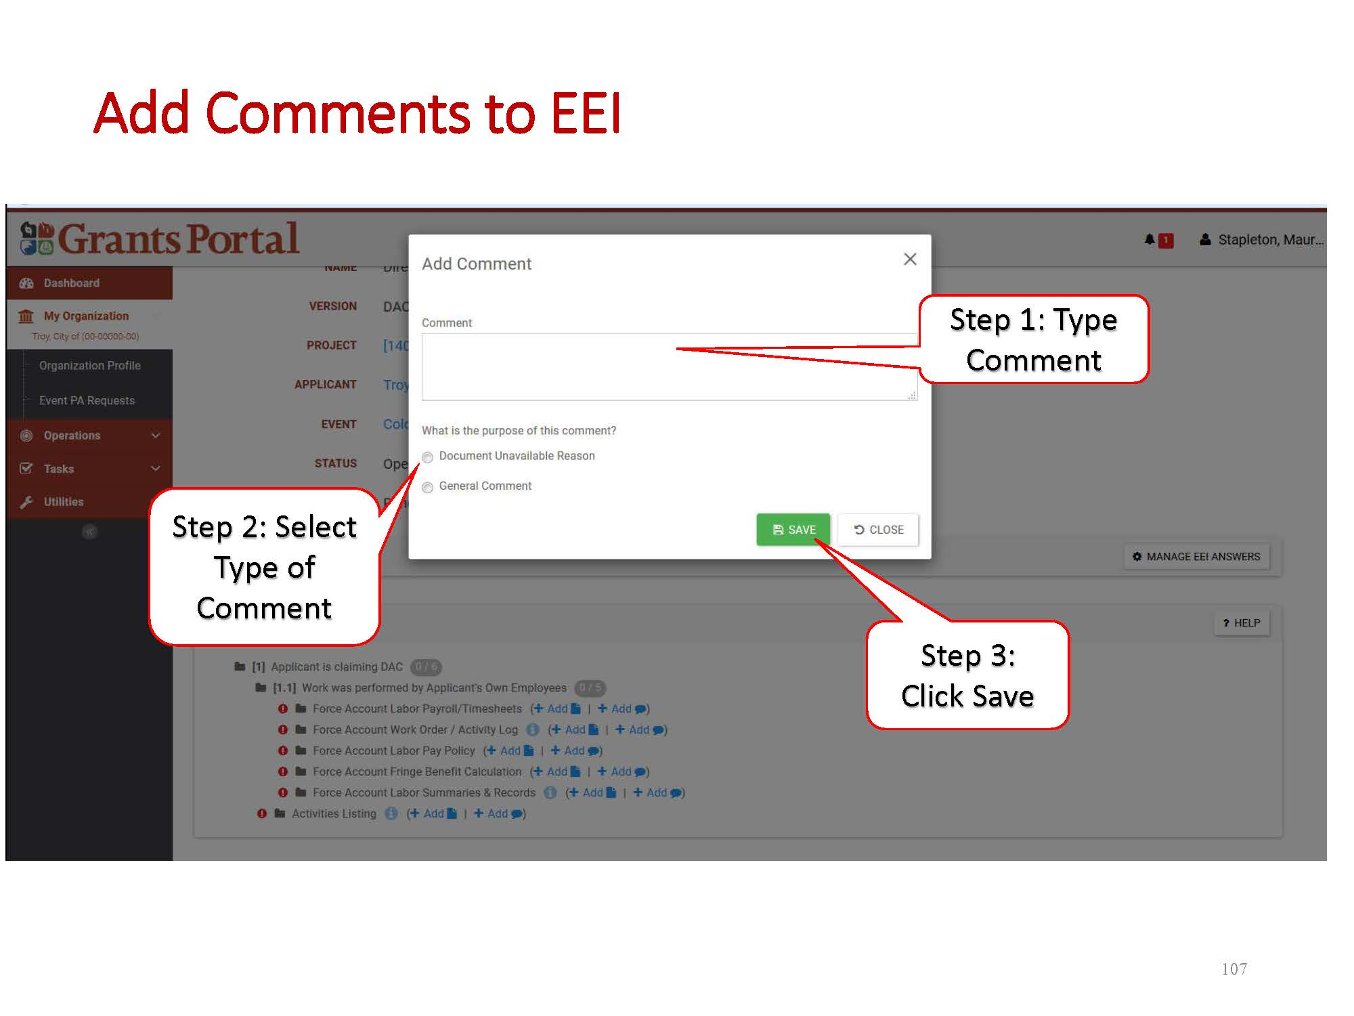
Essential Elements of Information (EEI)
Lives in Grants Portal
Reference for required documentation
Notes:
1.) R = Requested, S = Submitted
(click once for accountability photo to display)

Slide 15
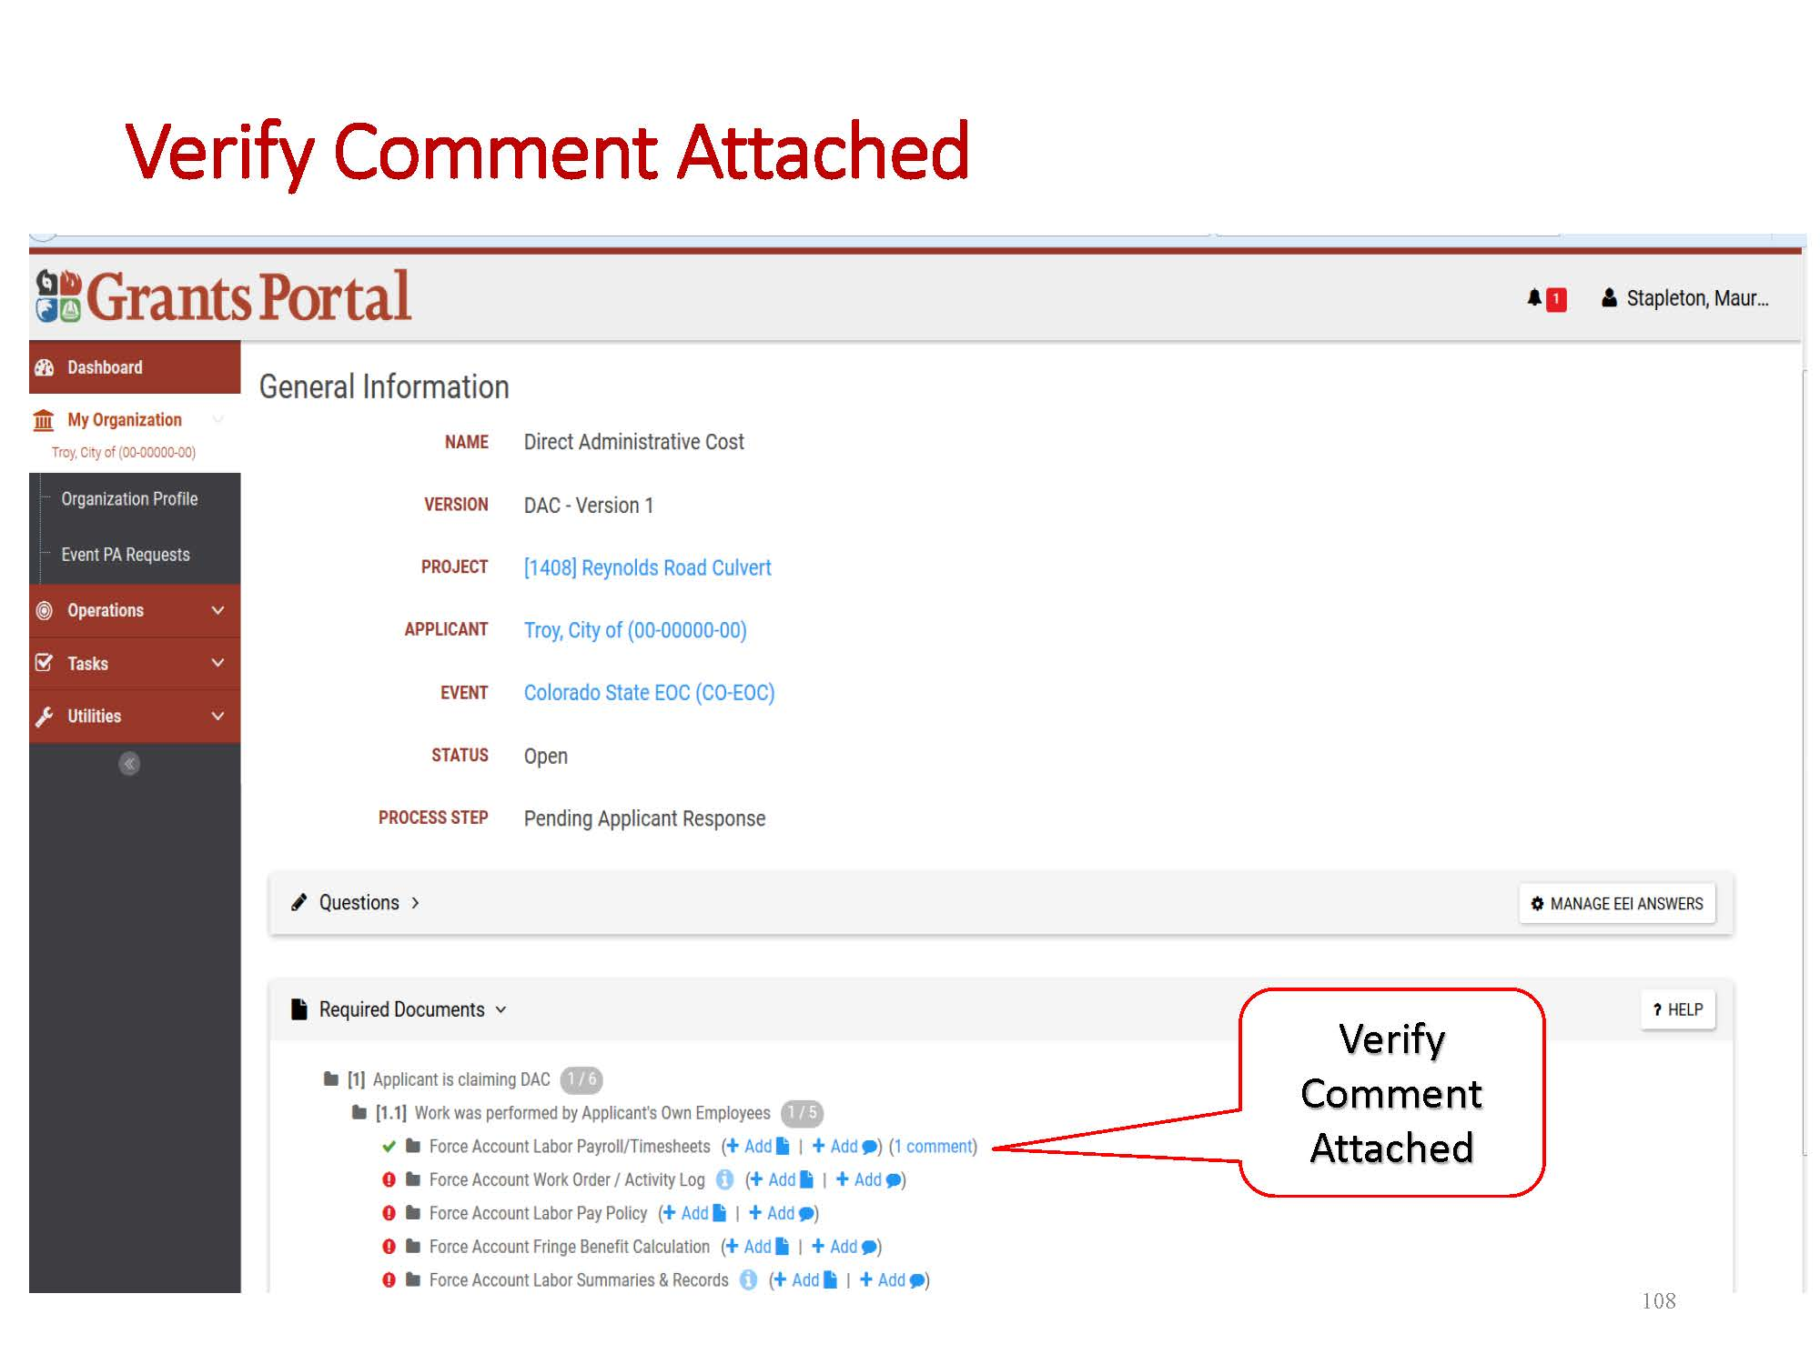
Essential Elements of Information (EEI)
Notes:
1.) R = Requested, S = Submitted

Slide 16
Phase II – Intake Damage and Eligibility Analysis Objective - Capture and document all the incident-related damage
DETERMINATION MEMO
DDD = Damage Description and Dimensions SOW = Scope of Work
100% WORK COMPLETED LANE:
NO
100% WORK COMPLETED:
Routed To Consolidated Resource Center (CRC)
VALIDATE AND DEVELOP DDD, SOW AND COSTS
PROGRAM COMPLIANCE REVIEW
PDMG THEN RECIPIENT REVIEWS DDD, SOW AND COSTS
APPLICANT REVIEWS & SIGNS PROJECT
ELIGIBLE?
YES
DETERMINATION MEMO
STANDARD
LANE:
SEND SITE INSPECTION WORK ORDER – WORK TO BE COMPLETED
SITE INSPECTION – applicant signs off in field
PDMG REVIEWS SITE INSPECTION REPORT (SIR) & DDD
NO
APPLICANT REVIEWS & SIGNS
DDD
SPECIALIZED
LANE:
ELIGIBLE?
YES
SEND SITE INSPECTION WORK ORDER – WORK TO BE COMPLETED
SITE INSPECTION – applicant signs off in field
PDMG REVIEWS SITE INSPECTION REPORT (SIR) & DDD
CONTACT SPECIAL CONSIDERATION SPECIALISTS AS NECESSARY

Slide 17
CRC Lanes
FEMA no longer treating all projects as equal
3 Lanes allow for efficient approach to project formulation and review
COMPLETED WORK
STANDARD
SPECIALIZED
WORK 100% COMPLETE
All documentation submitted
Projects move quickly through this lane
WORK TO BE COMPLETED
Site inspections
Projects written based on estimate by CRC
WORK TO BE COMPLETED
Complex Projects/Technical Expertise
Site inspections
Projects written based on estimate by CRC
Notes:
1.) FEMA estimates based on applicant’s estimates (from backup) or FEMA cost estimating tools

Slide 18
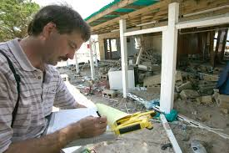
Site Inspections (SI)
PDMG will schedule site inspections for all work incomplete at time of RSM
State Program Coordinator may attend SI
A site inspector will be dispatched to meet with applicant and view incomplete work
SI records detailed information
Latitude/Longitude
Photos
Dimensions of damage
Report of all damage will be created from each site inspection
Report must be reviewed and approved in Grants Portal by PDMG and applicant

Slide 19
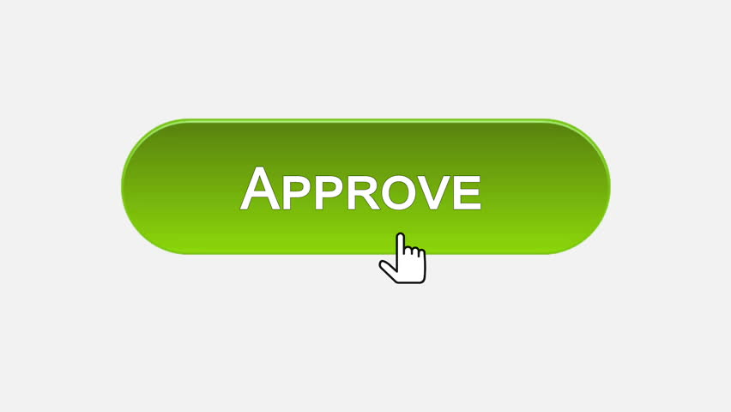
Consolidated Resource Center (CRC)
CRC’s employ full time project writing staff
Projects formulated from Damage Inventory sheet Damages logically grouped
For WORK 100% COMPLETE, CRC’s will write Damage, Description, and Dimensions (DDD) and Scope of Work (SOW) based upon information in Grants Portal
For WORK TO BE COMPLETED, Site Inspector will write DDD; CRC writes SOW
FEMA reviews will be conducted at CRC
Applicant signs off (approve) project(s) after development and validation at CRC
Notes:
1.) Damages logically grouped into projects by geographic location, department, complete versus incomplete work, type of work
2.) Applicant approval should be final step before project obligation

Slide 20
Phase III – Scoping and Costing Objective - Validate WORK TO BE COMPLETED projects
COMPLETED
LANE
APPLICANT SIGNED PW PROCEEDS TO END OF PHASE III
DETERMINATION MEMO
WORK TO BE COMPLETED
FEMA OR APPLICANT DEVELOPS SCOPE OF WORK AND COSTS?
FEMA DEVELOPS SOW/COSTS
FEMA
NO
ELIGIBLE?
STANDARD
LANE
FEMA VALIDATES APPLICANT SOW / COSTS
FEMA PROGRAM COMPLIANCE REVIEW
PDMG THEN RECIPIENT REVIEWS SOW AND COSTS
APPLICANT REVIEWS & SIGNS PROJECT
PROJECT ENTERED INTO EMMIE BY CONSOLIDATED RESOURCE CENTER DOCUMENT INTEGRITY UNIT
APPLICANT
APPLICANT DEVELOPED SOW/COSTS
YES
SPECIALIZED
LANE
FEMA VALIDATES APPLICANT SOW / COSTS
FEMA PROGRAM COMPLIANCE REVIEW
PDMG THEN RECIPIENT REVIEWS SOW AND COSTS
APPLICANT
APPLICANT DEVELOPED SOW/COSTS
CONTACT SPECIAL CONSIDERATIONS AS NECESSARY

Slide 21
Phase IV – Reviews Objective - Prepare eligible projects for obligation
DETERMINATION MEMO
INSURANCE
REVIEW
NO
INITIAL
REVIEW
EHP
REVIEW
PDMG
REVIEW
RECIPIENT (MEMA)
REVIEW
APPLICANT
REVIEW
FEMA FINAL
REVIEW
ELIGIBLE?
YES
OBLIGATION
ELIGIBILITY REVIEWS AT CRC
MITIGATION
REVIEW
Approvals

Slide 22
Request for Information (RFI)
RFI’s drafted by CRC if missing information/documentation
Sent to PDMG with time limit to obtain information
PDMG requests information from applicant
Determination Memo (DM)
Determination Memo – A detailed explanation of ineligible costs/activities
DM’s outline ineligible costs from what was requested by applicant
DM’s include:
Overview of eligibility concern
Explanation of law, policy, regulation
Application of law, policy, regulation to specific eligibility concern(s)
Decision

Slide 23
Large Project Closeouts
Large, long term projects will be closed out by FEMA Region 1, (thru MEMA)
Recovery Transition Meeting
Applicant documentation will still be uploaded into Grants Portal
FEMA Regional staff will award final project funding

Slide 24
Initial Applicant Account Creation
Invitation e-mails will be sent after the completion of the trainings
All e-mails come from support@pagrants.fema.gov; please check your junk/spam folder if you do not receive an invite in your inbox
Grants Portal runs best on Firefox, free download available

Slide 25
You will receive an e-mail from support@pagrants.fema.gov inviting you to join Grants Portal:
1.
Subject:
Your E-mail
Your Name

Slide 26
Use the “click here” link provided in the email to fill in your info and hit “submit” in the lower left of screen 5 to register your organization:
2.
Your Organization’s Name
Only boxes with * are required

Slide 27
You will receive an email from support@pagrants.fema.gov notification that your request was initiated:
3.
Subject:
Your E-mail
Your Name

Slide 28
Once approved, you will receive an email from support@pagrants.fema.gov with your Username (email) and a Temporary Password generated by the system:
4.
Subject:
Your E-mail
Your Name
Your E-mail
System Generated

Slide 29
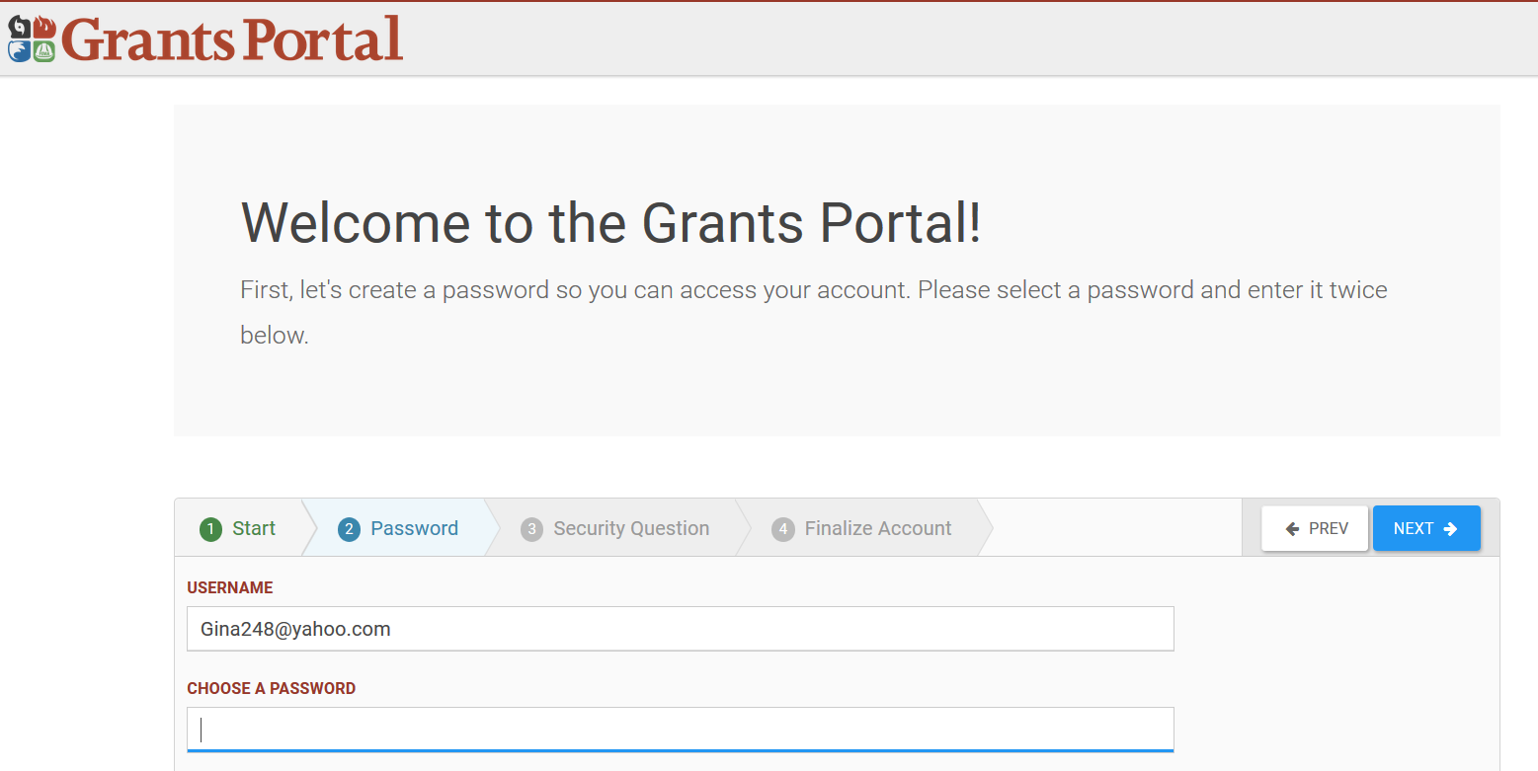
Use the “click here” link in the email to sign in with your Username and Temporary Password provided. Once in the portal, you will be prompted to change your password, create a security question, and finalize your account:
5.
Your E-mail
Create your own password

Slide 30
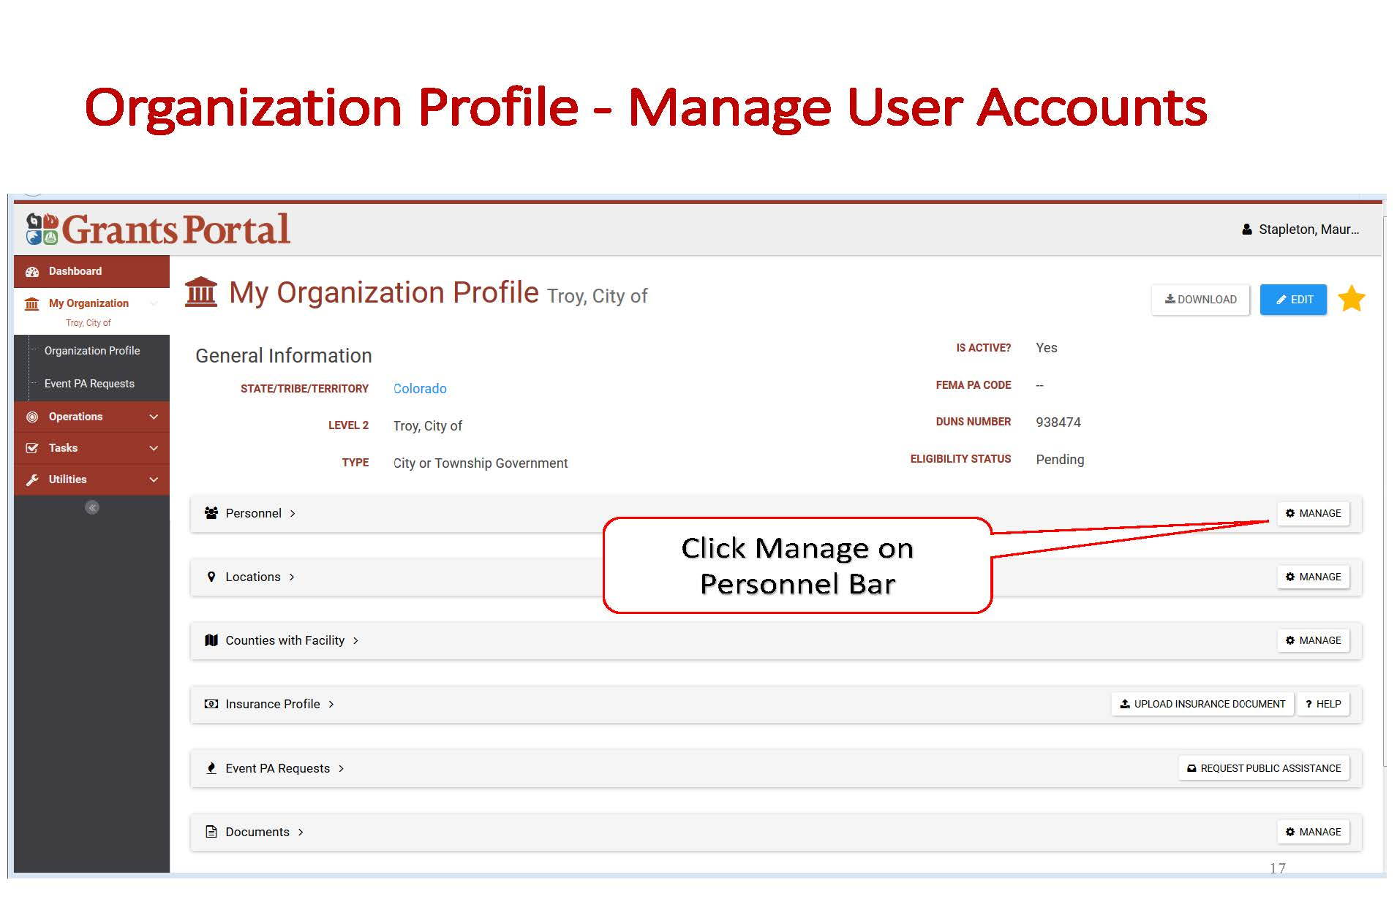
Adding Additional Applicant User Accounts Within Your Organization

Slide 31
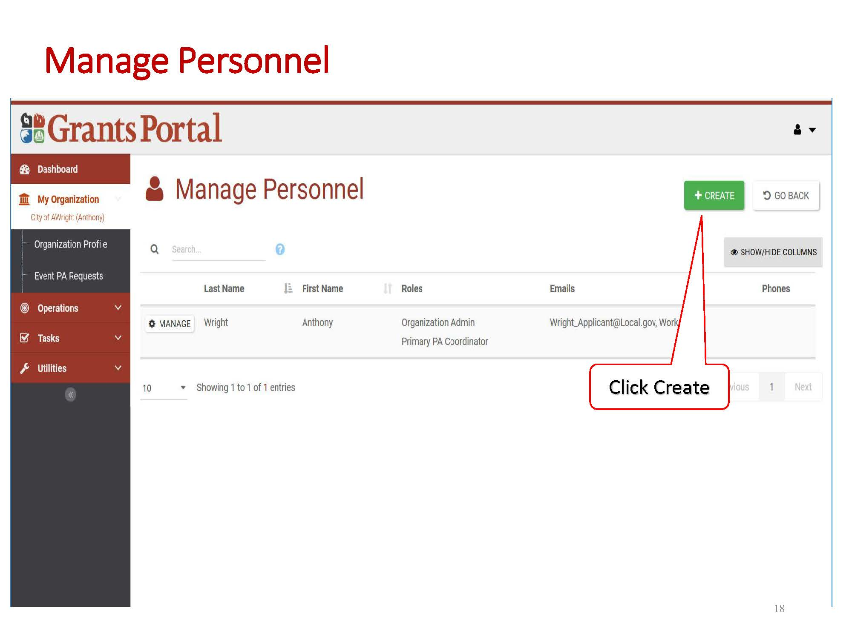

Slide 33
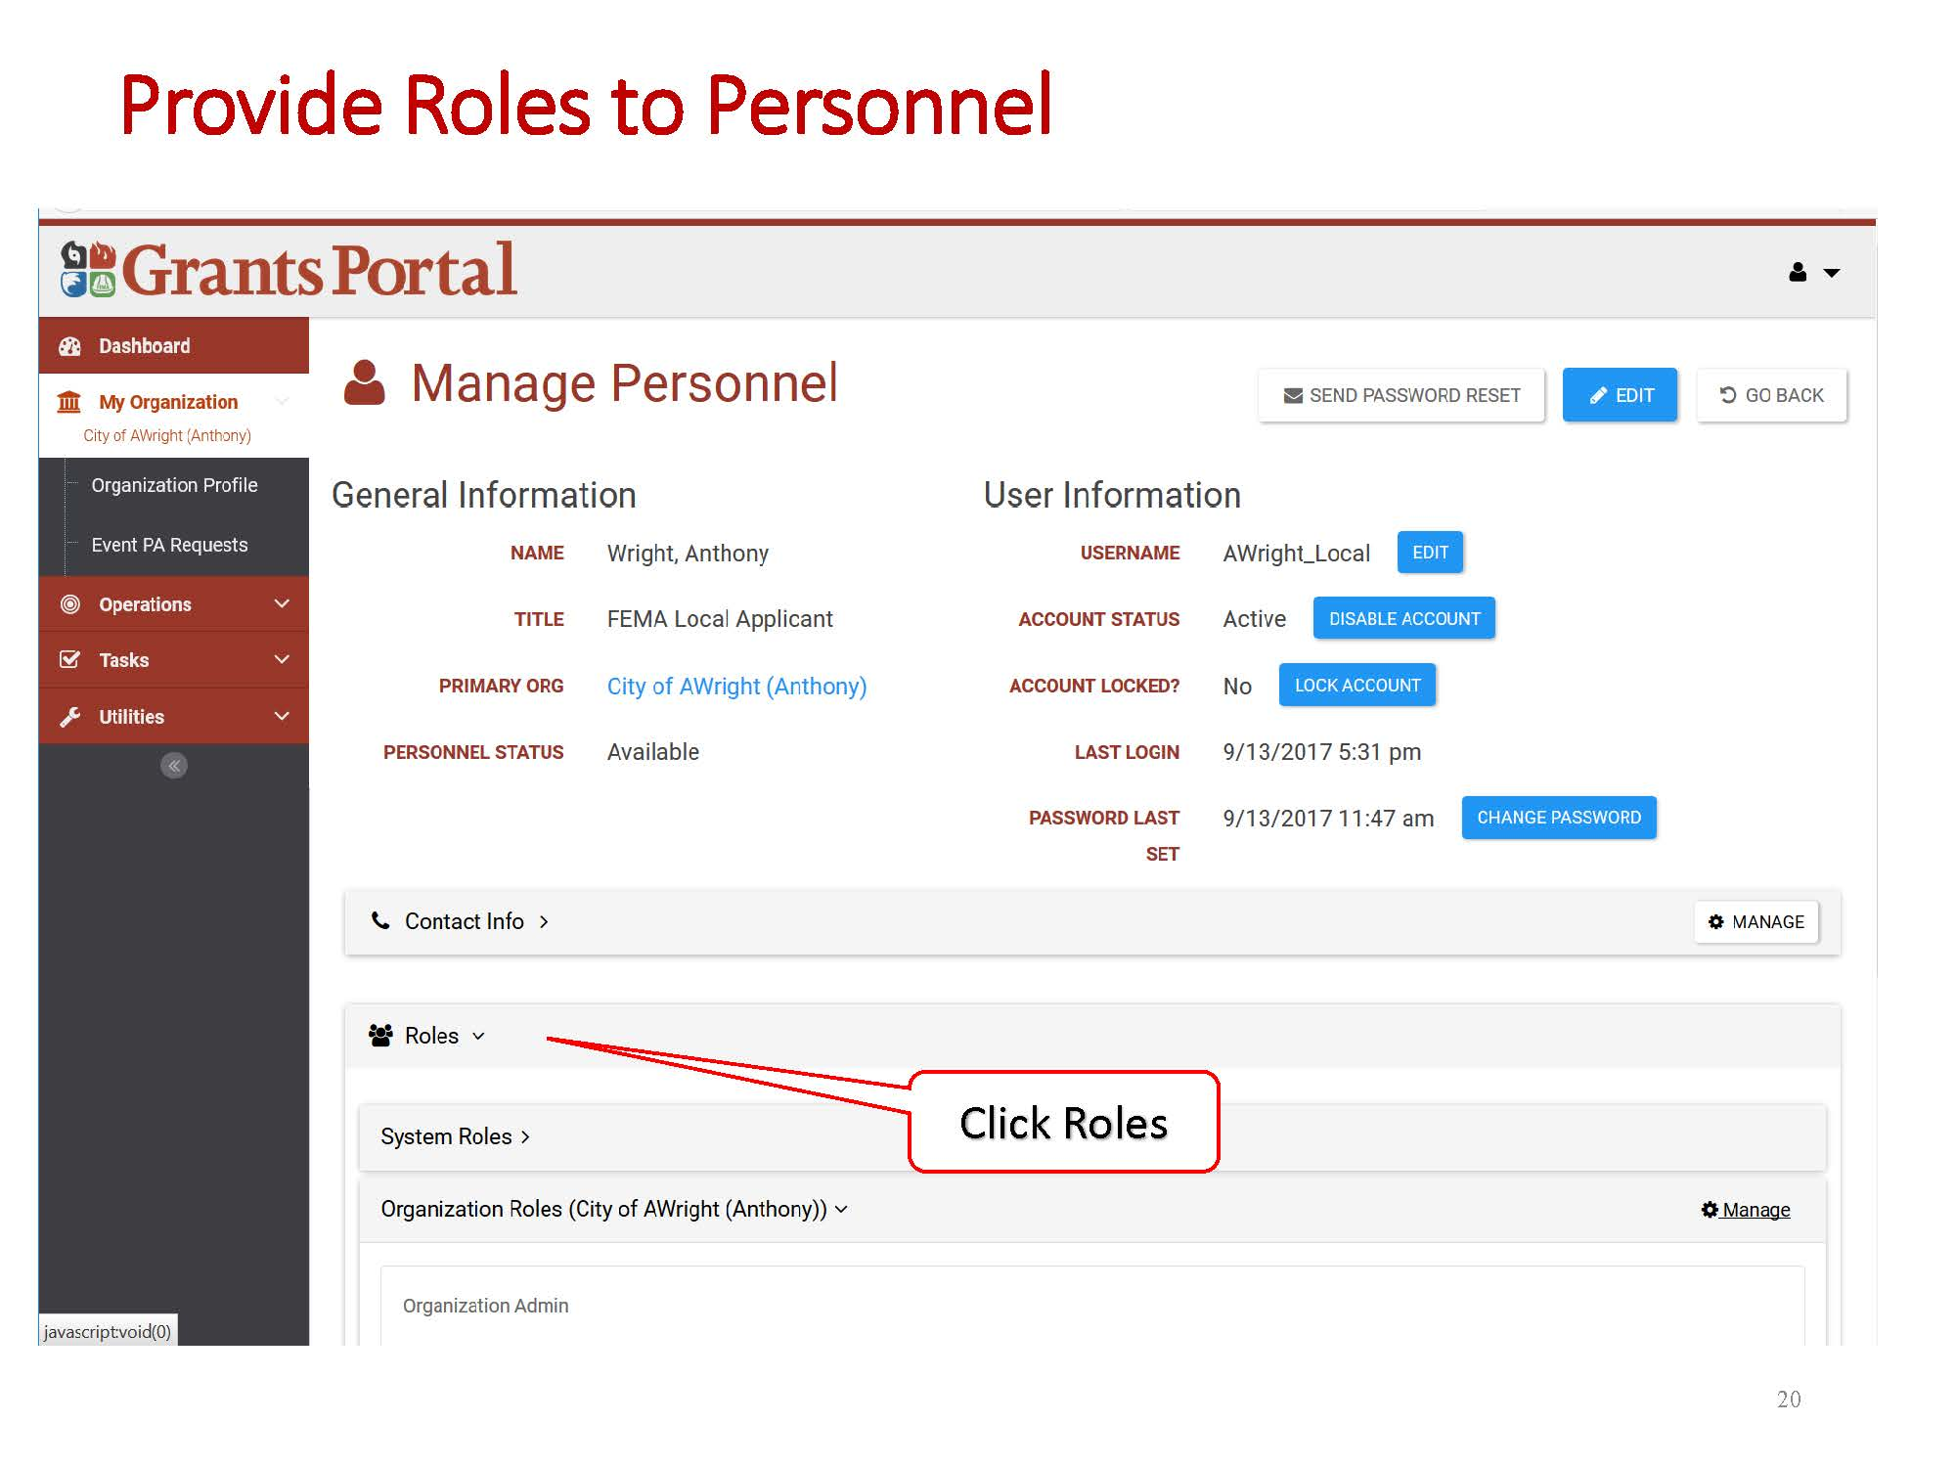

Slide 34
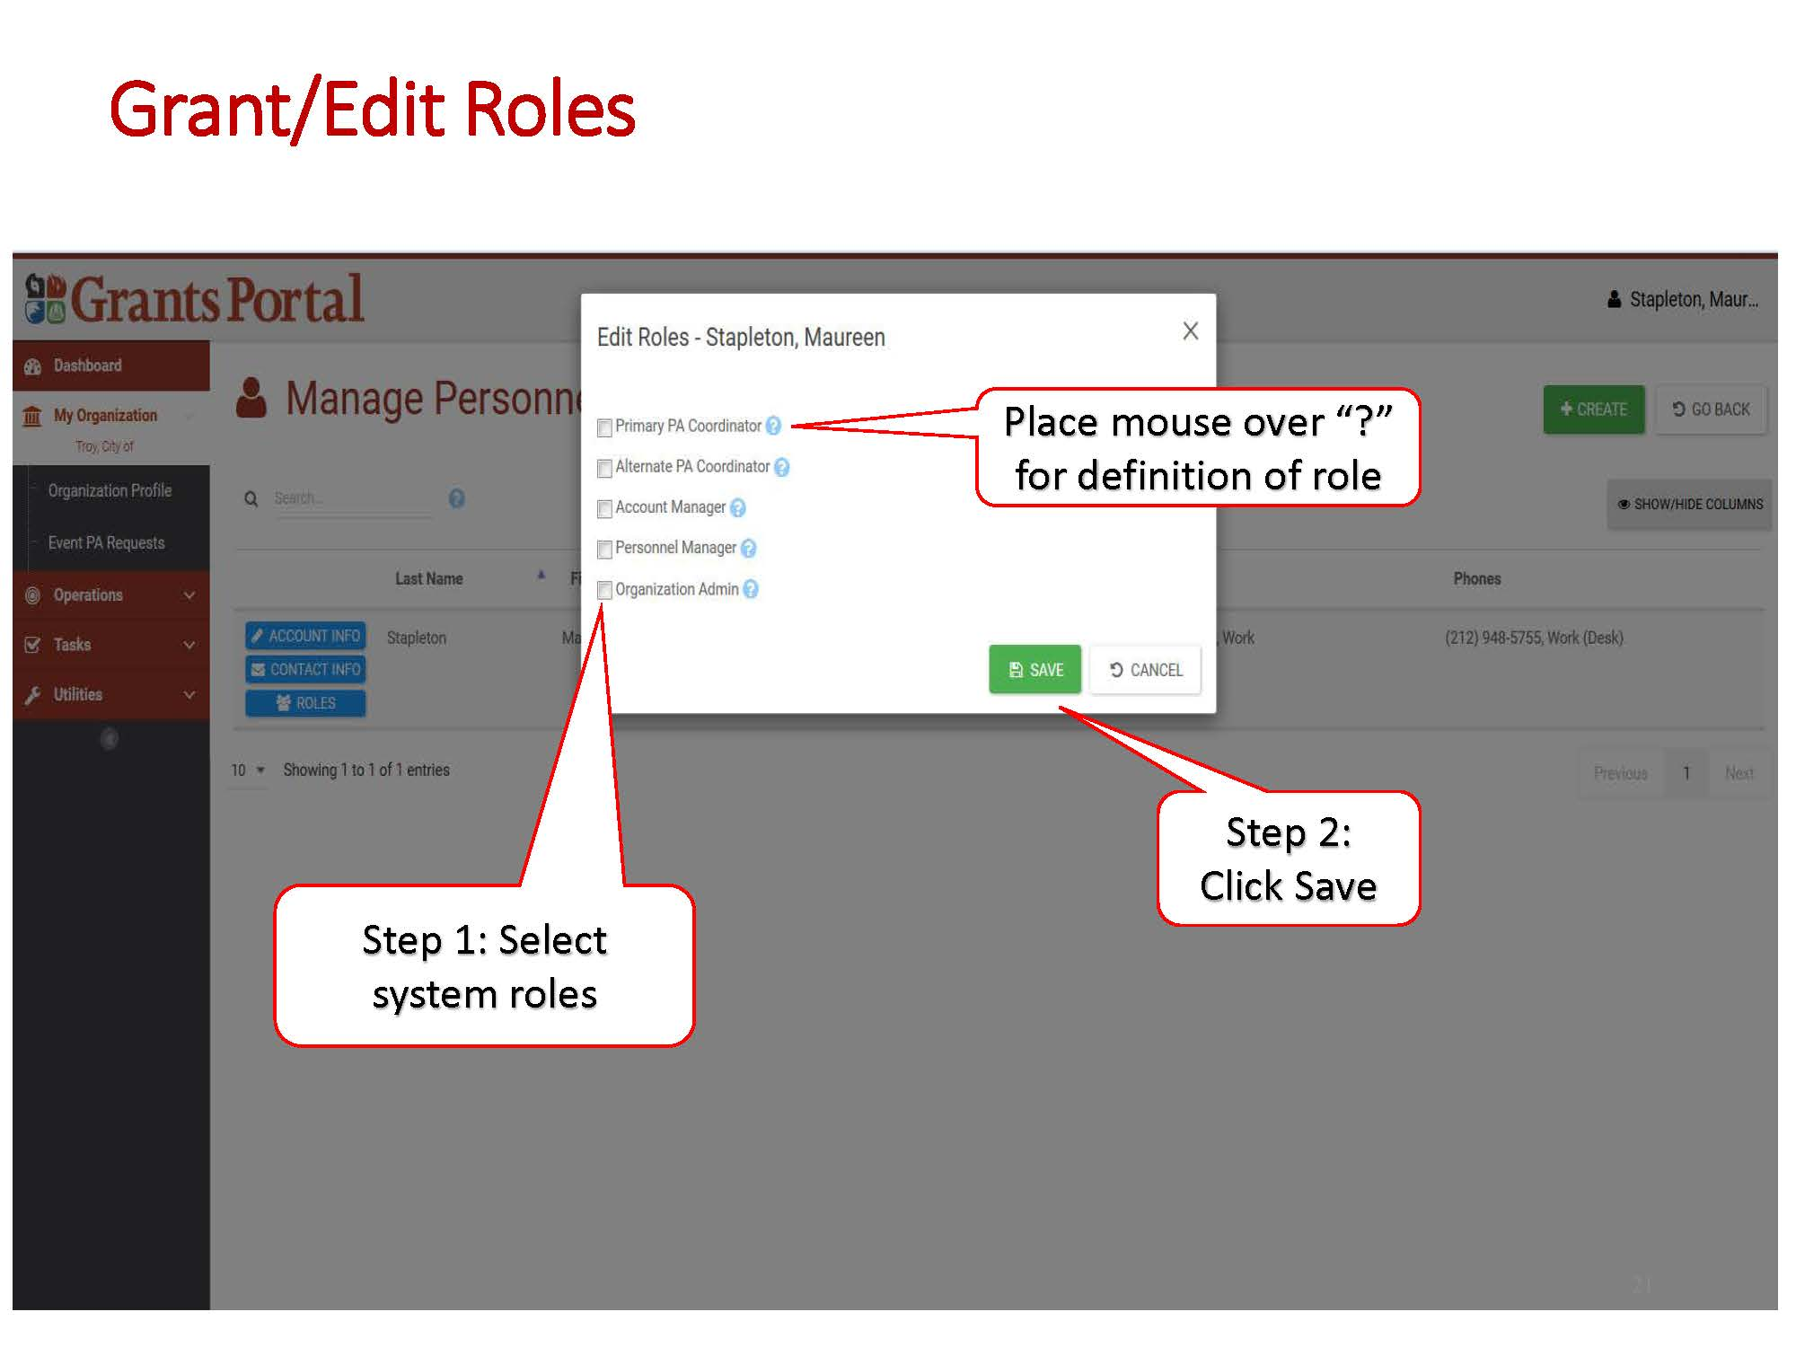

Slide 35
FEMA’s New Public Assistance Delivery Process & Grants Portal
Thank you!
Questions?
FEMA Help Desk:
866-337-8448
Disaster.recovery@state.ma.us

