Slide 1
Career Readiness Initiative
Job Profiler Overview Webinar
June 2016
Notes:
Cheryl

Slide 2
Agenda
Career Readiness Initiative Overview
ACT WorkKeys Overview
Job Profiling
What is it?
Job Profiling Process
Job Profiler Application Process
Job Profiler Training & Expectations
Required Forms & Key Dates
Notes:
Cheryl

Slide 3
Today’s Speakers
Exec. Office of Labor and Workforce Development
Cheryl Scott – Exec. Director, MA Workforce Development Board
Yasmen Bellemsieh - Career Readiness Initiative Research Analyst
Sandy Goodman- World Education, Inc., Career Readiness Capacity Building Expert
ACT, Inc.
Helen Palmer – Director, Industrial/Organizational Psychology
Paula Verlo – Specialist II, Industrial/Organizational Psychology
Notes:
Cheryl provides brief introduction to agencies
Each person introduces self and gives brief intro to their “duties”

Slide 4
Career Readiness Initiative
Phase 1
Career Ready 101
99 Learning Labs
National Career Readiness Certificate
NCRC Testing Sites (42) (Career Centers & community colleges)
Credential
Job Match
Job Analysis
16 Staff
Assess and Remediate
Test Literacy, Numeracy, Work Behavior
Analyze competencies of real job openings (MA and nationwide)
Improve individual’s skill
(Career Centers, community colleges, ABE programs)
Phase 3
Phase 2
CAPACITY BUILDING (World Education, Inc.)
Notes:
Cheryl
Here is a visual of all the components of the Career Readiness Initiative
World Education will be doing “capacity building”
Convening regional user groups
Job profiler groups
Workshops, webinars, national models, blending learning, etc…

Slide 5
ACT WorkKeys Overview
Assessments and credentials that measure and certify foundational work readiness skills critical to career success
Developed to address the need for standardized measures of work readiness skills
Widely adopted by job seekers, educators, employers, and others across the country
Relevant to success on multiple career pathways
Notes:
ACT

Slide 6
ACT WorkKeys Overview
ACT WorkKeys® Cognitive Assessments are research-based measures of foundational skills essential to career success
Criterion-referenced to workplace skill requirements
Linked to over 20,000 ACT-authorized job profiles
Multiple-choice assessment
Results expressed as level scores (Level 3 – Level 7)
Proctored and time-bound
Pencil-and-paper and computer-based formats
Offers immediate score reports (on-line) or ACT scored (paper)
Notes:
ACT

Slide 7
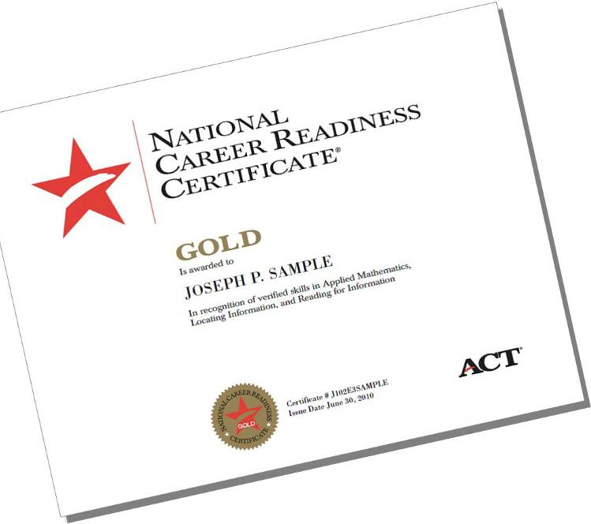
ACT National Career Readiness Certificate
Industry-recognized
Portable
Uses Applied Math, Locating Information, and Reading for Information
Awarded at four levels: Bronze, Silver, Gold, Platinum
Notes:
ACT

Slide 8
Job Profile: Links Job to Assessments
WorkKeys Job Profiling
WorkKeys Tests
Tasks of the job
WorkKeys Job Profiling
Identifies WorkKeys skills and skill levels required
to perform the tasks of the job
Notes:
ACT
Purpose of job profiling: determining which WKs assessments are relevant to jobs and what skill level or cut score.

Slide 9
Uses Same Metric for Jobs and Assessment Scores
Notes:
ACT
Key is that assessments and profiling are on the same metric
Differentiator for ACT

Slide 10
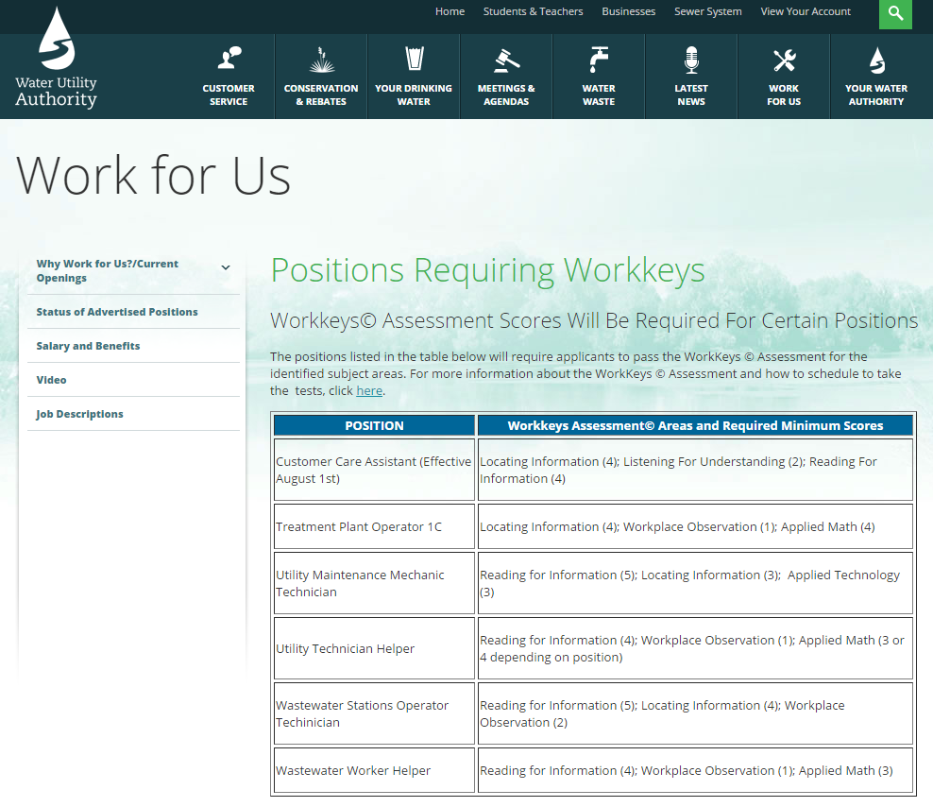
Employment
Screening
Notes:
ACT
So why is profiling important?
For employers: This allows the employer to identify the most critical WorkKeys skills and the skill level required for entry into the job and to effectively perform the job. For example, Listening for Understanding is a critical skill for a Customer Care Assistant, Workplace Observation is critical for a Treatment Plant Operator, and Applied Technology is critical for a Utility Maintenance Mechanic Technician. Without the profile, they wouldn’t be able to be as precise in their requirements for applicants.
For Individuals: Profiles provide individuals with valuable information about the skills and skill levels needed for jobs. This provides guidance on what jobs they are possibly qualified for as well as where additional training that may be needed for jobs to which they aspire.

Slide 11
Showcasing Value
Notes:
ACT

Slide 12
The Process
Notes:
ACT
Spend a few minutes talking about how job profiling is conducted

Slide 13
Preparation: Client Contact, Tour, Initial Task List
Obtain job-related information
Schedule job shadowing and profiling session(s)
Use SkillPro to develop initial task list to reflect activities on the job
Notes:
ACT

Slide 14
On-site Activities
Task Analysis
Edit Initial Task List using SkillPro
Rate tasks for Importance
Skill Analysis
Define a WorkKeys skill
Identify tasks requiring skill
Discuss how tasks require skill
Use consensus process to determine skill level required
Notes:
ACT

Slide 15
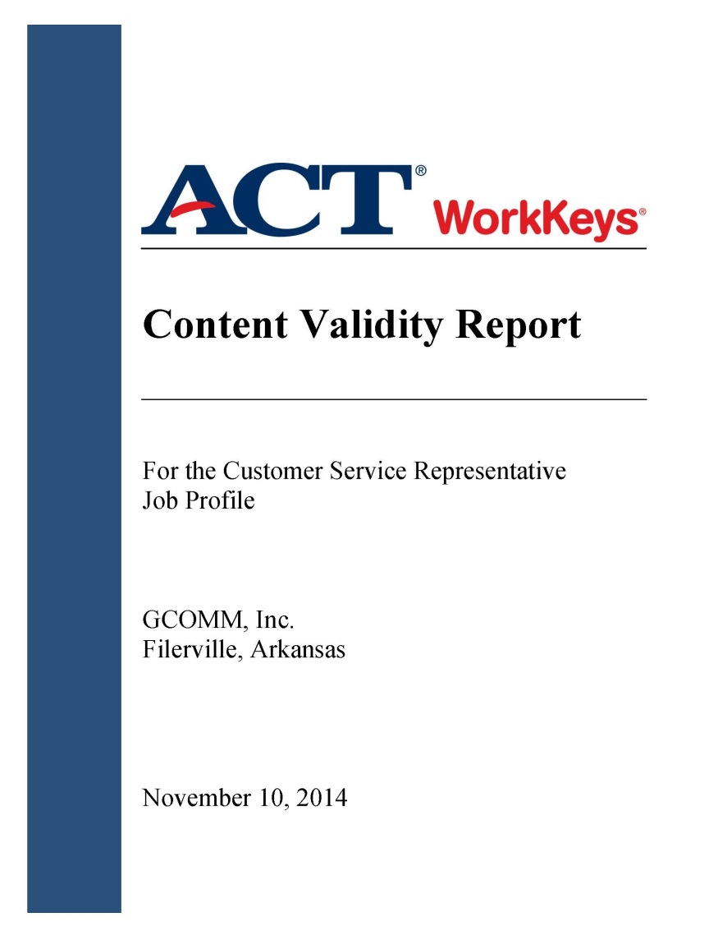
Completing the Profile
Enter profile data into SkillPro & send to ACT
Write the client report
Document content validity
Required to meet ACT expectations
Notes:
ACT

Slide 16
Career Readiness Initiative Job Profiling Training Process
Application
Distance Learning
Onsite Training
Active Profiling
Notes:
Cheryl
Brief overview of the process in MA
Next slides cover this process

Slide 17
Job Profiling Training Application
What is the application process:
Workforce Boards identify a PRIMARY and a Back-up person to submit a training application
Applicants/trainees do not need to work for the workforce board
Applications are submitted directly to and are reviewed by ACT; ACT makes admission decisions
If the primary applicant is not accepted, ACT will consider the back-person’s application
All applicants MUST be able to complete the distance-learning, attend live webcasts, and be available to attend the on-site training
Notes:
Cheryl

Slide 18
Job Profiling Training Application
How are job profilers selected?
Applicants need to have education, training or work experience with:
Job analysis
Development and implementation of training programs for business and industry
Interactive on-line guided activities
Group facilitation
Federal Regulations related to employment
Notes:
ACT

Slide 19
Job Profiling Training
7 weeks of training
6 weeks of distance learning
Approximately 20 hours per week
Interactive, on-line guided activities
3 two-hour webcasts (Weeks 2, 4 and 6)
3.5 Day on-site training in Massachusetts
Role play and simulation
Notes:
ACT

Slide 20
Job Profiling Training Dates
COHORT 1
Central, West
Participants: 8 – 10 people
Distance Learning Dates:
Aug. 29 – Oct. 7, 2016
Sept. 8 – Webcast #1
Sept. 22 – Webcast #2
Oct. 6 – Webcast #3
On-site Training Dates:
Oct. 11 – 14, 2016
On-site Training Location:
Central / Western MA
COHORT 2
Boston, Northeast, Southeast
Participants: 8 – 10 people
Distance Learning Dates:
Oct. 3 – Nov. 11, 2016
Oct. 13 – Webcast #1
Oct. 27 – Webcast #2
Nov. 10 – Webcast #3
On-site Training Dates:
Nov 15 – 18, 2016
On-site Training Location:
Greater Boston
Applicants will be placed into a cohort as they are accepted into the training. Email careerreadiness@state.ma.us if the applicant has a scheduling conflict that will preclude attending the training slated for that region.
Notes:
Cheryl

Slide 21
Job Profiling Expectations
What happens after Job Profiling Training?
Profilers are expected to complete four job profiles per year
If less than four profiles are completed, profilers must take a refresher training at a cost in order to renew SkillPro License
Workforce Boards are encouraged to work with their region’s designated Job Profiler to develop job profiling strategy (i.e. aligned with strategic plan, labor market information, in-demand occupations, etc.)
The Career Readiness Initiative will convene job profilers statewide for peer-to-peer support and learning
Notes:
Cheryl
ACT – anything to add or correct?

Slide 22
CRI Job Profiling Key Dates
July 15th – Job Profiling Training Applications Due to ACT
July 25th – Admissions decisions determined
August 5th – All required documents due to ACT
August 29th – COHORT 1 Distance Learning Begins
October 3rd – COHORT 2 Distance Learning Begins
October 7th – COHORT 1 Distance Learning Concludes
October 11th-14th -- COHORT 1 On-site Training
November 10th – COHORT 2 Distance Learning Concludes
November 15th-18th – COHORT 2 On-site Training
Notes:
Cheryl

Slide 23
Job Profiling: Required Forms
Job Profiling Training Application
Must be completed and submitted by Primary and Back-up Job Profiler to ACT, Inc.
Due to ACT by July 15th, Admissions Decision by July 25th
Job Profiling Agreement
Agreement between ACT and the job profiler’s agency (workforce board, OSCC, community college, etc.) identifying the training and responsibilities required to be an ACT-authorized job profiler, along with ACT’s role with training and support.
Due to ACT by August 5th
Skill Pro License Agreement
Software license agreement between ACT and the job profiler’s agency
Due to ACT by August 5th
Delegation of Payment Agreement
Legal document that connects profiler’s agency’s Job Profiling Agreement and SkillPro License Agreement to the EOLWD/ACT contract—ensuring that EOLWD will provide payment.
Due to EOLWD by August 5th
Notes:
ACT

Slide 24
Contact Info
ACT, Inc.
jpanswers@act.org
Career Readiness Initiative
careerreadiness@state.ma.us
Notes:
Cheryl

Slide 25
Questions & Answers
Notes:
Cheryl will open up the floor for Q&A, everyone will field inquiries as necessary

