Slide 1
WorkKeys/ NCRC Testing Site Orientation
Jennifer James, Cheryl Scott and Yasmen Bellemsieh
Executive Office of Labor and Workforce Development
WorkKeys Testing and NCRC Certificates

Slide 2
Adobe Connect
This webinar will be recorded!
On the right hand side of your screen, you will see a chat box. This chat box is visible to all participants
  Use the chat box to communicate (ask questions, commentary, etc.)
On the top of your screen, there is an image of a man holding his hand up, the drop down menu next to him allows you to raise your hand, request me to speak louder, slow down, applause, and other actions

Slide 3
Orientation Agenda
WorkKeys/NCRC Overview
Setting up testing sites
Vouchers
Next Steps

Slide 4
Who should attend?
Primary Liaison:
  Main contact person for the Career Readiness Initiative
Secondary Liaison :
  Supporting contact person for the Career Readiness Initiative
Test Coordinator:
  Main Contact person for WorkKeys/NCRC testing
Career Ready 101 Instructor Account Holders:
  Any person at your organization who uses CR101 as an instructor

Slide 5
Massachusetts Model
Phase 1
Workkeys
Testing
Career Ready 101
99 Learning Labs
National Career Readiness Certificate
NCRC Testing Sites (42) (Career Centers & community colleges)
Credential
Job Match
Job Analysis
16 Staff
Assess and Remediate
Test Literacy, Numeracy, Work Behavior
Analyze competencies of real job openings (MA and nationwide)
Improve individual’s skill
(Career Centers, community colleges, ABE programs)
Phase 3
Phase 2
CAPACITY BUILDING (World Education, Inc.)
Notes:
Here is a visual of all the components of the Career Readiness Initiative
World Education will be doing “capacity building”
Convening regional user groups
Job profiler groups
Workshops, webinars, national models, blending learning, etc…

Slide 6
WorkKeys/NCRC CRI Testing Overview
CRI Phase II: Deploying WorkKeys Testing System Statewide
42 Testing Sites throughout the Commonwealth
Testing Sites:
  Community Colleges (15)
  Career Centers (27)
  Only One Stop Career Centers and Community Colleges have the ability to become NCRC testing locations.

Slide 7
Key Terms
WorkKeys: Online computer-based, high-stakes test that assesses skill level
WKIV: WorkKeys Internet Version; software to administer WorkKeys
WorkKeys Tests/Assessments: ACT has many WorkKeys assessments, for this initiative we are promoting Reading for Information, Applied Math, Locating Information, and Talent
Talent: A personality survey that assesses workplace behavior
RegiSTAR: Database that stores WorkKeys testing results
NCRC: National Career Readiness Certificate
Voucher: A virtual “ticket” that allows a test taker to take a WorkKeys test paid through CRI
Career Ready 101: Computer based, self paced remediation tool

Slide 8
WorkKeys Overview
WorkKeys Assesses skill level in workplace competencies:
  Applied Mathematics:
  Reading for Information
  Locating Information
  Talent
  Others tests are not covered under CRI
High-stakes test
  ID required, timed, no outside materials
Test Preparation is required:
  CR101
  Test taking skills

Slide 9
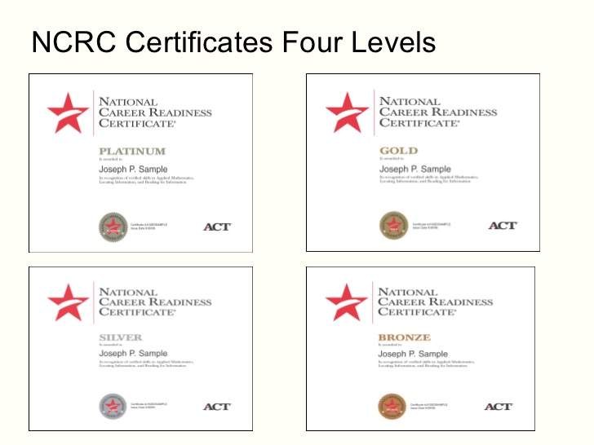
NCRC Overview
Documents foundational skills related to work-related capacities
Measured by ACT™ WorkKeys® assessments
Many states have NCRC systems
Nation-wide, portable credential for work Readiness
Career Ready 101 helps prepare students to earn an NCRC

Slide 10
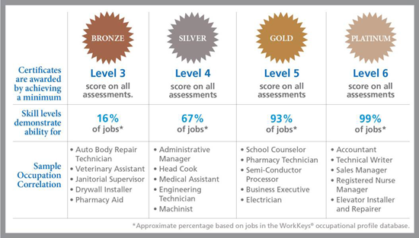
NCRC Scoring System
WorkKeys Test that identifies and assesses an individual’s levels in:
  Applied Math
  Reading for Information
  Locating Information
  Results scored in levels 1 – 7
NCRC awarded based on results of WorkKeys test:
  Bronze (score of 3 on one or more)
  Silver (score of 4 on one or more)
  Gold (score of 5 on one or more)
  Platinum (score of 6 on one or more)

Slide 11
Talent
A personality survey using 165 assessment questions asking a range of “agree” or “disagree” statements that ranks a person’s attributes against a normative sample.
  Work Discipline – productivity, dependability
  Teamwork – tolerance, communication, attitude
  Customer Service Orientation – interpersonal skills, perseverance
  Managerial Potential – persuasion, enthusiasm, problem solving
  Results scored using a point system (1 – 99)
“Talent” scored from (1 – 99) in 4 sections: Team work, Work Discipline, Managerial Potential and Customer Service
  Job candidates use to demonstrate competencies and alignment with job requirements
  Previously, Talent was scored with a Star system and appeared on the NCRC
  *NCRC Plus no longer offered by ACT

Slide 12




WorkKeys NCRC Testing Process (Testing Site)
Math
Locating Information
Reading
WorkKeys Internet Version (WKIV)
NCRC
Talent
WorkKeys Tests
RegiSTAR
Uses voucher to administer one assessment at a time
Tests can be taken on same or separate days
Sites establish individual testing policies
Show Test results and/or print out Talent Assessment Profile
WorkKeys Test Scores are stored here
Register Test takers
Activate WorkKeys Test to begin testing
Testing sites distribute NCRCs and Talent Assessment Profile from ACT
Test taker earns NCRC if they score above a 3 on all three WorkKeys Tests

Slide 13




WorkKeys NCRC Testing Process
(Test Taker)
Career Ready 101
WorkKeys Internet Version (WKIV)
Test taker prepares for WorkKeys by using Career Ready 101
Adult Basic Education sites, Career Centers and Community Colleges utilize this tool across Massachusetts
WorkKeys Test Scores are stored here
Test taker earns NCRC if they score above a 3 on all three WorkKeys Tests
Test Taker receives Testing results from Testing site (WorkKeys scores, NCRC, and Talent Assessment Profile)
Test taker signs up for tests with Testing Site
Test Taker begins assessments (can be taken on separate days)

Slide 14
Becoming a WorkKeys/NCRC
Testing Site

Slide 15
Roles and Responsibilities of a Testing Site
Identify Testing Coordinator(s)
  Attend ACT trainings
  Over see/manage test taking operators
  Serve as testing point of contact for ACT and EOLWD
Identify Proctors
  Establish pre test process
Set-up Test takers
  Register Test Takers
  Provide pre-test information to Test Takers
Administer WorkKeys Testing
  Ensure that site meets requirements for high stakes testing
  Provide materials for testing (e.g. blank scrap paper and calculators)
  Establish post-test process
Distribute NCRC back to those who earn one
  Provide test takers informtion on how to access scores
Track and manage testing vouchers

Slide 16
Setting up a Testing Site the MA Process
Complete Voucher Survey
Complete ACT user agreements
Attend Required Trainings from EOLWD and ACT
  Understand ACT requirements to administer WorkKeys tests: http://www.act.org/workkeys/tech/index.html
The Commonwealth will only grant access to the WKIV testing tools and RegiSTAR database once a completed Voucher Survey is submitted and approved by the Executive Office of Labor and Workforce Development.

Slide 17
Vouchers
Through the CRI, we have 2,035 vouchers for each assesment.
We are allotting a baseline of 25 sets of vouchers per testing site to be distributed upon completion of the voucher survey and ACT User Agreements.
These vouchers can be used by the customers of the testing site this includes:
  Students of ABE sites
  CRI Partners in the region
Vouchers allow one person to test for four (4) WorkKeys Assesments:
Locating Information
Reading for Information
Math
Talent*
CRI Primary and Secondary Liaison will receive a Voucher Survey to complete. The survey will include questions about how many tests the site plans to administer through the CRI. This information will better help us in distributing a pool of reserve vouchers.

Slide 18
Testing Site Voucher Process
Attend Orientation Webinars
Primary and Secondary Liaison receive and fill out Voucher Survey
Submit Voucher Survey
Receive Voucher numbers from EOLWD (at least 25 sets of vouchers)
Manage Voucher Spreadsheettrack voucher usage and report voucher usage monthly back to EOLWD

Slide 19
Voucher Information
Voucher spreadsheet will have tabs for all 4 WorkKeys tests
Ex:
0001M= voucher for Math
0001L= voucher for Locating Information
0001R= voucher for Reading
0001T= voucher for Talent
With Voucher spreadsheet, each site will be given a set of unique Voucher codes for WorkKeys Testing
There will be a field in WKIV for a Voucher codes
This is a required field, without it you cannot test using CRI testing realms
Indicate usage of Voucher codes on Voucher spreadsheet
Submit updated Voucher spreadsheet to EOLWD monthly
Once you exhaust Voucher codes, notify EOLWD

Slide 20
Guidelines for MA Vouchers
Once these vouchers are exhausted by a site, the site can find an alternate funding stream to test students/customers. This requires setting up a separate billing relationship with ACT to continue testing. (*See separate slide)
When completing the Voucher Survey and setting up sites, consider regional partners in the process for use of these vouchers.
  ABE CRI partners
  Non-testing One Stop Career Centers and Community College Campuses
  Other Regional partners

Slide 21
ACT’s User Agreement
ACT will send each site a User Agreement
This document covers the legal requirements and protocols regarding testing including, copyright, privacy safeguards, etc…
This agreement must be signed and returned directly to ACT:
  Email ACT
  Copy EOLWD at the email provided: Careerreadiness@state.ma.us
Must submit User Agreement to receive WKIV and RegiSTAR login information from ACT, and voucher codes from EOLWD

Slide 22
Preparing a WorkKeys Test Taker
We recommend that each person tested through this program be pre-tested on the Career Ready 101 software in each section of Locating Information, Math and Reading
We recommend that if someone pre-tests below level 3 they should not be tested for an NCRC until they have spent sufficient time in Career Ready 101to consistently score above their desired score (example: 40 hours within the Career Ready 101 tool.)
We recommend that sites should consider exisiting programs and populations best suited for testing to plan out use of the limited free vouchers.

Slide 23
Re-Testing
Testing Fees by WorkKeys Assesment:
Locating Information Cost: $7.25
Reading Cost: $7.25
Math Cost: $7.25
Talent Cost: $11.00
  *See Testing without Vouchers for more information on setting up a separate testing process.
Each testing site much establish site-specific policies regarding re-testing
  If re-tests are allowed using CRI vouchers this may cause un-even number of vouchers to be available for other test takers
  If re-tests are allowed through other funding steams (e.g. test taker pays) the testing site must establish a separate WKIV/RegiSTAR with ACT.
As a testing site you will be able to administer the NCRC credential if students earn above a 3 in all three parts that include:
Locating Information
Reading
Math
Talent (cannot be used toward earning an NCRC)

Slide 24
Testing without Vouchers
In order to test without a pre-paid voucher, a site must contact ACT in order to set-up a separate WKIV and RegiSTAR.
Email: workkeys@act.org
There is no cost to setting up WKIV and RegiSTAR
The tests will have to be paid by a separate funding stream provided by the site/individual.
Sites will need to complete separate contracts, paperwork and bill directly with ACT.
This can be done at anytime
Reasons to Test without Vouchers
Vouchers are exhausted
Testing through separate programs or grants
CRI ended
Re-tests

Slide 25
Training
Required Training for Testing Sites:
  ACT WorkKeys Test Administration Training for Online Testing Webinar
    Overview of testing process and protocols (proctoring, registering test takers, etc.)
    Free, online webinar held by ACT
  WorkKeys training module
    On-demand training provided within the WKIV (need license in order to complete training)
  *Experienced ACT WorkKeys testing sites can be exempt from this training

Slide 26
Testing Site Process Recap
EOLWD sends voucher survey (Feb. 12)
Site fills out Voucher Survey and chooses Testing Coordinators (Feb 26th)
Site attends ACT WorkKeys Test Administration Training for Online Testing Webinar
Site receives WKIV, RegiSTAR access and Voucher codes after submitting paperwork
Site starts Testing
ACT sends each site a User Agreement. Sites fill this out and sign it
Site sends User Agreement to ACT and copies EOLWD
Site creates login access for EOLWD (username and password for administrator access)

