Slide 1
Massachusetts  Puerto Rico
National Peer-to-Peer
Technical Assistance and Training
Workforce Innovation and Opportunity Act &
Customer Flow Model
Beth Goguen, DCS
March 5 - 7, 2018

Slide 2
Adult Job Seeker Customer Flow Model
GOAL: New statewide customer flow to manage individuals from various referral sources who are triaged based on new, intensive skill assessment tools to Job Ready and Skill Building Teams within the Career Center.

Slide 3
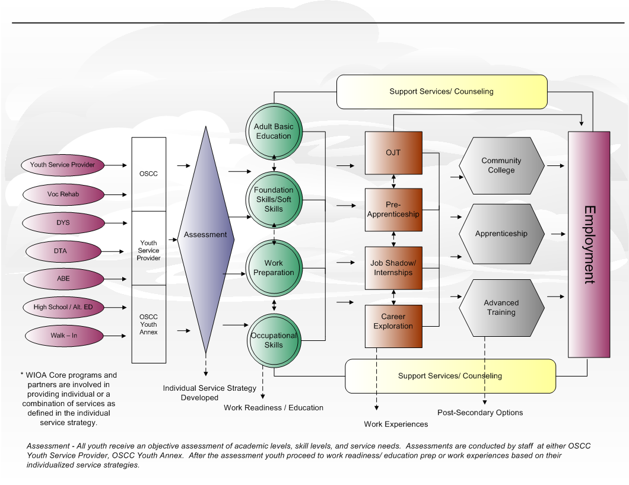
Youth Career Pathway & Customer Flow Model
GOAL: Increase credentialing and job placement outcomes for youth, including youth with barriers to employment.
Notes:
In general youth services are individualized. This youth customer flow model is a high level visual (framework) that local areas and partner agencies can use to understand how youth access WIOA program services and the type of program services they receive.
· Referrals are made from Partner programs, word of mouth, schools, CBO’s to:
o OSCC
o Youth Career Center
o Youth Services Provider
· Eligibility determination is made
· Academic, occupational, interests, and skill levels are assessed
· Individual Service Strategy developed based on results of assessments- needs are identified and short/long term goals are set
· Youth receive services based on need and goals – enrollment in program service elements such as alternative ed., work experiences, etc.
· Staff work with local partners to align additional programs and services
· Support services/ case management are offered to youth throughout their program enrollment

Slide 4
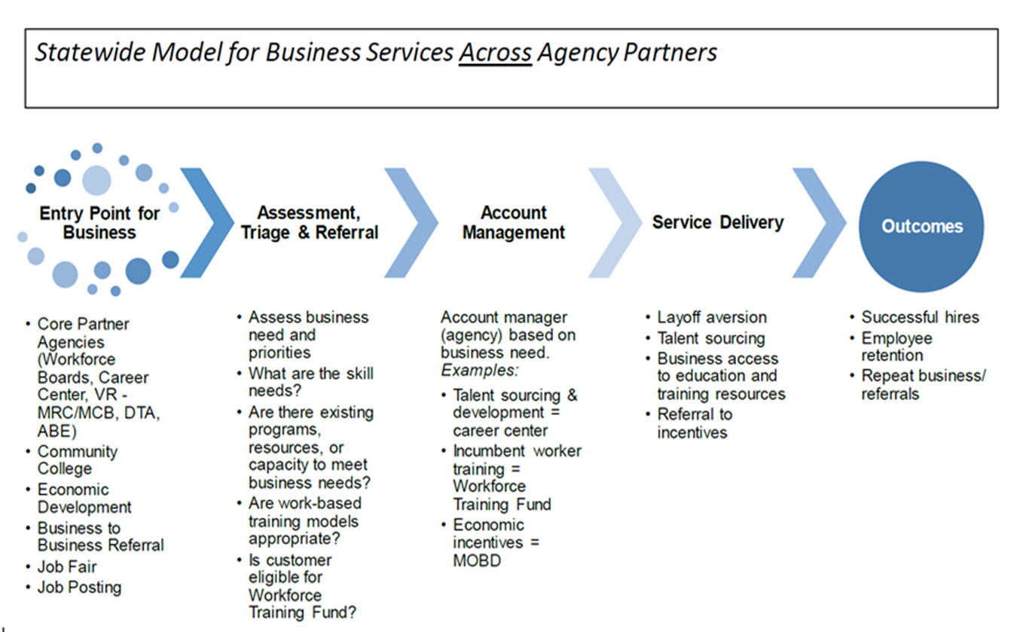
Business Customer Flow

Slide 5
Integrated Customer Flow
Massachusetts will utilize our statewide integrated, technology-based intake and case management information system as the main entry portal - JobQuest.
MA is in the process of designing and implementing a common intake/registration application with real-time triage processes that feature strong skills and transferability assessments, job matching and job referral, common career planning and reporting systems across all partners.
All staff utilize this system and common customers (both job seekers and business).
It is imperative to our ability to strengthen the consistency and quality of services provided by the system to job seekers and businesses.
Notes:
-WorkForce Connect: This system will support an upfront common intake/registration application and case management tracking system.
Utilization of one system allows ease of tracking customers whether they partake in services in the Berkshires one week and Boston another.

Slide 6
Common Customer Flow
RESEA CUSTOMER
TAA CUSTOMER
Receive Notification To Report To Career Center
Front Desk Sign In & Register On JOBQUEST
Attend Career Center Seminar
INITIAL RESEA Meeting: Receive Assessment (intro and incorporate tools) Develop Career Action Plan Receive Labor Market Information Receive U.I. Eligibility Assessment Review Work Search Activity Logs & Resume Sign Training Opportunities (TOP) and TAA Acknowledgement Receive Referral To An Additional Career Center Service
Attend 1st Career Center Service Referral
RESEA REVIEW Meeting: Receive more in depth Assessment Develop Career Action Plan Review Labor Market Information Receive U.I. Eligibility Assessment Review Work Search Activity Logs & Resume Receive Referral To An Additional Career Center Service
Attend 2nd Career Center Service Referral
Receive Notification To Report To Career Center
Front Desk Sign In & Register On JOBQUEST
Attend Career Center Seminar
INITIAL Meeting: Receive Assessment (intro and incorporate tools) Develop Career Action Plan Receive Labor Market Information File TAA eligibility Application (MA Form 1666) Receive U.I. Eligibility Assessment Review Work Search Activity Logs & Resume Sign Training Opportunities (TOP) and TAA Acknowledgement (review TAA benefits, if eligible) Receive Referral To An Additional Career Center Service
Attend 1st Career Center Service Referral
Second Meeting: Receive more in depth Assessment Develop Career Action Plan Review Labor Market Information Review Work Search Activity Logs & Resume Receive Referral To An Additional Career Center Service More in depth conversation regarding TAA benefits
Attend 2nd Career Center Service Referral

Slide 7
WIOA Career Services
WIOA Career Services – interwoven throughout our Customer Flow Model
Eligibility for services
Outreach, intake, orientation
Initial assessment
Labor exchange services
Referrals to programs
Labor market information
Performance and cost information
Supportive services information
Information on UI
Financial aid information
Follow-up services
Comprehensive assessment
Individual employment plan
Career planning, counseling
Short‐term prevocational services
Work experience (internships)
Out-of-area job search
Financial literacy services
English language acquisition
Workforce preparation
✓ Comprehensive
assessment
✓ Individual
employment
plan
✓ Career
planning,
counseling
✓ Short--‐term
prevocational
services
✓ Work
experience,
internships
✓ Out--‐of--‐area
job
search
(WIOA
Does
Not
Include:
“Case
management
for
participants
seeking
training
services”)
Notes:
Red are the keys to our customer flow:
Intke-Job Quest-ensures portal for looking for work and assists with building a database of talent
Orientation-all CC deliver a CCS-allows customers to have an overview of all services at the local CC-state set framework – locals make their own
An initial assessment is key to assisting the customer to understand next steps based on their wants and their needs
LMI-key to assisting the customer to understand where they are at-start building a plan-know what decisions they need to start to make
TRIAGE

Slide 8
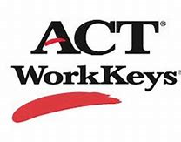
Assessment Tools
Information is gathered not only through conversation, but also assessment tools.
Burning Glass: NEW January, 2018, EOLWD/DCS contracted with this local company for the use of their Labor Insight tool and for a feed of open job orders to our JobQuest system.
TORQworks’: a patented TORQ algorithm ranks alternative occupations based on transferable skills from a client’s individual work experience across multiple occupations, presented with all the key data required to make informed decisions in a job search.
Career Readiness 101: an internet-based comprehensive, easy-to-use curriculum to help individuals master work readiness skills they need to be successful in a changing workplace. It incorporates tools and activities for identifying career interests, developing a resume, creating and managing a personal budget and exploring careers through job shadowing and mentoring.
Triage is the key
Utilize the information provided by the customer and know how to ask the right questions

Slide 9
Job Ready Team v. Training Team
Job Ready
Focus on getting a job-resume, workshops
Education and experience are marketable
Current and in demand skills
Labor Market Information supports education, experience and skills in demand
What skills do I need to update?
Labor Market Information supports need to update education, experience and skills to compete
What programs can assist me with the cost?
What supports are available?
Skill Development

Slide 10
Results
AT THE END OF THE DAY……..
THE RESULTS BOTH TEAMS WANT

