Slide 1

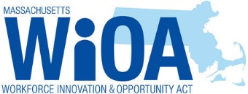
Massachusetts  Puerto Rico
National Peer-to-Peer
Technical Assistance and Training
Workforce Innovation and Opportunity Act &
Combined Plan
At-a-Glance
Alice Sweeney, Director DCS
March 5 - 7, 2018

Slide 2
Agenda
MA WORKFORCE SYSTEM GOVERNANCE
MA WORKFORCE SYSTEM INTEGRATED SYSTEM FUNDING
CURRENT LANDSCAPE OF THE MA WORKFORCE SYSTEM
WIOA IMPLEMENTATION
WHAT HAS HAPPENED
COMBINED PLAN VISION
IMPLEMENTING THE COMBINED PLAN
WHAT’S NEXT FOR WORKFORCE SYSTEM
BRANDING THE WORKFORCE SYSTEM

Slide 3
MA Workforce System Governance – National
President
U.S. Secretary of Labor
US Department of Labor (DOL)
Employment & Training Administration (ETA) & Veteran Employment and Training Services (VETS)
Appoints
Region I
USDOL/ETA & VETS
GOVERNOR
Oversight
EOLWD/DCS

Slide 4
MA Workforce System Governance - State
GOVERNOR
MA Workforce Development Board (State Board)
(51% Private Sector Majority- Required and Membership make-up federally regulated)
EOLWD provides staff to the State Board
EXECUTIVE OFFICE
OF
LABOR AND WORKFORCE DEVELOPMENT
(EOLWD)
Appoints
STATE BOARD
DEPARTMENT
OF
LABOR STANDARDS
DEPARTMENT
OF UNEMPLOYMENT ASSISTANCE
DEPARTMENT
OF
CAREER
SERVICES
COMMONWEALTH
CORPORATION
DEPARTMENT
OF
INDUSTRIAL
ACCIDENTS
DEPARTMENT
OF
LABOR
RELATIONS
Oversight
MA Workforce Development System
WDBs/Career Centers

Slide 5
MA Workforce System Governance - Local
GOVERNANCE
Chief Elected Official (CEO) (Grant Recipient)
LOCAL
WORKFORCE
DEVELOPMENT BOARD
(Local Board)
(51% Private Sector
Majority-Required Membership make-up federally regulated)
*Local Board may hire Staff for support
**CEO may appoint a fiscal agent
One-Stop
Career Center
(LEAD OPERATOR)
APPOINTS
BUSINESS
Core Partners
DCS – DUA – MRC – MCB – ACLS – DTA - SCSEP
Other Local Partners
MOBD
DVS
HIGHER EDUCATION
VOCATIONAL EDUCATION
LOCAL COMMUNITY BASED ORGANIZATIONS
BUSINESS ASSOCIATIONS
DCS = Department of Career Services (WP, WIOA, JVSG, TAA, RESEA) DUA = Department of Unemployment Assistance (UI, RESEA, TRA )
MRC = MA Rehabilitation Commission MCB = MA Commission for the Blind ACLS = Adult Center for Learning Services
DTA = Department of Transitional Assistance = TANF, SNAP SCSEP = Senior Community Services Employment Program
MOBD = MA Office of Business Development DVS = MA Department of Veteran Services

Slide 6

Integrated Workforce System Funding
Reemployment
Services
Eligibility
Assessment
WIOA
Title I
Adult
State Partners negotiating and providing guidance on operating costs (Shared and Infrastructure)
Trade
Adjustment
Assistance
(TAA)
WIOA
Title I
Youth
DUA
WIOA Title I
Dislocated
Worker
Local Board
Career
Center
DESE
State Funding
DOL Funding DCS/DUA
DESE – ABE/ESOL Funding
MRC & MCB - Rehab Funding
DTA – TANF/SNAP Funding
SCSEP Funding
MRC & MCB
WIOA
Federal Discretionary
Dislocated
Worker Grants
(DWG)
DTA
Wagner
Peyser
Employment
Services
SCSEP
Jobs for Veteran
State Grant
(JVSG)
State
Funding

Slide 7
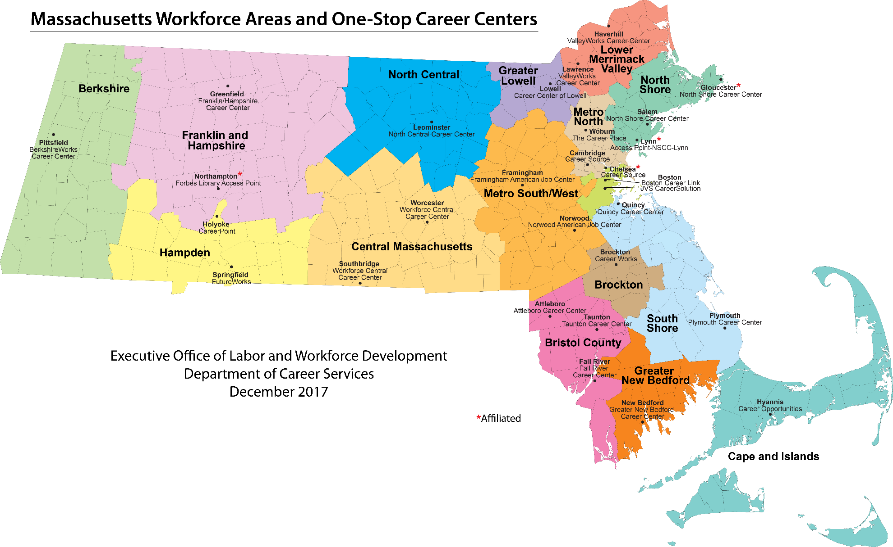

Current Landscape MA Workforce System
16 Workforce Development Areas & Boards
29 Career Centers
  25 Comprehensive Centers (full service)
  4 Affiliated Centers or Access Points (limited service)

Slide 8
WIOA Implementation
JULY 22, 2014 - PRESENT
WIOA
July 2014 Enacted
Combined
State Plan
Draft
November 2015
Implementation Phase:
Technical Assistance & WIOA State Policy Guidance for local areas
April, 2016 –
On-going
Lead Operator
In Place
Local Signed
Umbrella
MOU
July 1, 2017
MWIB
Establishes
WIOA Steering Committee
October, 2014
Steering Committee &
Workgroups
October, 2014 – November, 2015
Final Rules
Enacted
August, 2016
Provisions
Take Effect
July 2015
*ETPL
*Eligibility
Submission of Combined State Plan
March, 3, 2016
Adjusted
April 1, 2016
DOL Final Approval
October, 2016
Policy & Planning in Regional Local Areas
April, 2017 -
March, 2018

Slide 9
Massachusetts What Has Happened?
Hundreds of partners across systems and across the state engaging in ideas – dropping sterotypes and turf at the door, hitting the reset button - to shift the collective system and partner together
Launched new regional planning process (7 regions) to focus on talent shortages in regions and data analysis of critical career pathways in region
Completed procurement of One Stop Career Center operators, now 29 Centers statewide
16 Signed Umbrella MOUs focused on WIOA priority populations (shared resources and infrastructure)
Re-designed adult education (Title II) procurement process focused on career pathway vision and partnership across systems
NEW, nationally recognized partnership between Department of Transitional Assistance and One-Stop Career Centers serving 1,440 customers since May, 2017 462 in FY17 and 978 to date in FY18
NEW pilots and integrated services with UI, Career Centers, SCEP, adult education, TANF/SNAP, and Vocational Rehabilitation for adults and youth
NEW data metrics and data sharing agreements to evaluate employment and wage impacts across WIOA partners

Slide 10
Massachusetts Combined Plan Vision
    All Massachusetts residents will benefit from a seamless system of education and workforce services that supports career pathways for individuals and leads to a more informed, educated, and skilled workforce, which meets the Commonwealth’s businesses’ demands and sustains a thriving economy.

Slide 11
Implement the Combined Plan
Submit Regional Plan
  Use Labor Market Information to Inform Plan and MOU Process
Strengthen Local Umbrella MOUs
  Strengthen Business Driven Strategies to meet Business Customer Needs
  Strengthen Customer Flow and Career Pathway processes for Adult and Youth Across Partner Customer Populations
Branding the Workforce System
  All Strategies Identified in Above Process Determines the Local Product Behind the Brand

Slide 12
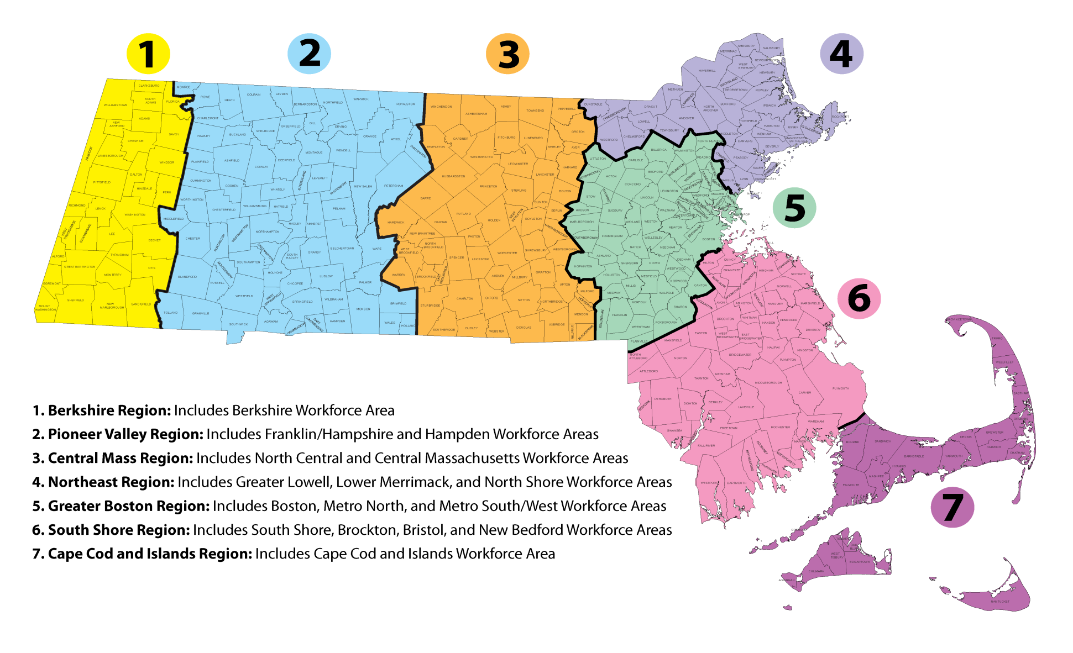
Massachusetts
GOAL: Align economic, workforce and education systems to coordinate systems based on skill needs in regions.

Slide 13
Labor Market – Workforce Information
GOAL: Develop a state of the art Labor Market and Workforce Information (LMWI) system by which timely and accurate information is provided to consumers, and from which a customer service focus ensures that the workforce partners, economists, researchers, businesses and job seekers have the support they require in accessing labor market and workforce date, not just within MA but nationwide.
Conduct a redesign of the EOLWD LMI website
Support Boards and Partners in ability to provide LMWI to customers
Establish a reliable LMWI product line of data resources that addresses stakeholder needs
Expand access to and develop additional sources of information LMWI and economic data
Engage LMWI partners in forward thinking discussions and innovative project collaborations

Slide 14
Regional Planning
Established Regional Breakdown
Governor, Lt. Governor and Secretariat Lead Kick Off - April 5, 2017
Partners Involved in Regional Planning
  Labor and Workforce Development, Economic Development & Education
Presentations of Plans to Workforce Skills Cabinet (WSC ) – December 11, 2017
Blue Prints due to WSC – January 31, 2018
WSC & Public Comment Period – No later than March 2, 2018
Final Regional Blueprint due – March 31, 2018

Slide 15
Business Services
GOAL: Strengthen Business-Driven Strategies to meet Business Customer Needs. Business-Driven builds upon our prior job seeker model but represents a significant change in our labor exchange philosophy. We must “flip” the model to start with business demand – first.
DD1.0 – SUPPLY DRIVEN (WIA)
Recruitment Solutions Initiative– DEMAND DRIVEN (WIOA)
Job Counselor
Concentrates on Job Seekers Interest, Skill Needs
Job Seeker
Review job listings and sends resumes (self-referral)
Company
Hopes for Interview
Hire / No Hire
Business Service Representative
Reaches out to Business
Post Job Opening in JobQuest
JobQuest
Business Service Representative
Reaches out to Business
Identify Job Openings/ Analyze Hiring Need
Job Counselor & Business Service Representative
Identify OSCC Job Seekers Candidates
Vet Candidate Qualifications and Referral to Company
Company
Interviews
Hires

Slide 16
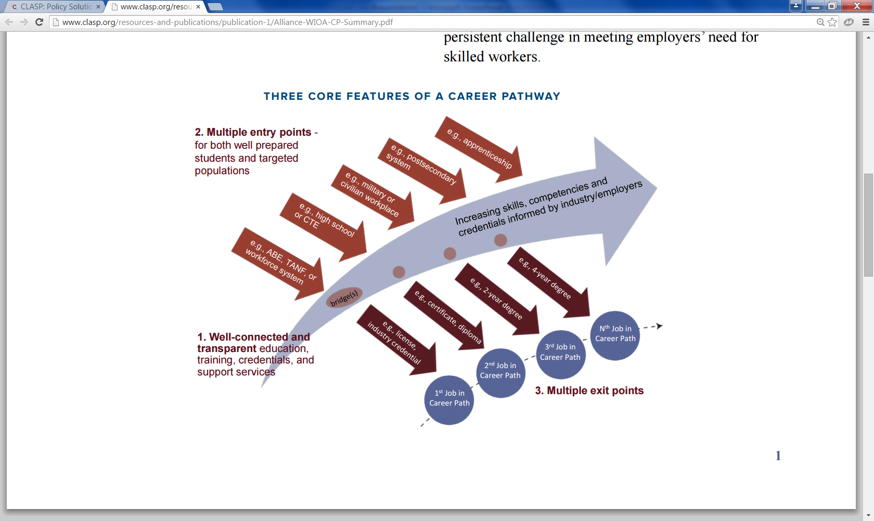
Integrated Service Design: Person-Centric
GOAL: State and Local MOUs are designed around a “career pathway” approach based on customer perspective, not focused on the operations of funding streams.
CLASP GRAPHIC: http://www.clasp.org/resources-and-publications/publication-1/Alliance-WIOA-CP-Summary.pdf

Slide 17
Adult Job Seeker Customer Flow Model
GOAL: New statewide customer flow to manage individuals from various referral sources who are triaged based on new, intensive skill assessment tools to Job Ready and Skill Building Teams within the Career Center.

Slide 18
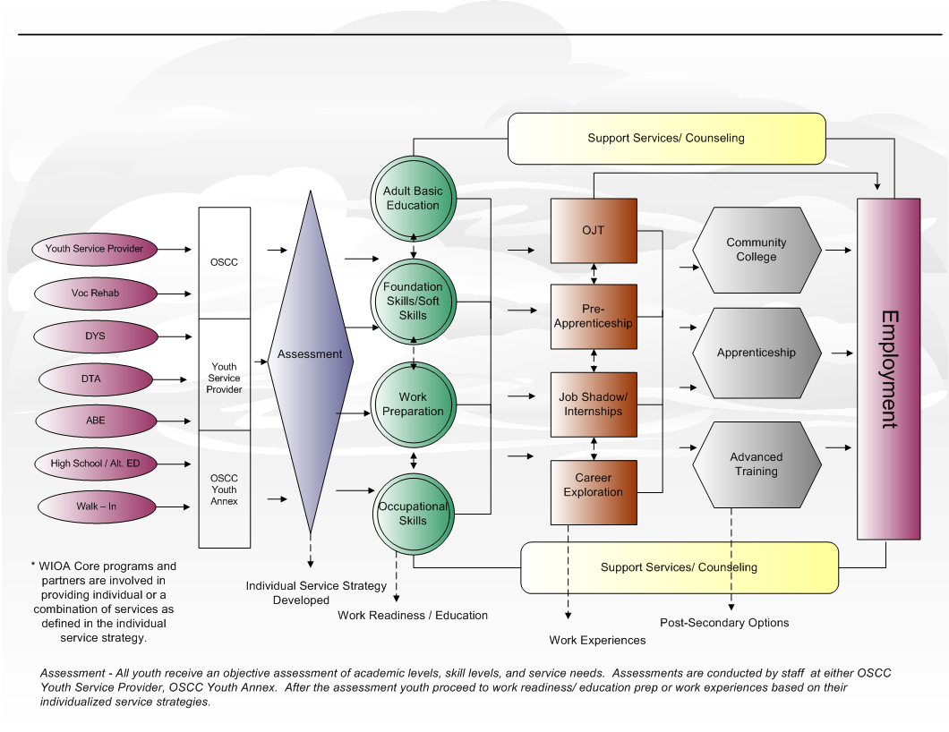
Youth Career Pathway & Customer Flow Model
GOAL: Increase credentialing and job placement outcomes for youth, including youth with barriers to employment.

Slide 19
What’s Next
Final Regional Blueprint due – March 31, 2018
Updating the Local Umbrella MOUs
Career Center Certification
Workforce Development Board Certification
NEW automated integrated registration process partners working together to develop automate process that will provide customers and staff with a dashboard of services for both job seeker and business customers
Brand Implementation
MWIB
Establishes
WIOA Steering Committee
October, 2014
Steering Committee &
Workgroups
October, 2014 – November, 2015

Slide 20
Common Intake Integrated Systems
Design and develop common intake & registration process for shared customers
Shared data through automation – Workforce Connect
Business and Job Seeker Dashboards made available
MWIB
Establishes
WIOA Steering Committee
October, 2014
Steering Committee &
Workgroups
October, 2014 – November, 2015

Slide 21





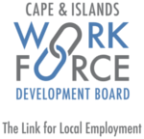







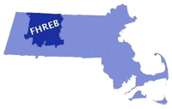

















Branding the Need
Businesses and jobseekers lack awareness of the depth, breadth, and interconnectedness of public workforce resources available in the Commonwealth.
Inconsistent branding permeates state, regional, and local workforce systems.
Internally, workforce system employees lack common organizational culture and do not feel like part of a unified system.
Executive Office of Labor and Workforce Development

Slide 22
The New Brand Will
Communicate the depth, breadth, and connectivity of our workforce system to multiple audiences
Capture a joint mission and vision of the Massachusetts public workforce system
Provide a visual and cultural unification of the Massachusetts workforce system
Improve visibility and understanding to jobseekers and employers
Lead to an increase in interactions with jobseekers and employers
Lead to improved morale, accountability, and performance among employees

Slide 23



Brand Architecture Recommendation – Phase II
One dominant brand name
Regional Workforce Development Boards
have geo-locators and consistent
naming structure
Local Career Centers have geo-locators and
consistent naming structure
Partners are co-branded; events and programs are endorsed
Executive Office of Labor and Workforce Development

Slide 24
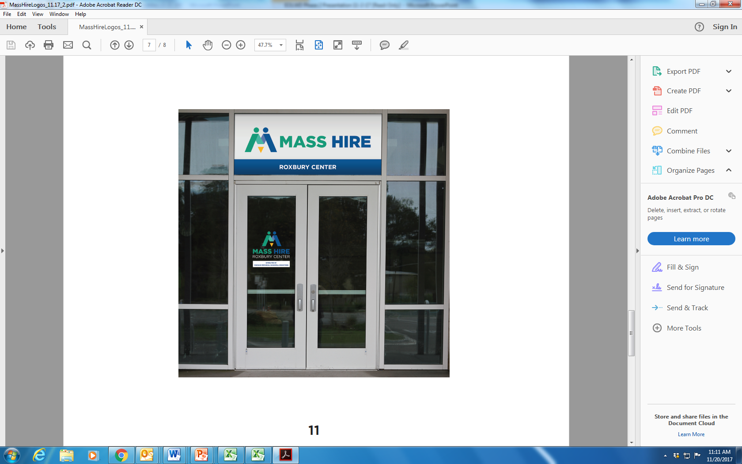
Signage Example

Slide 25


Product Behind the Brand
Collaboration
believes in the power of partnership and streamlined integration of services to achieve
effective and timely results for those we serve.
Respect
is committed to understanding and valuing the diverse, unique requirements and
professional goals of the businesses and people we serve.
Reliability
creates trust and reliability by consistently delivering high quality professional Services
at each location and in every interaction.
Ingenuity
leverages flexibility, expertise, and knowledge to successfully meet our mission,
regardless of new challenges and circumstances.

