Slide 1

Supporting a Commonwealth of Communities
New Officials Finance Forum
June 7, 2018

Slide 2
Mission
The Division of Local Services (DLS) provides:
  Technical Assistance
  Training
  Oversight to assist Massachusetts cities and towns in the achievement of sound and efficient fiscal management
DLS is responsible for:
  Ensuring the fairness and equity of local property assessment and taxation
  The accuracy and quality of local accounting and treasury management
  Interpreting state laws that govern local finances
  Distributing local aid
  Maintaining a comprehensive databank on local finances
DLS Offices are located in Boston, Worcester and Springfield

Slide 3
Executive
Coordinate trainings and workshops for local officials:
    Course 101 Assessment Administration
    New Officials Finance Forum
    “What’s New in Municipal Finance Law”
    Regionalization Conference
    Tax Rate and Property Valuation Certification Workshops
    On-site Trainings
City & Town e-newsletter is published twice monthly and distributed electronically to nearly 9,000 local and state officials. This newsletter includes articles and fiscal analyses on topics of interest to local officials.
Public Information Requests

Slide 4
Bureau of Accounts
Oversight of municipal financial management through:
    Tax rate certification
      Certified $28.4B statewide in municipal financing for FY18
    Free cash certification
      The calculation of free cash is based on the balance sheet as of June 30th
      FY18 Free Cash certified in excess of $1.7B
      345 Communities
    Review and approval of Balance Sheet, Schedule A and Audits
Each community is assigned a BOA field representative

Slide 5
Technical Assistance Bureau
Provides FREE guidance and advice to cities and towns on opportunities to improve their financial management operations
  Develop and circulate best practice resources and tools
  Promote strategic, long-term thinking and emerging innovations
  Encourage performance, accountability, and internal control standards
  Connect community leaders, managers, and administrators
  Facilitate regionalization and shared services efforts among communities

Slide 6
Bureau of Local Assessment
Responsible for regulation and oversight of real and personal property assessment, valuation, and certification
Property value certification every five years
  2016 Equalized Valuation (EQV) (fair cash value of all taxable property in the Commonwealth as of 1-1-16) - $1.104T
  Largest value – Boston - $141.8B
  Smallest value – Monroe - $26.04M
New Growth Certification
  New construction, personal property and other growth in the tax base
  FY18 Growth – $19.8B certified in new growth; $335M in new taxes
Each community is assigned a BLA field advisor

Slide 7
Municipal Data Management/Local Aid
Provide free access to the municipal financial and demographic data collected by DLS, including the Municipal Finance Trend Dashboard
Develop and maintain Databank website including reporting tools to facilitate analysis, trending and comparisons of financial, property tax, assessment and socioeconomic data
Work in conjunction with DLS IT to maintain, develop and enhance DLS Gateway application modules
Manage preparation and posting of annual Cherry Sheet estimated receipts and assessments based on state budget recommendations to the Municipal Databank website
Prepare and distribute $6 billion in total local aid payments to municipalities, regional schools and charter school districts on a monthly basis

Slide 8
Municipal Finance Law
Serves as legal counsel to DLS
Provides legal and technical assistance to state and local officials on municipal finance and taxation issues
Develops DLS legislative proposals and reviews municipal finance law legislative proposals
Issues Bulletins, Information Guideline Releases (IGR’s) and Local Finance Opinions (LFO’s)

Slide 9
IT Section
Enhance the flow of information between DLS and cities and towns in the Commonwealth
Gateway application:
  All BLA and BOA forms submitted by cities and towns are online for direct data entry, review, retrieval, signing and submissions by authorized officials at the local level
  Ongoing Gateway enhancements
  Maintains the Local Officials Directory

Slide 10
Community Compact Cabinet
Community Compact Cabinet (CCC) strives to incentivize best practices at both the state and local level
Improves state-municipal relations by having state agencies work better with and for municipalities
Works to better coordinate and leverage state resources available to cities and towns

Slide 11
Contact
Sean R. Cronin
croninse@dor.state.ma.us
617-626-2381

Slide 12
Municipal
Management

Slide 13
Municipal Mix & Match
Identify which office(s) in the left column performs each of the duties listed in the right column
Accountant/Auditor
Assessors
City Council
Clerk
Collector
Finance Committee
Mayor/City Manager
Selectmen
Town Meeting
Treasurer
___ Records all votes of the legislative body
___ Authorizes debt
___ Manages the community’s money
___ Approves all transfers from the reserve fund
___ Prepares and submits the annual budget recommendations
___ Administers the motor vehicle excise
___ Reviews vendors bills to ensure that they are lawful expenditures
___ Makes appropriations
___ Retains all municipal contracts
___ Prepares the annual Tax Rate Recapitulation Sheet
___ Chooses an audit firm to conduct the annual town audit
___ Signs debt issues in towns
___ Pays vendors after proper authorization
___ Monitors municipal spending to ensure that departments are within their budgets
___ Notifies DOR of any votes to incur debt
___ Issues municipal tax lien certificates

Slide 14
Municipal Management
Selectmen/Mayor/City Manager
City Council/Town Meeting
Finance Committee
Assessors
Collector
Treasurer
Accountant/Auditor
Clerk

Slide 15
Selectmen/Mayor/City Manager
Oversees Finances
Appoint Employees
Sign Debt
Decide Tax Policy (Town)
Call Town Meetings
Prepare Budget (City)

Slide 16
City Council/Town Meeting
Makes appropriations
Adopts Budget
Authorizes Debt
Enacts Ordinances/Bylaws
Decides Tax Policy (City)

Slide 17
Finance Committee
Makes Budget Recommendations
Approves Reserve Fund Transfers
Approves Year End Transfers

Slide 18
Assessors
Prepare Property Database
Value & Classify Property
Submit Tax Rate Recapitulation
Commit Taxes
Grant Abatements and Exemptions
Administer Excises

Slide 19
Collector
Bills & Collects Taxes
May also be designated “City” or “Town” Collector, which authorizes the tax collector to also collect other non-tax receivables due the city or town

Slide 20
Treasurer
Deposits, Invests & Distributes Money
Issues Debt
Manages Tax Titles and Foreclosures
Administers Payroll

Slide 21
Accountant/Auditor
Keeps Contracts (Town)
Maintains Finance Records
Prepares Finance Reports
Monitors Spending

Slide 22
Clerk
Keeps Contracts (City)
Maintains Records
Conducts Elections

Slide 23
Municipal Mix & Match
Identify which office(s) in the left column performs each of the duties listed in the right column
Accountant/Auditor
Assessors
City Council
Clerk
Collector
Finance Committee
Mayor/City Manager
Selectmen
Town Meeting
Treasurer
_D_ Records all votes of the legislative body
C, I_ Authorizes debt
_ J_ Manages the community’s money
C, F Approves all transfers from the reserve fund
F,G,H Prepares and submits the annual budget recommendations
_B_ Administers the motor vehicle excise
_A_ Reviews vendors bills to ensure that they are lawful expenditures
C, I_ Makes appropriations
A, D Retains all municipal contracts
A,B,D Prepares the annual Tax Rate Recapitulation Sheet
_H_ Chooses an audit firm to conduct the annual town audit
D,H,J Signs debt issues in towns
_J_ Pays vendors after proper authorization
_A_ Monitors municipal spending to ensure that departments are within their budgets
_D_ Notifies DOR of any votes to incur debt
_E_ Issues municipal tax lien certificates

Slide 24
The Assessors Role
in the
Tax Billing Process

Slide 25
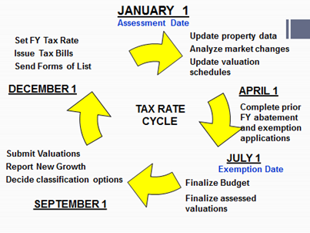

Slide 26

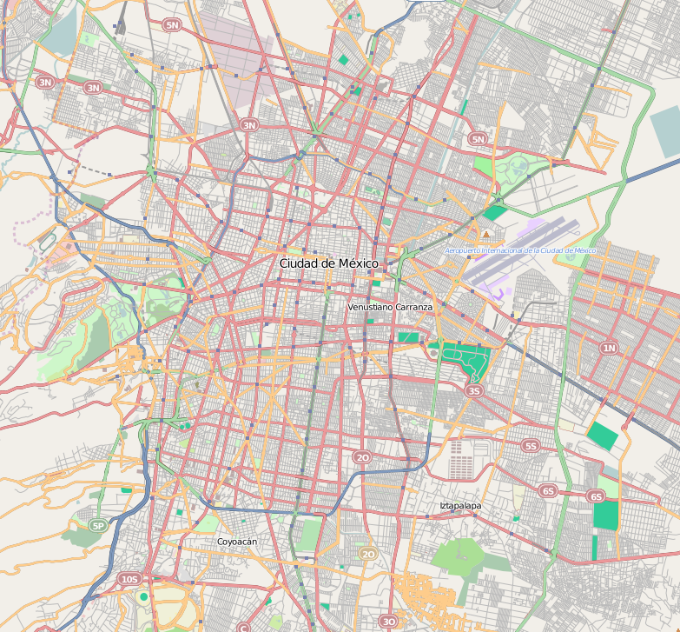
Common Assessors Tasks
Accurate property descriptions
Accurate assessing maps
Assessments based on “full and fair cash value
“Classification” code for each property

Slide 27

Database Maintenance
Real Estate market is dynamic
Values “as of” January 1
Property descriptions are also dynamic
      Property descriptions “as of” January 1

Slide 28
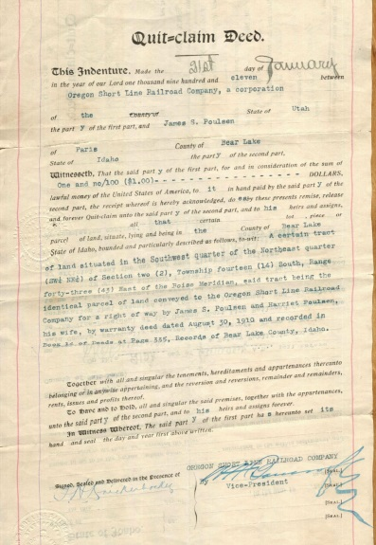

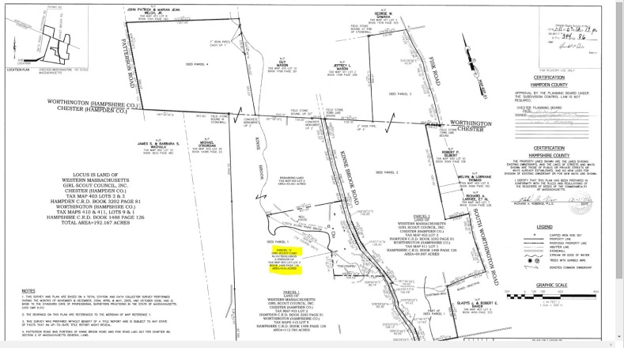

Database Changes
Deeds – up to January 1
Field review of sales
Building permits
Cyclical inspections
Lot Splits
Use changes
Abatements

Slide 29

Map Maintenance
Assessing maps need to be updated “as of” January 1.
  Computerized maps
  GIS (Geographic Information System)

Slide 30

Valuation
For “mass appraisal”, the statistical analysis of the sales is the basis for the valuation of other (unsold)
properties.

Slide 31

Sales Review
Sales Verification
  An on-going investigation
  Analysis only includes “arms-length” sales
Field Review of Sales
  Accurate description of all sales

Slide 32
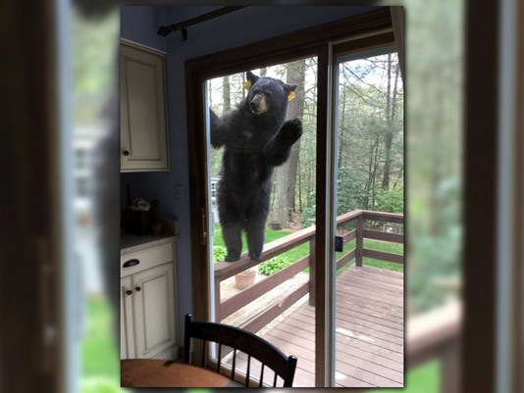
Field Review

Slide 33
Sales Analysis - ASR
Assessment Sales Ratio Studies (ASR) are a statistical tool used to measure “full and fair cash value”.

Slide 34
Sales Report
Assessors annually submit a sales report called an “LA3”
  The LA3 is used to compare assessments to the market sales

Slide 35

Proposed Assessments
  Submit LA4 Report
    Values by Class Code
  Certification Review
    Now every 5 years
  Annual Interim Year Review

Slide 36
New Growth
Proposition 2 ½ allows a municipality an annual increase of 2 ½ percent to the levy limit.
Above and beyond that 2 ½ percent, an additional increase to the levy limit is permitted based on the valuation of new construction and other increases to the tax base that are not attributed to market value changes.

Slide 37
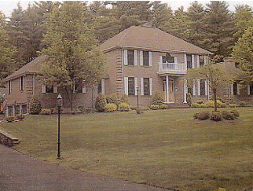
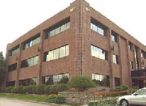
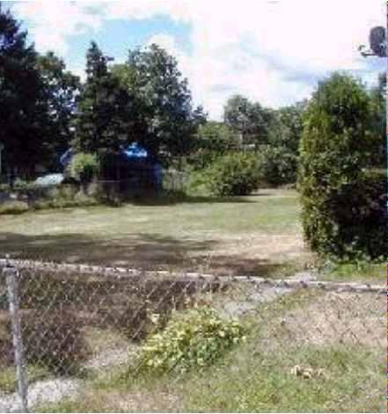
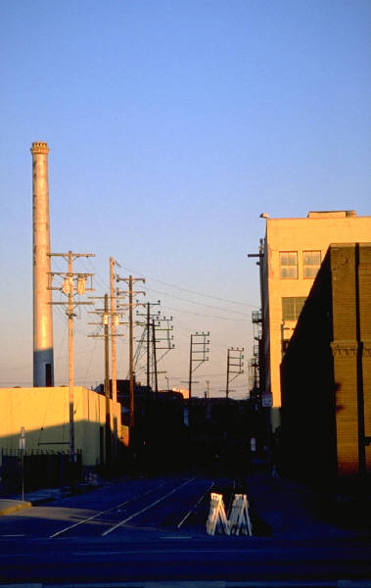
Classes of Real Property
Residential
Commercial
Open Space
Industrial

Slide 38

Classification Hearing
Single or Split Tax Rate
Open Space Discount
Residential Exemption
Small Commercial Exemption

Slide 39

Tax Bills
Tax Abatements
Appellate Tax Board
Statutory Exemptions

Slide 40
Tax Billing Process
January 1
Database and Tax Map Maintenance
Valuation
Classification
Abatements
and Exemptions

Slide 41
Municipal Budgeting

Slide 42
Introduction
Municipal Budget
Translates community needs and priorities into services
Provides short- and long-term fiscal context to guide decision-making
Derives from a transparent, deliberative process that informs the public
Serves as a community’s single most important policy document
Is more than simply matching revenues to expenditures
Represents the intersection of all aspects of municipal finance

Slide 43
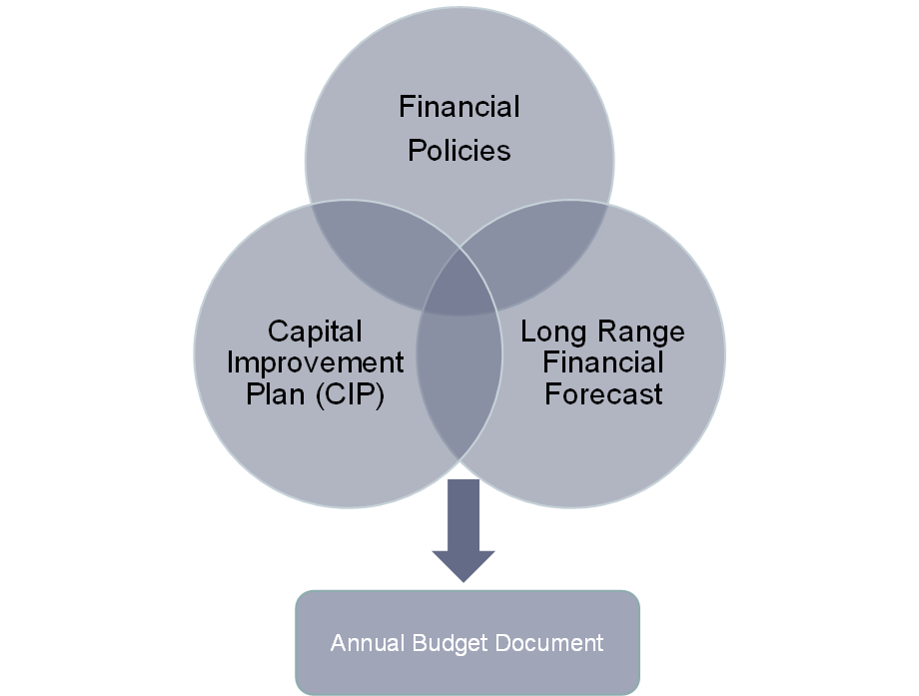
Essential Concepts

Slide 44
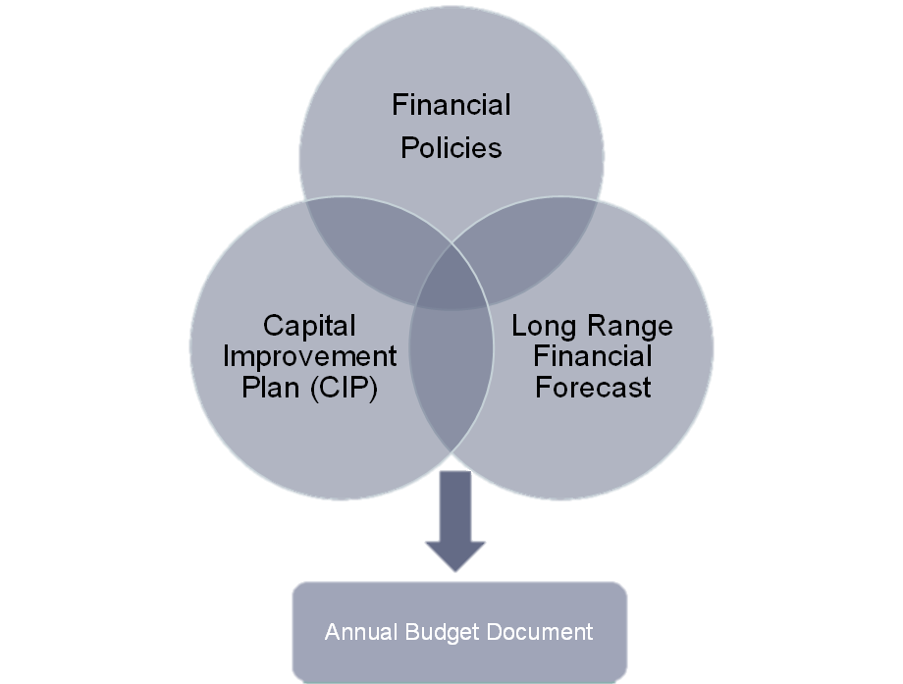
Financial Policies
Reduce uncertainty
Funding priorities
Revenue allocation
Structure financial planning
Identify stakeholders
Define roles & responsibilities

Slide 45
Core Policies
Financial Planning
Capital Planning
Forecasting
Financial Reserves
Use of Free Cash
Debt Management
Investments
OPEB
Enterprise Indirect Costs
Financial Operations
Reconciliations
Tax Enforcement
Revenue Turnover
Antifraud
Procurement

Slide 46
Capital Planning Policy
Define capital project
Assign responsibility
Outline process
Establish selection criteria
Identify capital financing strategy
  Debt vs cash
  Capital spending as % of annual revenue
Debt Maturity

Slide 47
Forecasting Policy
Project fiscal impact
  Policies
  Programs
  Capital needs
Establish as part of budget process
  Assign responsibility
    Town Manager/Admin
    Finance Committee
    Board of Selectmen
    Mayor
    City Council
Set Revenue Guidelines
  Use: one-time, reserves
  Be conservative
Set Expenditure Guidelines
  Level-funded vs level-service
  Community-specific priorities

Slide 48
Capital Improvement Plan
Maintain community assets
Provide optimal service
Maintain and improve existing infrastructure
Identify and invest in future needs
Organize capital spending
Asset inventory
Prioritize project submissions
Five-year investment strategy
Set spending parameters
  Debt vs. cash
  % annual revenue

Slide 49
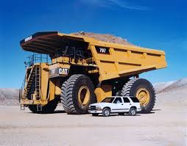
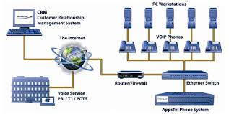
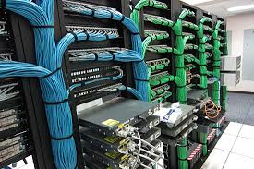
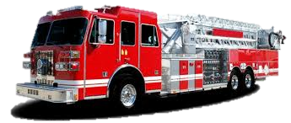

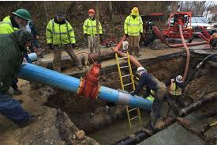

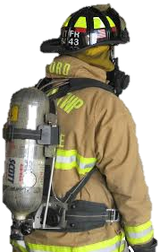
Capital Assets
Vehicles
Large Scale IT Infrastructure
Schools and Town Buildings
Road and Utility Infrastructure
Heavy Equipment

Slide 50
Asset Inventory
Identifier
Construction/acquisition date
Useful life (in years)
Physical description
Purchase Price
Replacement cost
Condition
Use type
Area for comment

Slide 51
Capital Project
A capital project will either acquire, construct, enhance, maintain, or rehabilitate a capital asset.
City/Town should establish definition via policy
  Dollar threshold – ex: $25,000 or more
  Minimum useful life – ex: Ten or more years
  Include purchase of supporting services
    Design/engineering
    Feasibility studies

Slide 52
Capital Improvement Plan
Multi-year strategy for financing capital projects
  Incorporates policy priorities
  Complies with CIP financing policies
  Integrated into financial forecast
  Ensures capital assets support base level of service
  Includes detail and summary of proposed projects:
    Description of project
    5-year breakdown of prospective project costs
    Funding source(s)
    Operating budget impact
    Stakeholders involved
    Benefit to residents

Slide 53
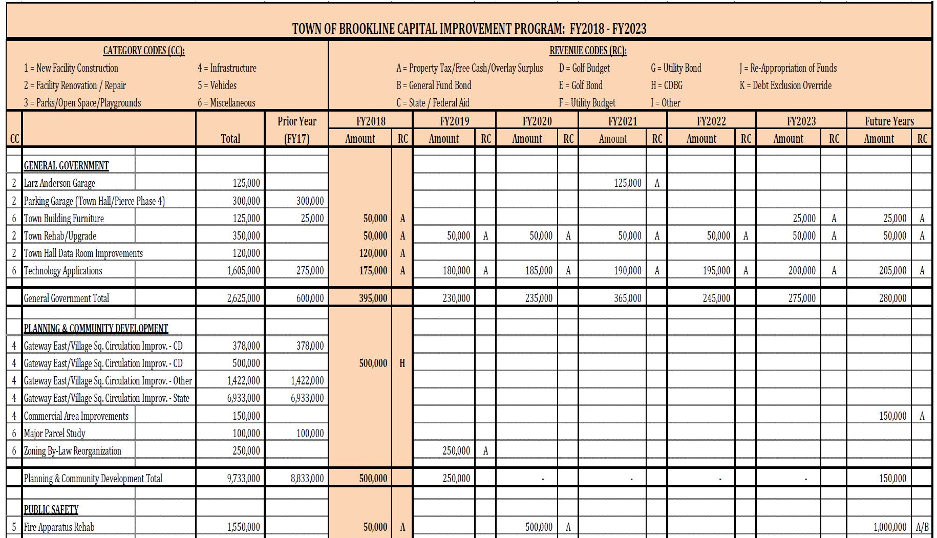
Capital Improvement Plan Summary

Slide 54
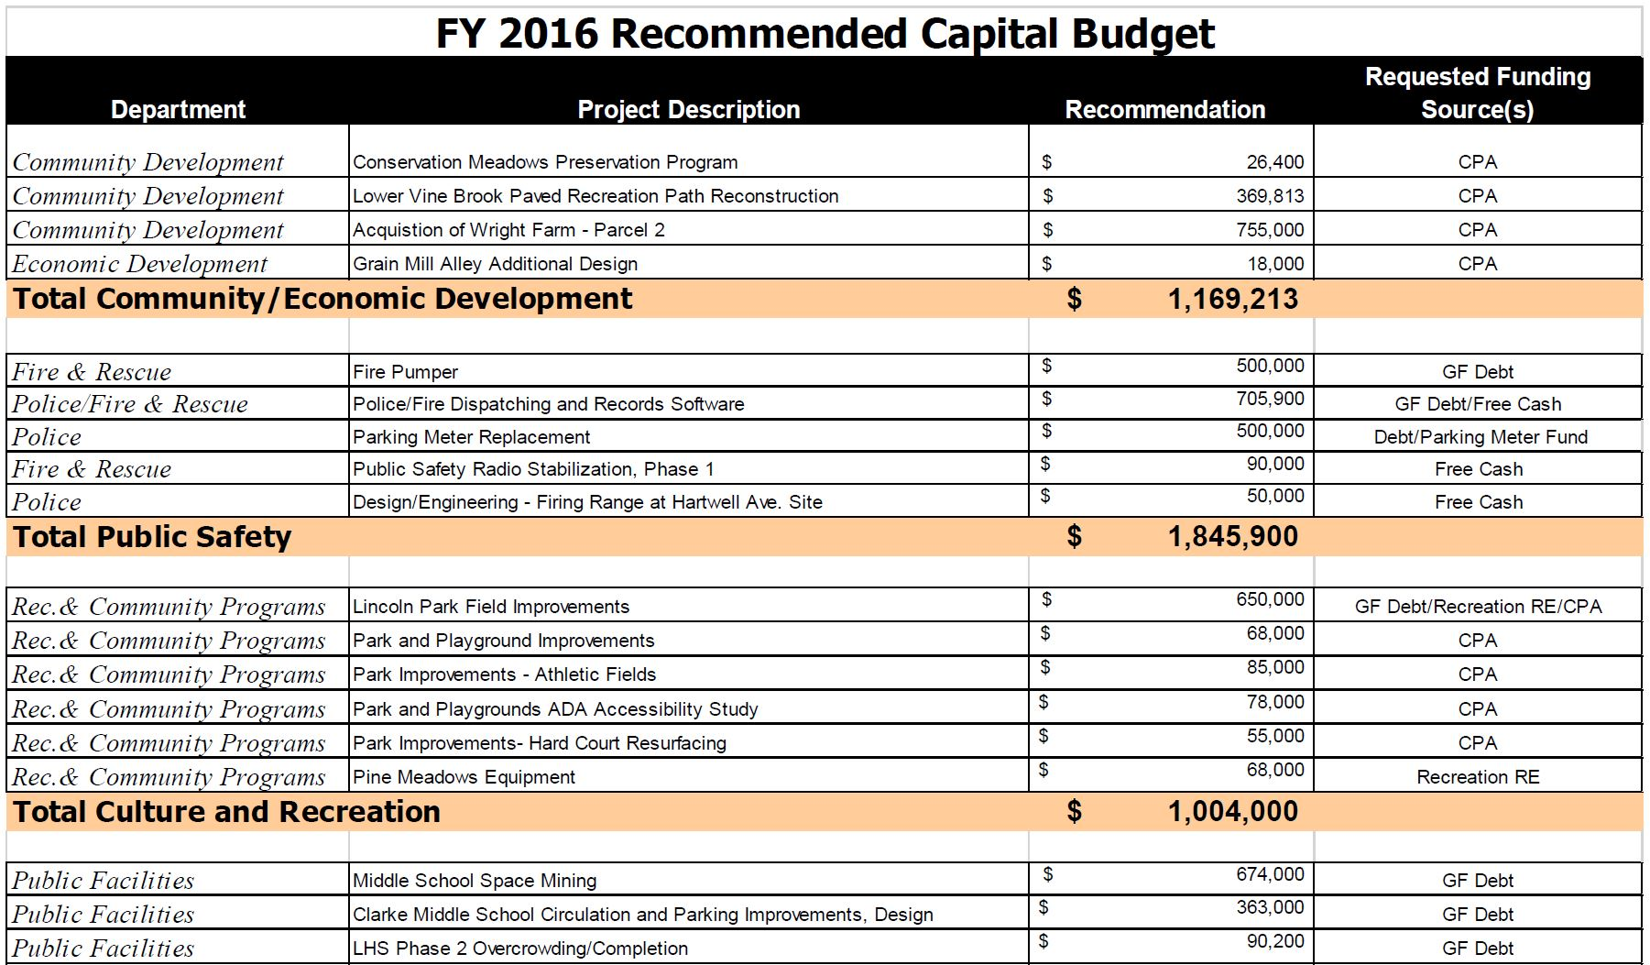
Capital Budget

Slide 55
Maintain a Steady Balance of Capital Investment
Track debt service as a percentage of revenue
Take on new debt as old is retired
Lack of reinvestment leads to lost capacity
Codify in capital planning policy
Debt Service at Current % of Revenue
Lost Investment Capacity
Existing Debt

Slide 56
Long Range Financial Forecast
Brings context to budget decisions
Determine fiscal condition: present and future
Implication of policies and capital needs
Financial planning tool
Project revenues and expenditures
Play out varying assumptions
  Trends, policies, future needs
Evaluate impact of budget choices
Make strategic decisions
  Program expansions
  Collective bargaining

Slide 57
Forecast Concepts
Revenue
Tax Levy
State Aid
Local Receipts
Available Funds
Enterprise Receipts
Expenditures
Employee Benefits
Insurance
Debt Service
State Assessments
Departmental Costs
Operating Budget
Policy Implications
Community priorities
Capital funding
Debt level
Stabilization fund
Free cash management
Collective Bargaining

Slide 58
Historical Revenue and Expenditure Data
Five Year Trend

Slide 59
Build Assumptions
Program Increases
Revenue trends
Policy Implications
Collective Bargaining
Capital Needs

Slide 60
Use Assumptions
Project Revenues and Expenditures Five Years
Projection

Slide 62
Annual Budget Document
Communicate financial plan
Financial policies
Revenues and expenditures
Departmental budget detail
Capital financing plan
Goals and Objectives
Highlight community priorities
Budget message
  Town Manager/Administrator
  Finance Committee
Long-term financial goals
Upcoming challenges

Slide 63
Budget Preparation
Document Components
Establish authority
Assign roles & deadlines
Set process
Allow for public review
Table of Contents
Budget Message
Forecast
Organizational Chart
Budget Calendar and Process
Overview of Revenues and Expenditures
Revenues Section
Departmental Budget Sections
Capital Investment Section
Financial Policies
Appendices

Slide 64
Board of Selectmen
Finance Committee
Town Admin/Manager
Mayor
City Council
Budget Process
Departments meet with budget manager (exec or committee)
Develop Guidelines
Collect Submissions
Issue Materials
Board of Selectmen
Finance Committee
School Committee
Budget Revision
Department Review
Public Hearings
Town Meeting
Adoption by Policy Boards
Publish Final Budget
Standardized submission forms and instructions
Allow time to develop requests
Individual/joint board meeting(s):
Department Presentations
Refine forecast
Adjust budget priorities
Allow time for public review

Slide 65
Budget Process
Develop Guidelines
Collect Submissions
Issue Materials
Budget Revision
Department Review
Public Hearings
Town Meeting
Adoption by Policy Boards
Publish Final Budget

Slide 66
Budget Calendar

Slide 67
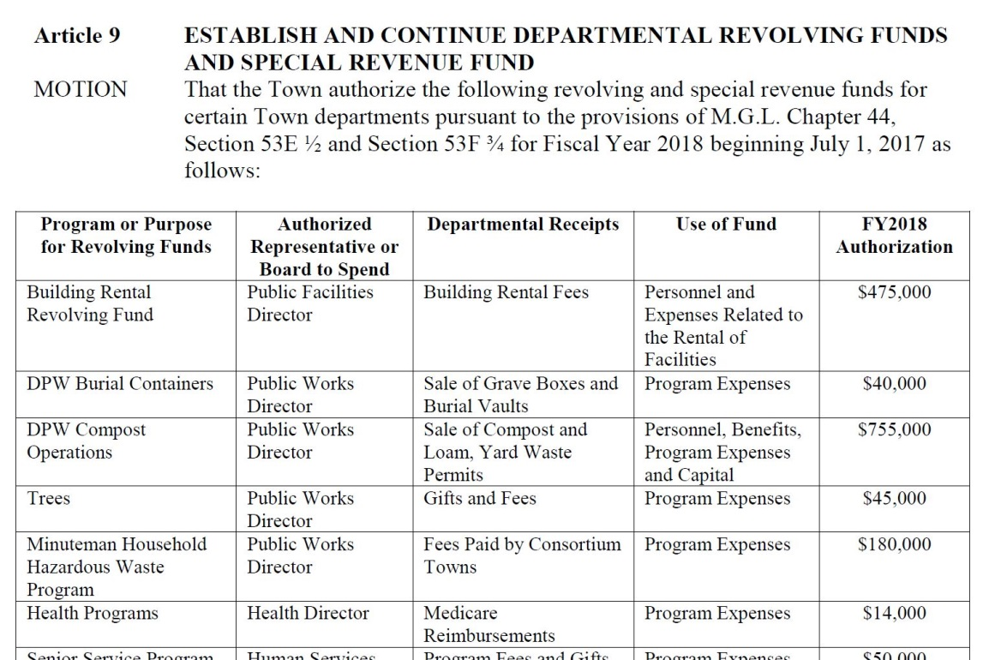
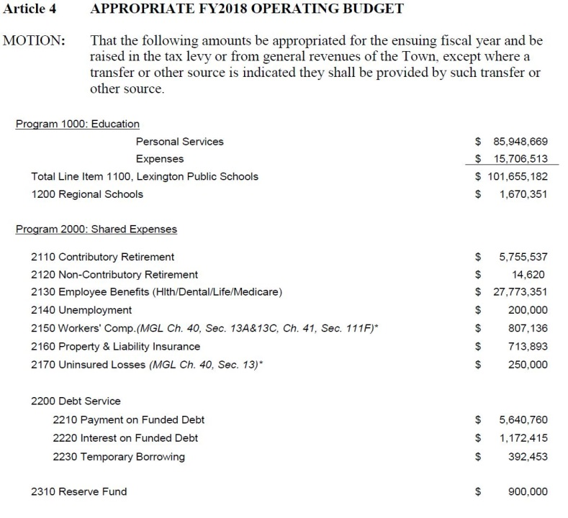
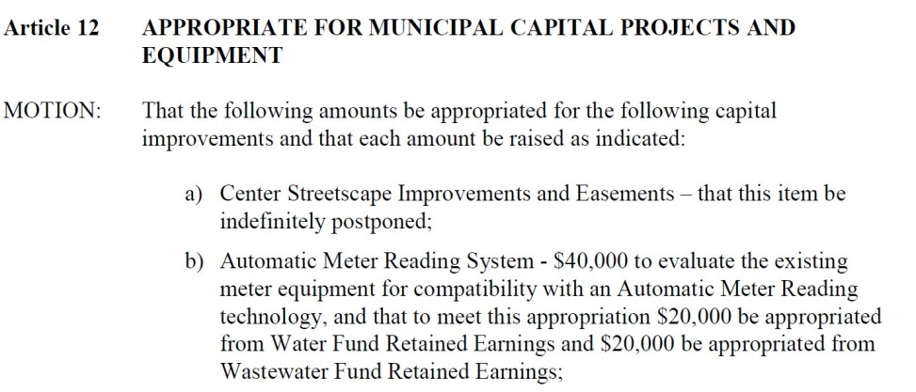
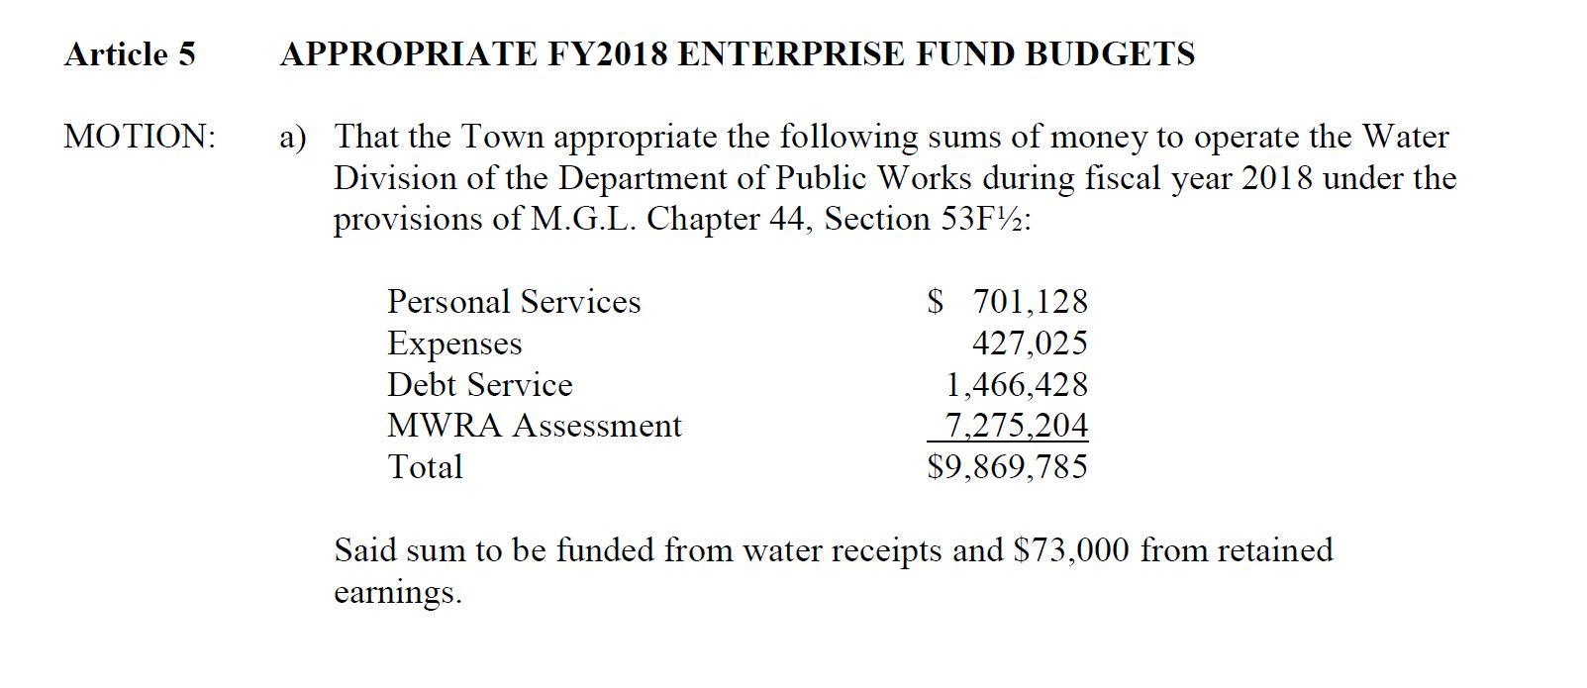
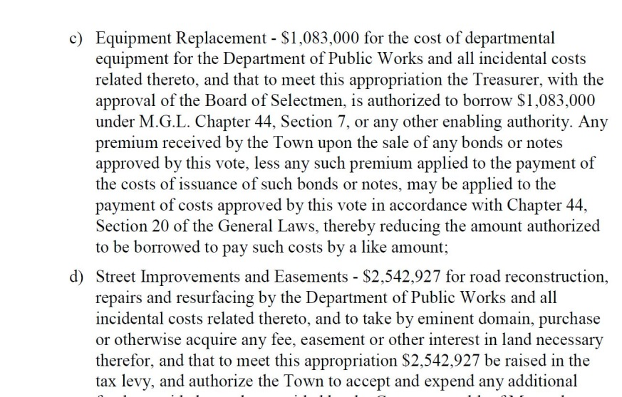
Prepare Motions for Warrant

Slide 68



Present to Town Meeting/City Council
$$?

Slide 69

Budget Monitoring
Motions = GL entries
Budget vs Actuals
  Department Budgets
  Capital Appropriations
Keep accurate data
  Basis for next year’s budget

Slide 70
Conclusion
Priorities
Guidelines
Structure
Maintain Assets
Financing Strategy
Fiscal Condition
Impact of:
  Programs
  Policies
  CIP

Slide 71
Theo Kalivas
Project Manager
Technical Assistance Bureau
kalivast@dor.state.ma.us
On the web:
Division of Local Services
mass.gov/dls
Community Compact Cabinet
mass.gov/ccc

Slide 72
Debt

Slide 73
Debt Management Policies
Deals with community’s need and ability to borrow money
Can acquire long and short term debt
  long-term debt - issued for acquisition of major pieces of capital equipment and facilities
  short-term debt - issued in anticipation of a particular revenue
Repay long term loans over the useful life of the item for which the debt was incurred
Create a capital improvements plan (CIP)
Ensure that short-term debt does not exceed the revenue source used for repayment of the debt
Be aware of limitations on amount of debt municipalities can carry

Slide 74
Developing a Debt Policy
Ensures funding of necessary projects
Provides guidance to municipal officials when evaluating possible expenditures
Provides method to project impact of decisions on budget
Should incorporate short term needs with long term goals

Slide 75
A well developed debt policy:
Calculates amount of debt that can be incurred without jeopardizing the municipality’s credit standing and causing financial hardship in future years
Incorporates affordability guidelines for expenditures
Includes an annual review of the capital improvements plan
Incorporates guidelines stating appropriate uses for and acceptable amounts of short term debt to be acquired by the community

Slide 76
Consequences of Acquiring Debt
Consider long life of debt payments
Consider all other sources of funds
i.e., Grants, one-time revenues such as free cash and revenue from the sale of property, and stabilization funds
Consider long range impact on budget and burden on taxpayer

Slide 77
Proposition
2 ½ Videos
http://www.mass.gov/dor/local-officials/training-and-seminars/levy-limits.html

Slide 78
DLS Gateway

Slide 79
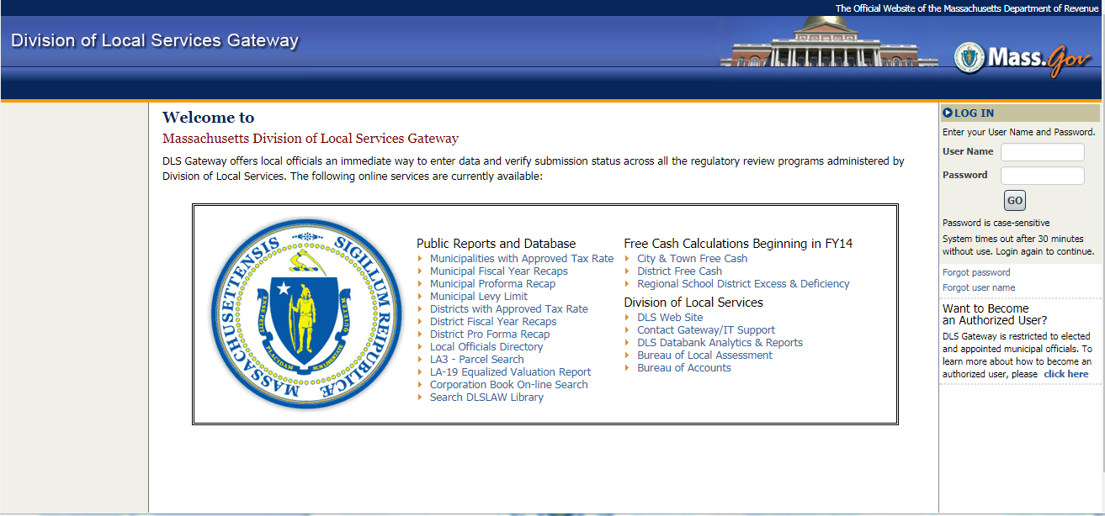
What is DLS Gateway?
It’s how DLS transacts business with
cities, towns and districts

Slide 80

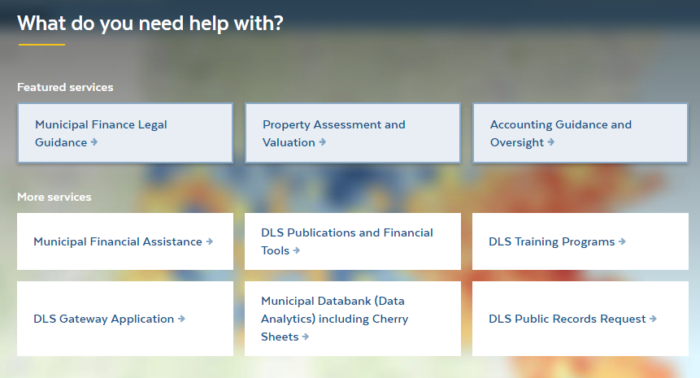
How do I get to Gateway?
Add a bookmark in your Web browser
https://dlsgateway.dor.state.ma.us/gateway/Login
From the DLS Web site:
https://www.mass.gov/orgs/division-of-local-services

Slide 81
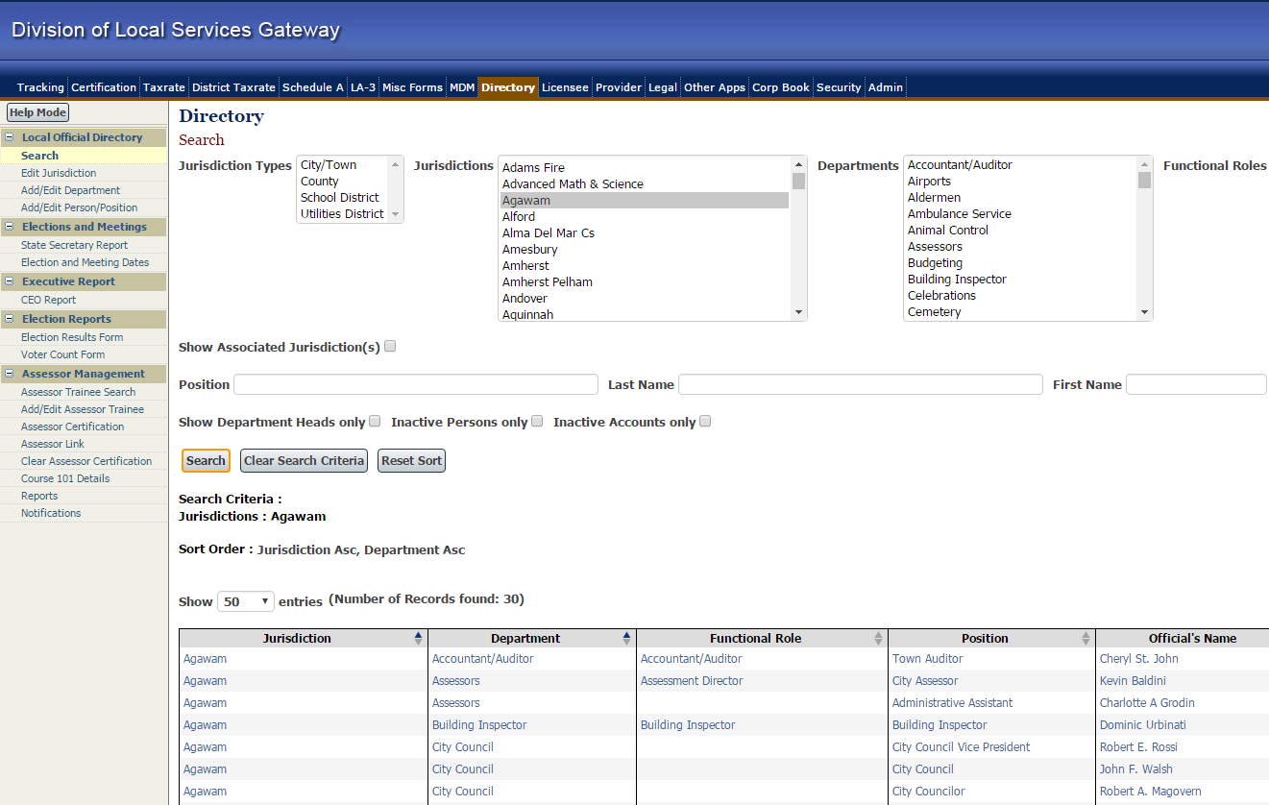
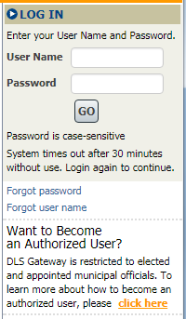
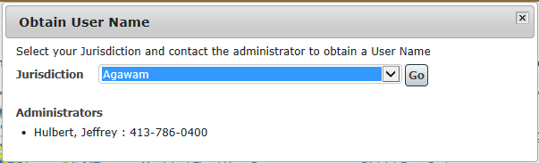
Need an Account?
You must be listed in the
Local Officials Directory
Contact your Local Administrator or DLS IT
if you need a Gateway account
City/Town Clerk
IT staff
Town Administrator

Slide 82
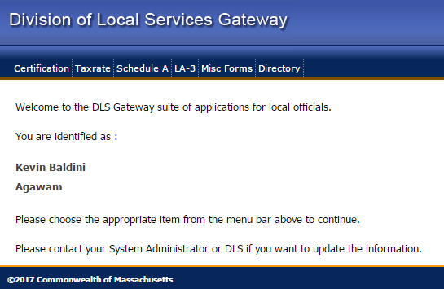
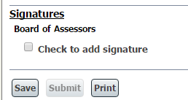

System Rights
“Who does what” in Gateway
is a local decision
If you don’t see a button
for the action you want to perform, you may not have the correct system rights
If you see a button but it’s not active: a step in the process (prerequisite) is missing

Slide 83
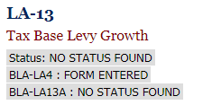
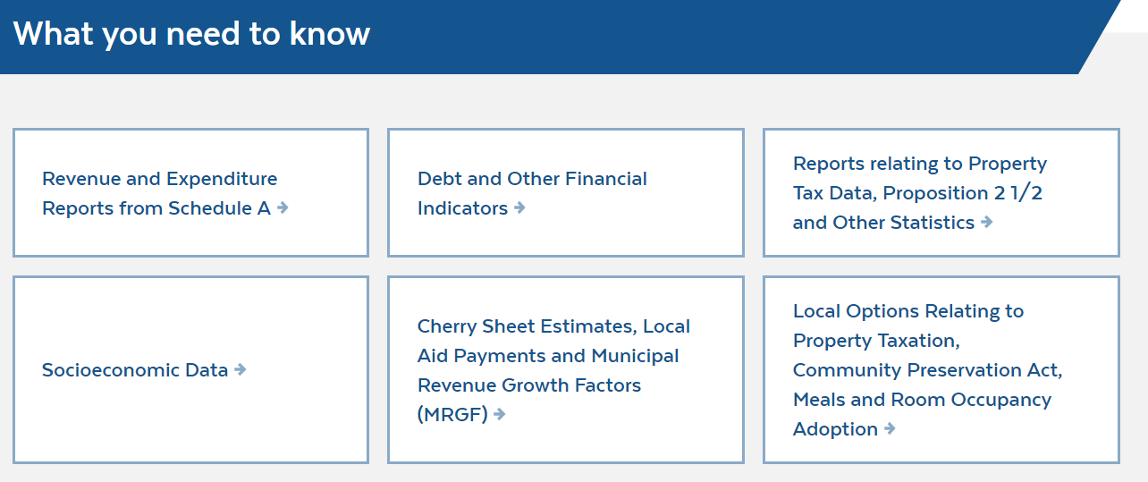
Who sees the data I enter?
Before approval: data is not public
“Work in Progress” is seen only by your authorized community users and DLS
When data is “Approved” by DLS, it’s public

Slide 84
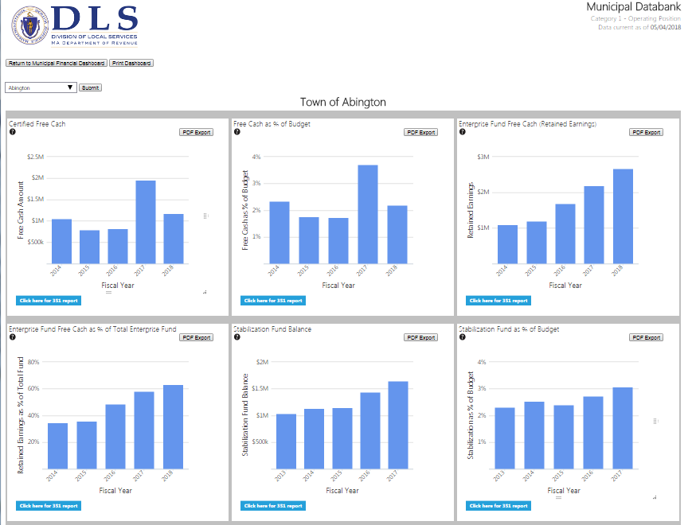
Municipal Finance Trend Dashboard

Slide 85
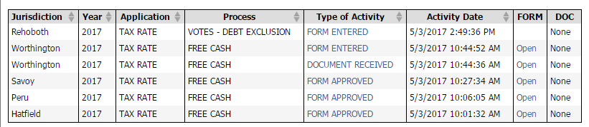
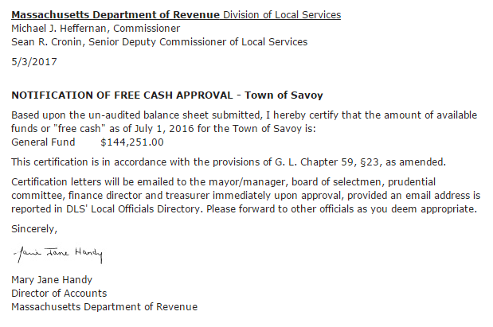
Gateway Notification System
DLS field representatives are notified when you submit data
You receive system-generated email when your data
is approved
Make sure your email address is correct in
Local Officials Directory!

Slide 86
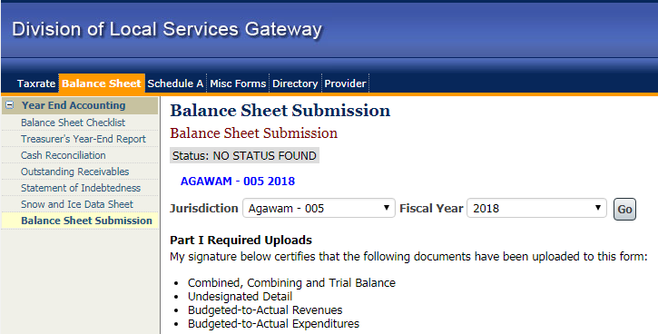
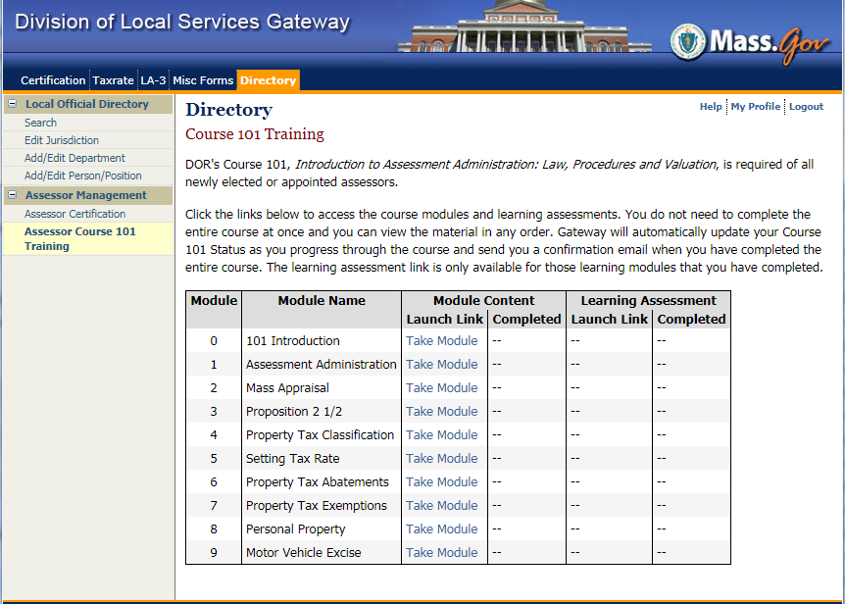
FY 2019 Gateway Enhancements
New Balance Sheet module Balance Sheet Submission form
Online Course 101
Satisfies qualification requirements for new assessors including Classification Training

Slide 87
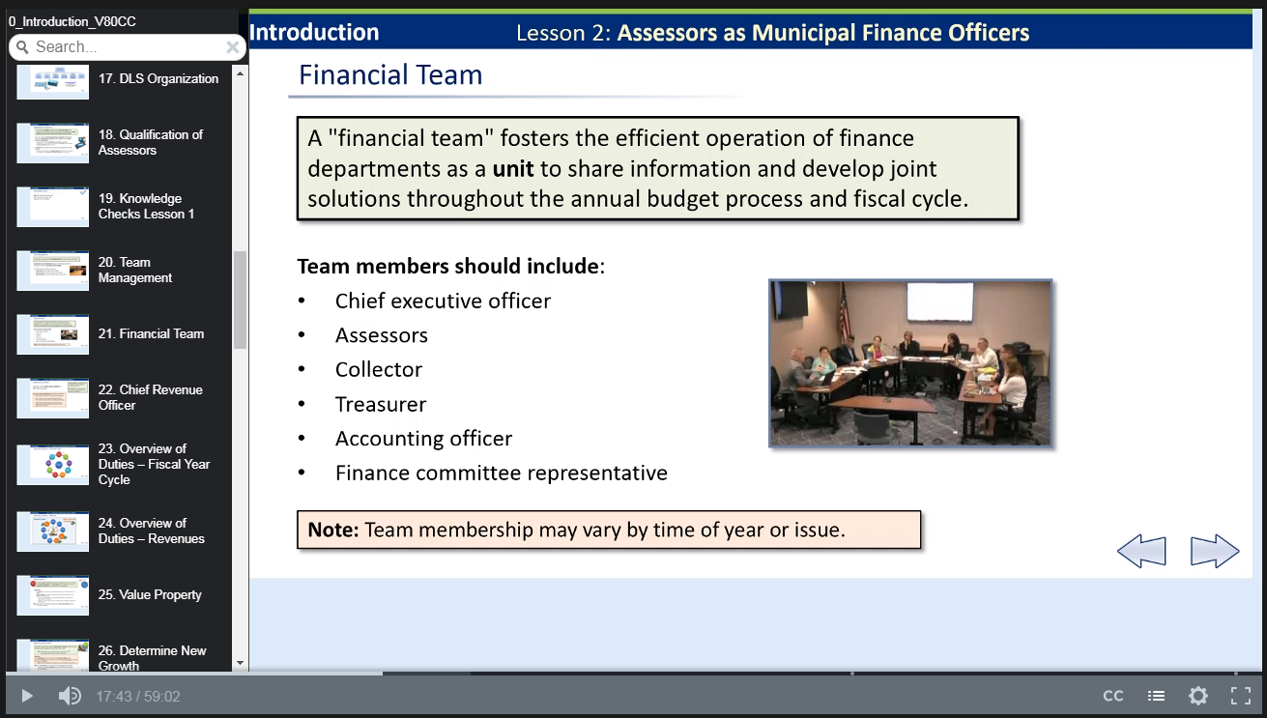
Complete all modules and knowledge assessments at your own pace
Gateway tracks progress and sends completion email

Slide 88

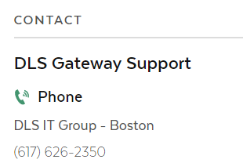
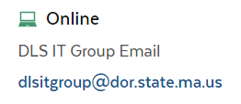
Whom do I call for help?
DLS IT provides assistance with:
Account setup
Password problems
Error messages
Uploading data
General information
If you aren’t sure who to call, start with Gateway Support

Slide 89
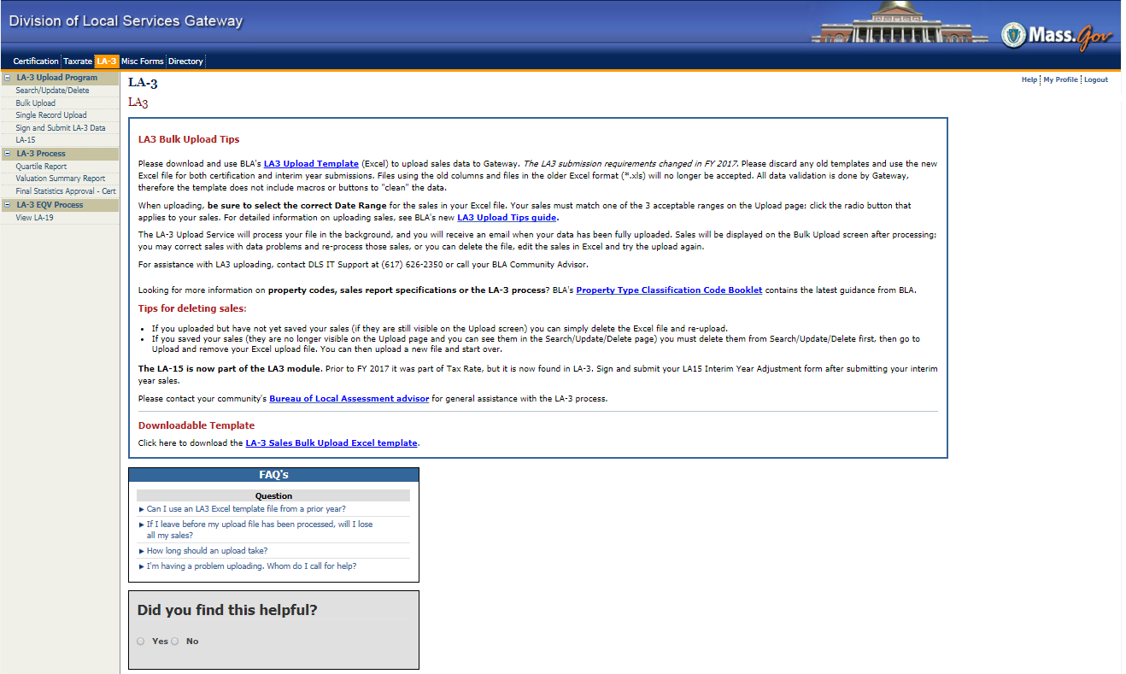
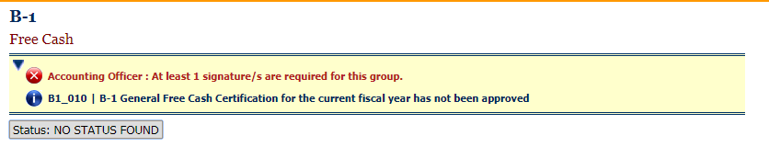
Other sources for help
Module Landing Pages
Links to documentation
Upload templates
Frequently Asked Questions (FAQs)
For assistance with individual forms, contact the Bureau or Unit responsible for the form

Slide 90
Free Cash, Stabilization Funds and Other Reserves

Slide 91
Revenue Sources Available for the
Annual General Fund Budget
Property Tax Levy - see Prop 2-1/2 Levy Limit Sheet
State Aid – see Cherry Sheets
Estimated Local Receipts – see Page 3 of Tax Recap
Other Available Funds – by Municipal Vote
  Certified Free Cash
  Stabilization Funds
  Overlay Surplus

Slide 92
Free Cash Definition
Unrestricted available funds for appropriation by a majority vote of the legislative body (Town Meeting / City Council)
Certified as of July 1 based on the June 30th Balance Sheet which reflects results from the prior year
Cannot be appropriated until it has been certified by the Director of Accounts as per MGL 59:23
Any remaining balance expires on June 30th
Should be considered a non-recurring revenue source

Slide 93
Why Having Free Cash is Critical
Is an available fund which can be appropriated for any legal spending purpose including to “Reduce the Tax Rate”
Depletion of Free Cash, particularly if used to balance annual budgets, can endanger future spending plans if it is not regenerated the following year
Drawdown on total reserves may result in a negative impact on the community’s credit rating
Retention of ample Free Cash balance provides municipalities with financial flexibility and confidence

Slide 94
Generating Free Cash
Free Cash certified > Free Cash appropriated
Actual Revenues > Budgeted Revenues
Budgeted Expenditures > Actual Expenditures and Encumbrances
Outstanding Property Taxes Prior Years > Outstanding Property Taxes Current Year

Slide 95
BOA Review Process
June 30th Balance Sheet is submitted for all Funds
Cash, Debt & Receivables must all be Reconciled
Deficits that impact Free Cash
  Overdrawn Budget Appropriations
  Unreimbursed Overdrawn Grants
Deficits that have no impact on Free Cash, but must be raised as part of the Tax Rate:
  Legally Overdrawn Appropriations – Snow & Ice
  Revenue Deficits
  Court Judgments
  Overlay Deficits

Slide 96
Basic Free Cash Formula
+ Undesignated Fund Balance
- Accounts Receivables
- Illegal Deficits
+ Deferred Revenues
= FREE CASH

Slide 97
Stabilization Funds – MGL 40:5B
A Stabilization “Rainy Day” Fund is a special reserve fund into which monies may be appropriated and reserved for later appropriation for any lawful purpose
Stabilization Fund balances carry forward from one fiscal year to another
Interest earned on investment of the balance in this fund remains with the fund
A majority vote of the legislative body is needed to appropriate money into a Stabilization Fund
However a two-thirds vote is required to establish each fund, appropriate from a fund, and to amend the purpose of a fund

Slide 98
Overlay Surplus
Overlay (Allowance for Abatements and Exemptions) is an annual amount raised to cover anticipated abatements and exemptions
As abatements and exemptions are granted by the Assessors the account is charged and the balance is reduced
At the appropriate time the Assessors can make a determination that a surplus exists and declare some as Overlay Surplus which is an available fund to be voted by the legislative body

Slide 99
Developing Reserve Policy
* * * *
Each City and Town should have a formal written reserve policy regarding:
Free Cash
Stabilization Funds

Slide 100
Benefits of a Reserve Policy
Building essential reserves can:
  Finance unforeseen and emergency needs
  Hold monies for specific future purposes
  Serve as a revenue source for the annual budget
  Positively impact a community’s credit rating which can influence the long term cost to fund major projects
  Lower interest costs by reducing the need for debt

Slide 101
Free Cash Policies
Adoption of a maintenance level of Free Cash to provide a financial cushion and to meet unforeseen expenditures
Consistent generation of Free Cash signals sound financial management
Free Cash should be used for non-recurring expenses (ie. annual Capital Outlay) and not to balance operating budgets
Consider appropriating some Free Cash into Stabilization Funds, particularly at fiscal year end

Slide 102
Stabilization Fund Policies
Think long term; develop replacement and maintenance programs
Create multiple special purpose funds for these savings objectives
Make annual appropriations to the funds
Monitor the use of the funds and set spending thresholds
Use proceeds from these funds to avoid borrowing and attendant costs of incurring debt such as interest

Slide 103
Setting the Tax Rate

Slide 104
    II. Amount to be raised
III. Estimated receipts and other revenues sources
IV. Summary of total amount to be raised and total receipts from all sources
A sample of this form can be found in Exercise 2 of your manual

Slide 105
Certification of Appropriations and Source of Funding
A sample of this form can be found in Exercise 2 of your manual

Slide 106
II. Amount to be raised
A sample of this form can be found in Exercise 2 of your manual

Slide 107
III Estimated receipts and other revenue sources
A sample of this form can found in Exercise 2 of your manual

Slide 108
IV. Summary of Total Amount to be Raised and Total Receipts from all Sources
A sample of this form can be found in Exercise 2 of your manual

Slide 109
→1. Motor vehicle excise
5. Charges for services -- water
6. Charges for services -- sewer
7. Charges for services -- hospital
8. Charges for services -- trash disposal
+ or - 10%
12. Departmental revenue -- schools
13. Departmental revenue -- libraries
14. Departmental revenue -- cemeteries
15. Departmental revenue -- recreation

Slide 110
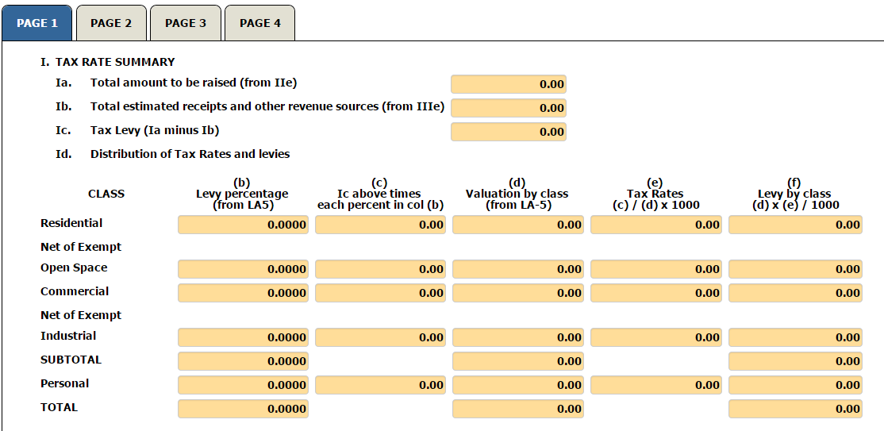
I. Tax Rate Summary
Total Amounts Raised
less state aid
less estimated receipts
less available funds
Tax Levy < Maximum allowable levy

Slide 111
For Review
The Tax Rate Formula is...
Tax Levy
Tax Rate = X 1,000
Assessed Value

