Slide 1
2018 DHCD Occupancy Compliance Training
Presented by: FinePoint Associates, LLC

Slide 2
Programs Covered
HOME
Housing Stabilization Fund (HSF)
Capital Improvement and Preservation Fund (CIPF)
Housing Innovations Fund (HIF)
Community Based Housing (CBH)
Facilities Consolidation Fund
(FCF)
Affordable Housing Trust Fund
(AHTF)
Commercial Area Transit Node Housing Program (CATNHP)/Transit Oriented Development (TOD)
Federal Housing Trust Fund (HTF)

Slide 3
Training Objectives
Increase
Increase knowledge
Clarify
Clarify Regulations
Highlight
Highlight DHCD Program Requirements
Improve
Improve Monitoring and Oversight
Share
Share Stories w/ Amnesty

Slide 4
Parties Involved
DHCD
Other funders: CEDAC, MassHousing
Property Owners
Property Mangers
Residents
FinePoint Associates
Notes:
Takes us all to make this work and reach our goals

Slide 5
DHCD Program Compliance
What you need to know…..

Slide 6
Determining “Assisted” Units
Assisted units are designated at project commitment by:
DHCD program
Income tier
Bedroom size
Always review the Affordable Housing Restriction (AHR)

Slide 7
Affordability Matrix
Notes:
Be sure to mention “contracts” which also has HOME

Slide 8
Fixed vs. Floating HOME Units
HOME-assisted units will either be “fixed” or “floating”
The designation will be determined in HOME written agreements
“Fixed” = same units for duration of affordability period
“Floating” = unit numbers can change but income and bedroom size distribution must remain the same
Bond Fund-assisted units always “float”

Slide 9
Income Targeting HOME and HTF
What you need to know…..

Slide 10
HOME Income Targeting
High HOME Units: Reserved for households at or below 60% of AMI at move-in, up to 80% of AMI at recertification
Low HOME Units: Reserved for households at or below 50% of AMI at move-in
20% of HOME-units must be restricted at Low HOME when there are 5 or more HOME-assisted units in a project
Deeper income targeting may be required in the AHR
HUD publishes annual income limits

Slide 11
HOME Income Targeting (cont.)
 | One Person | Two Person | Three Person | Four Person
30% Limits | $18,100 | $20,700 | $23,300 | $25,850
Very Low Income (50%) | $30,200 | $34,500 | $38,800 | $43,100
60% Limits | $36,240 | $41,400 | $46,560 | $51,720
Low Income (80%) | $48,300 | $55,200 | $62,100 | $68,950
Very Low Income = Low HOME or 50% AMI
60% = High HOME
Low Income = 80% AMI

Slide 12
HTF Income Targeting
HTF units are reserved for households at or below 30% of AMI or below the poverty line (whichever is greater)
HUD publishes annual income limits
 | One Person | Two Person | Three Person | Four Person
HTF Limits | $18,100 | $27,000 | $23,300 | $25,850
30% Limits | $18,100 | $27,000 | $23,300 | $25,850
Poverty Guideline | $12,140 | $16,460 | $20,780 | $25,100
Notes:
Published on HUD website

Slide 13
Income Targeting Bond Funds
What you need to know…..

Slide 14
Bond Fund Income Targeting
Income bands for all Bond Fund programs range from
30% (ELI)
50% (VLI)
60% (LI)
80%
Projects will often have multiple income tiers by Bond Fund Program
Always refer to the AHR
Refer to HUD published income limits or LIHTC income limits

Slide 15
CBH: Extra Eligibility Elements
A household member must be certified as a “Person Certified as Eligible” (PCE) by MassRehab Commission (MRC)
Person with physical or mental disability limiting one major life activity
Person institutionalized or at risk of institutionalization
“PCE” certification must be in tenant file
CBH referrals must come from MRC

Slide 16
FCF: Extra Eligibility Elements
Household must be referred as a client of DMH or DDS
Referral letter must be in the tenant file

Slide 17
Increases in Tenant Income
What you need to know….

Slide 18
Increases in Tenant Income HOME: Low HOME Units
If income of Low HOME tenant increases over 50% but below 80% AMI
Fixed HAU: Must rent next HOME-assisted unit to VLI household at approved Low HOME rent
Floating HAU: Must rent next available comparable unit to VLI household at approved Low HOME rent

Slide 19
Increases in Tenant Income HOME “over-income rent”
Recertification, income exceeds 80% of AMI
Household is considered over-income
Rent must be increase to the “over-income rent”
Fixed HAU: Household must pay rent equal to 30% of adjusted monthly income
Floating HAU: Household must pay rent equal to 30% of adjusted monthly income up to the comparable ‘street’ or market rent level and “next available” unit rule applies

Slide 20
Increases in Tenant Income HOME “over-income rent”
HOME with LIHTC: “over-income rent” is capped at LIHTC rent limit
At no time can tenancy be terminated due to household becoming “over income”
In all cases of combined funding sources; the most restrictive rent rules apply

Slide 21
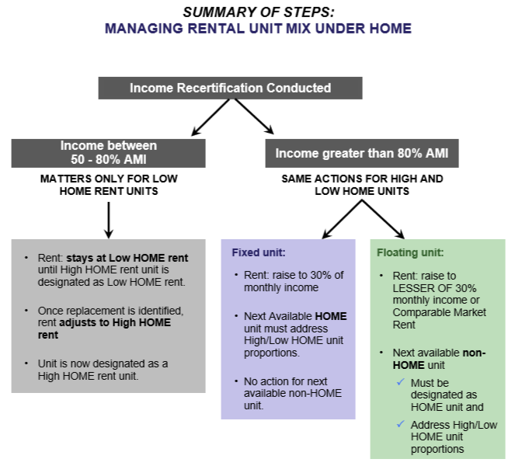

Slide 22
Increases in Tenant Income Bond Funds
30% (ELI) household’s income increases above 30% but below 50%
Household must pay the “over-income rent” – 1/12th of 30% of the household’s income as certified annually
Must rent next available unit to ELI household
30% (ELI) household’s income increases above 50% but below 80%
Considered “Low Income Family” and must pay the applicable 60% rent adjusted for utilities
Must rent next available unit to ELI household
50% (VLI) household’s income increases above 50% but below 80% AMI:
Considered a “Low Income Family” and must pay the applicable 60% rent adjusted for utilities
Must rent next available unit to VLI household
60% (LI) household’s income increases above 80%
Household is considered “over income” and must pay the over income rent
1/12th of 30% of household’s income as recertified annual up to a comparable market rent
Must rent next available unit to a LI household

Slide 23
Increases in Tenant Income Bond Funds “over-income rent”
Bond with LIHTC: “over-income rent” is capped at LIHTC rent limit
At no time can tenancy be terminated due to household becoming “over income”
In all cases of combined funding sources; the most restrictive rent rules apply

Slide 24
Determining Rents
What you need to know….

Slide 25
Project Floor Rents
HOME and Bond Fund rents never have to be reduced below rents established at time of loan closing
“Floor Rents” can be found in the AHR

Slide 26
Bond Fund Rent Limits
Per DHCD Rent Policy Memo dated November 1, 2017
Rents for DHCD Bond Fund-assisted units are capped at the applicable LIHTC rent limit by:
Bedroom size
Income tier
See the Novogradac website: www.novoco.com
Rents must be adjusted for tenant paid utilities
Properties are allowed to collect the full Section 8 gross rent on mobile and PBA vouchers (unlike HOME)

Slide 27
HTF Rent Limits
HTF rents plus utilities of an extremely low-income tenant shall not exceed the greater of
30% of the federal poverty line or
30%of the income of a family whose annual income equals 30% of AMI
Refer to HUD published annual rent limits
 | Efficiency | 1 BR | 2 BR | 3 BR
HTF Rent | $452 | $485 | $582 | $681
30% Rent | $452 | $485 | $582 | $672
Poverty Guideline Rent | $303 | $357 | $519 | $681

Slide 28
HOME Rent Limits
No longer only defined by HUD published rents
Project specific HOME rents may be lower than HUD published rents based on DHCD review
All HOME rents must be approved annually by DHCD
Regardless of an increase or not
HOME rents must be adjusted for tenant paid utilities
High HOME rent limit
Low HOME rent limit
Tenants must be given 30 days written notice before rents are adjusted and only at lease renewal
HOME rents may have to be decreased (never below the project floor)

Slide 29
HOME Rent Exception w/ Project-based Rental Subsidy
Properties can collect rent in excess of the HUD published or DHCD approved HOME rent:
When: All Following Conditions Met
HOME unit is assisted with project-based rental subsidy
Unit is designated as Low HOME
The occupying household pays no more than 30% of adjusted annual income towards rent: and
The occupying household is certified with an annual income at of below 50% AMI (VLI) for the full term of tenancy

Slide 30
HOME Rent Exception w/ Project-based Rental Subsidy (cont.)
If household is recertified with an annual income exceeding 50% AMI:
The household is no longer a “VLI” eligible household and THE UNIT NO LONGER MEETS the HOME RENT EXCEPTION REQUIREMENTS:
The gross rent cannot exceed applicable HUD published rent limit
The subsidy portion of rent may be reduced
The “VLI” designation may be swapped to “LI” if allowed for in AHR

Slide 31
HOME and Tenant Based Rental Subsidy
The gross rent cannot exceed the HUD published rent limit
If designated as a Low HOME gross rent cannot exceed the Low HOME rent
If designated as High HOME the gross rent cannot exceed the High HOME rent
The tenant rent, subsidy rent, and the utility allowance are all included in the gross rent calculation

Slide 32
HOME Rent and UA Approvals
To be continued…..

Slide 33
Property Wide Compliance
What you need to know….
Notes:
So now we will talk about subjects affecting the whole site, regardless of funding. With few exceptions.

Slide 34
Property Standards
Decent, Safe and Sanitary.
Ongoing Lead Based Paint maintenance
State and local Property standards; UPCS / HQS
Minimum Standards for ongoing
habitability
Notes:
Obviously all sites need to be maintained so to be Decent, Safe and Sanitary
We expect (AT LEAST) Annual inspections.
HQS or UPCS- guidance still pending but mostly about scoring- make sure units are decent safe and sanitary
Buildings pre-1978 construction- Provide all move-ins with LBP disclosure pamphlet
Use Safe work practices for all work around potential LBP
Notify tenants if work will be done
Maintain records for work and notifications of work to
-Ongoing habitability: Accessibility Requirements for Federally Assisted Housing: All Federally assisted housing dev (depending on the amount of rehab) dev with 5 or more units; 5 % units, or at least 1, accessible for persons with mobility disabilities. And additional 2 % units, or at least 1 unit accessible for persons with hearing or visual disabilities.
We will talk about some of these in more detail later

Slide 35
Fair Housing
Applicable Federal laws prohibiting discrimination
Title VI of the Civil Rights Act of 1964 – “prohibits discrimination of the basis of race, color, and national origin”
Limited English Proficiency: Must have Language Access Plan
Fair Housing Act of 1968
Section 504 of the Rehabilitation Act of 1973
Americans with Disabilities Act
Age Discrimination
But it’s more than prohibition against discrimination
Notes:
These laws go back to the 60’s before many of you were born.
Early 60’s with the Civil Rights Act prohibiting discrimination against race, color and national origin.
Grew to overtime to include persons with disabilities, Age discrimination, persons with limited English Proficiency etc.
But even more than the prohibition against discrimination, ……

Slide 36
Affirmative Fair Marketing and Tenant Selection
Marketing Plan for accessible units
Affirmative marketing procedures; Must be site specific
Required for all sites with 5 or more assisted units
Assess annually, Adjust based on data and Maintain records
Who’s least likely to apply? Reach out to that/those groups.
Notes:
You need to go beyond that and determine who is least likely to apply, and affirmatively market to those folks
-The marketing has to be Site Specific and is required for all sites with 5 or more assisted units.
It needs to be fluid and flexible- what’s changing at your site, on the block, in your neighborhood, in your larger city, and therefore how should you change your Affirmative Marketing Plan as a result?
It should be assessed at least annually and adjusted as based on data found. Keep records of what you’ve done to adjust it.
Keep your funding sources in mind as well. HIF, CBH, FCF; All the DHCD programs have specific requirements and therefore, populations, to whom you must market or reach out

Slide 37
Documenting Affirmative Fair Marketing and Tenant Selection
Must maintain marketing records showing efforts to;
Affirmatively Market to population least likely to apply
Market accessible units to disabled persons
Must maintain tenant selection procedure records;
Waitlist
Who was selected from waitlist and why
All units must be listed on the MassAccess Housing Registry
Notes:
Documentation is the only evidence that you have followed your Affirmative Fair Marketing and Tenant Selection Plan.
Special steps for Accessible units (next slide)

Slide 38
Marketing Accessible Units
Initial rent up
Persons with disabilities who need accessible unit
(Tenant applications allow for self identification of need for accessibility adaptations)
Turnover
First available to current occupant who requires accessibility adaptations
Next, to eligible qualified applicant on waitlist who requires accessibility adaptations
Next, market to attract new qualified applicant who requires accessibility
Last, unit may go to non-disabled applicant on waitlist
Notes:
Have an Accessibility PROGRAM and PLAN. Know which units are accessible for sensory and mobility disabilities, and change your plan as your sites needs change.

Slide 39
Tenant Protections/Leases
DHCD approves proposed leases or occupancy agreements at time of funding
Leases or occupancy agreements are required for all tenants
Annual lease term
Waiver must be granted by funding source if for shorter period
Lease must include:
Rent
Procedures for adjustments of rent
Termination procedures
Leases may include addendums to address program specific termination requirements
Notes:
the AHR often allows for an initial annual lease and then month to month after the first year. especially with AHTF and HIF

Slide 40
Prohibited Lease Clauses
Agreement to be sued
Treatment of property
Excusing owner from responsibility
Waiver of notice
Waiver of legal proceeding
Waiver of jury trial
Waiver of right to appeal court decision
Tenant responsible for legal fees regardless of outcome
Notes:
These are the prohibited clauses, by statute

Slide 41
Lease Termination/Refusal to Renew
Termination or refusal to renew lease requires good cause:
Violation of lease terms
Violation of applicable laws
Completion of tenancy for transitional housing
Other good cause (must be defined in lease)
Increase in income beyond designated income tier is not considered “good cause”
30 days notice of termination must be provided for all reasons including non-payment for HOME, HSF, CIPF and CATNHP

Slide 42
Violence Against Women Act (VAWA)
Applies to HOME and HTF
*Other Bond Fund Programs
VAWA protects applicants or tenants and survivors of
Domestic violence
Dating violence
Sexual assault, or
Stalking
Notes:
Not just for Women.
PLEASE NOTE; Act needs to be re-authorized – DEPENDS ON CURRENT ADMIN
Best practices for other programs– DHCD hoping to incorporate into emergency access plan

Slide 43
VAWA Emergency Transfer Plan
DHCD developing their emergency transfer plan
Must allow tenants who qualify, to transfer to another assisted unit in same project if tenant considers it safe
Must be given no less priority than any other type of emergency transfer
May bifurcate lease to evict abuser
May assist to move out of project into another assisted project
Notes:
DHCD currently working with a well known Non-Profit DV organization to perform as the organization to be contacted in the emergency.

Slide 44
Confidential Information (VAWA cont.)
Any information concerning incident(s) of violence, MUST BE MAINTAINED IN STRICT CONFIDENCE including:
Fact that the applicant or tenant is a victim
Any information on certification form, other victim status documentation, or emergency transfer request
Information may not be entered into shared database or disclosed to any other entity or person, except to extent disclosure is:
Requested/consented to in writing by victim
Required for use in eviction proceeding or termination hearing, or
Otherwise required by applicable law

Slide 45
VAWA Lease Addendum
VAWA lease term/addendum must incorporate requirements including:
Prohibited basis for eviction under VAWA
VAWA limits on lease terms
Tenant option to end lease without penalty if emergency transfer conditions are met
Notes:
To be in every lease

Slide 46
Student Rule* and HOME
Applicable to HOME-assisted units
Higher Education Students under 24 years old are ineligible for HOME assistance units unless:
Member of eligible household
Or meet specific exceptions
Applies to both full-time and part-time students.
*Not applicable to DHCD Bond Fund units.
Notes:
For the DHCD portfolio most HOME units are LIHTC units

Slide 47
HOME Student Rule Specific Exceptions
Veteran of the US Military
Married (including same‐sex)
Has dependent child who resides in the household at least 50% of the time
Disabled and was receiving Sec. 8 assistance as of 11/30/2005
If exceptions do not apply:
The individual must have established a household separate from parents or legal guardians for at least one year prior to application for occupancy

Slide 48
If… | Is the HUD/HOME student rule triggered? | Is the LIHTC student rule triggered?
The student is aged 18-23 | Yes | Yes, if all household members are full-time students
The household is comprised of all full-time students | Yes | Yes
The household is comprised of all part-time students | Yes | No
The household consists of all full-time high school students | No | Yes
The household consists of all recent high school graduates | No | Maybe (if full-time students for 5 months of the current calendar year)
The household consists of all recent college graduates | No | Maybe (if full-time students for 5 months of the current calendar year)
Notes:
(note that the handout says “HTF” on table and it should be struck out)
For properties with layered funding (both LIHTC and HUD Section 8 or HOME), both sets of student restrictions must be met.

Slide 49
Students in HOME-assisted Units at Recertification
Determine the household’s income level (including off site family such as parents at another location)
Student is not “Independent” if claimed for tax purposes as dependent of another household.
If the household is over-income; apply over-income provisions of the HOME regs at § 92.252(i).
“Over Income” not a reason for termination.
Notes:
You may find that a household has become a “Student Household” after move-in and you discover it at a recert.
What to do?

Slide 50
Students and Income Verifications
In addition to all other typical Income and Asset inclusions;
Financial Assistance “in excess of tuition* and other required fees” is included as income
(*Expenses associated with room and board, books, supplies, meal plans, transportation, parking and other non-fixed sum charges are not included in tuition)

Slide 51
Conflict of Interest Policy
All DHCD-assisted properties must have a written Conflict of Interest Policy
Based on HOME Rule at 24 CFR Part 92.356:
No owner, developer, sponsor or related party , may occupy a DHCD-assisted unit; includes:
Officers
Employees
Agents
Elected official
Appointed officer
Consultant
Immediate family member
Waivers may be granted…..
Notes:
Meant to support eligible households through a fair process into a unit

Slide 52
Conflict of Interest Policy Waivers
DHCD will review waiver requests on a case by case basis. (consultation with HUD may be required)
Waivers may be granted if the “conflicted person” is otherwise eligible and has applied for housing
Disclosure of relationship at application
Must be treated consistently with tenant selection policies and other applicants
Waiver must be granted prior to move in
Paid staff are exempt, if living on site is part of their job
Notes:
Must follow HUD’s guidance. Public Disclosure is key. Legal opinion needs to be submitted to DHCD. The early DHCD knows the easier

Slide 53
Monitoring for Compliance
What you need to know…..

Slide 54
Monitoring and Inspections
Verify compliance annually
On-site monitoring based on project size and funding sources
“Desk Reviews” when onsite monitoring not required
Owner or PM must certify annually that units are suitable for occupancy

Slide 55
Onsite Monitoring Visits
Frequency based on project size, funding, and previous monitoring results
FP will contact PM to schedule
FP will provide
Monitoring checklist
DHCD/CEDAC cashflow template
Unit designation compliance report
Requested information provided electronically, in advance, to FP
PM must notify all DHCD-assisted households of potential inspection

Slide 56
Documentation to be Provided Electronically by Property Manager
Completed monitoring checklist
Annual financial audit
Certificates of Insurance (DHCD/CEDAC)
Current comparable income statement
Annual per unit cash flow for prior two years (net depreciation and amortization)

Slide 57
Documentation to be Provided Electronically by Property Manager
HOME:
Current HOME Rent Approval
HIF, CBH, FCF:
Compliance Affidavit
Reserve account balances and contribution amounts
Reserve account disbursements
Unit designation compliance report
CEDAC annual cash flow template

Slide 58
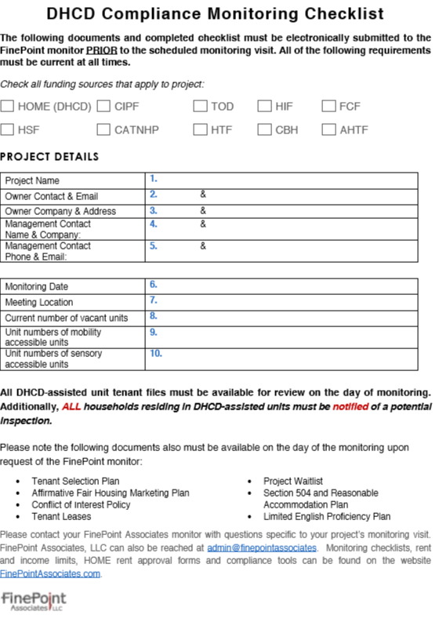
New Monitoring Checklist
Notes:
First of 2 pages.
Has links to required forms

Slide 59
Documentation to be Available at On Site Monitoring
All DHCD-assisted unit tenant files
Identification of project-based rental assisted units
Current leases
Copy of completed annual unit inspections
Utility allowance and source
Tenant selection plan
Affirmative Fair Marketing Plan
Conflict of interest policy
Project waitlist
Section 504 plan
Limited English Proficiency Plan
Supportive services plan

Slide 60
What to Expect During Monitoring
Typical visit ½ day depending on project size
Programmatic interview
Program documentation review
Financial health assessment
Eligibility documentation/tenant file review (random sample no less than five files)
Onsite Inspections (random sample no less than five units and common areas)
Exit review

Slide 61
Tenant File Compliance Expectations

Slide 62
Tenant File Should Include
Application or recertification checklist
Income certification summary sheet
Bedroom size
Household size/members
Income summary
Asset summary
Calculated annual income
Current income certification
Supporting documentation
Current lease and addendums
Affidavit of lead paint disclosure
Student status
VAWA lease addendum
FCF or CBH referral

Slide 63
DHCD Income Certification Requirements
Household income must be certified annually
CFR Part 5 (Section 8)
Technical Guide for Determining Income and Allowances for the HOME Program
www.hudexchange.info/resources.documents
HUD Handbook 4050.3 as supplementary guidance and “safe harbor”
HOME Rule and Tech. Guide trump contradictions in 4350.3

Slide 64
Documentation of Income
Source documentation required
Employment Income--2 consecutive months of pay stubs
*Third party verification may be used if source documentation cannot be collected but file must include clarification
Pension– official letter or statement
Social Security– official letter or statement
Affidavits to document lack of income– “zero income”
Must be signed under pains and penalties of perjury

Slide 65
Documentation of Income (cont.)
Child Support or Alimony
Copy of separation of divorce decree
Copy of most recent support payment
DOR statement
Self declaration
Affidavits to prove lack of child support or alimony
Must be signed under pains and penalty of perjury

Slide 66
Documentation of Income (cont.)
Regular Cash Contribution- including “cash gifts” or “other contributions”
Affidavit from gift provider
Self declaration

Slide 67
Documentation of Income (cont.)
Self Employment/Business Owner
All income sources must be verified including tips and gratuities
Documentation should include IRS Transcript of US Tax Returns
Use IRS Form 4506-T EZ
Notarized statement showing new income of business.
Audited or unaudited financial statements of the business including depreciation calculations.
Loan application listing income derived from the business from the preceding 12 months.
Note- Signed self affidavit indicating amount earned and payment period does not meet HUD criteria for source doc.

Slide 68
Documentation of Asset Income
All asset income must be verified regardless of total amount of assets
Bank statement(s)
Checking Accounts – average six months balance
Savings Accounts- current balance
Insurance statement
Copy of revocable trust
Retirement / Pension account statement
Appraisals of gems, jewelry, antique cars
Affidavits of “zero” and “disposed of” assets
Must be signed under pains and penalties of perjury
Notes:
“less than $5,000 in Assets” declaration form not acceptable for any of these funds (unlike LIHTC)

Slide 69
Annual Recertifications
Recertifications must be completed within 12 months of the effective date of prior income certification
Include requirement to cooperate in annual income certification process in lease
“Completed” means all documentation collected, reviewed, and tenant signed off on certification
Income documentation must be current (safe harbor of 6 months old)
Use “effective date” of recertification on cover sheet
“TIC” is good summary form to use

Slide 70
Annual Recertifications (cont.)
Alternative recertification method approved by DHCD:
If household benefits from a rental subsidy and income certified by the subsidy administrator annually
Then, an affidavit of eligibility may be used to document eligibility as long as it includes:
Unit address
Household size
Annual household income
Full source income documentation is required for all DHCD-assisted households every sixth year (6) of the affordability period for the project and all move-ins.
Effective date

Slide 71
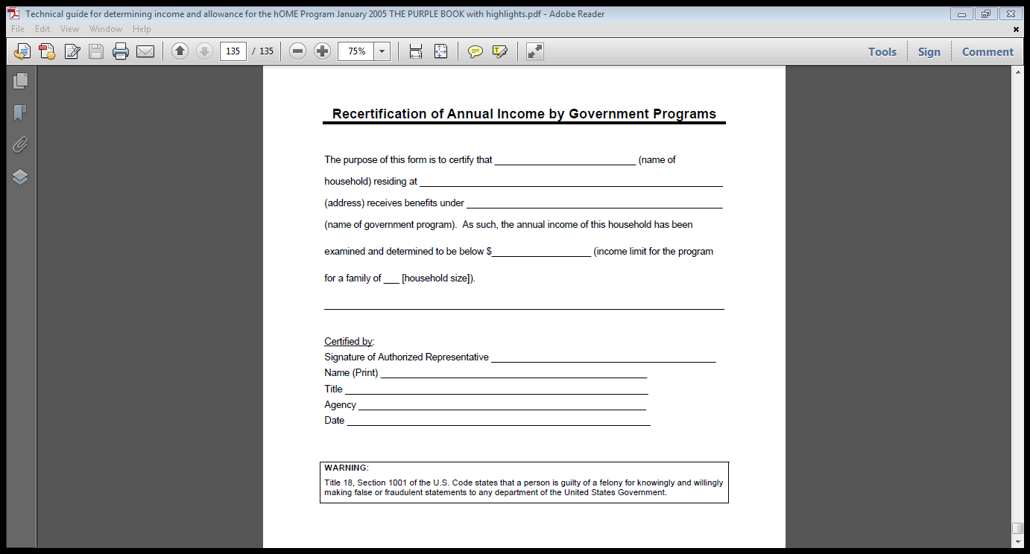

Slide 72
Compliance Monitoring of Rent and Incomes by Program
Now completed separately from onsite monitoring visit
Unit Designation Compliance Report OR report w/
Unit bedroom size
Tenant Rent
Subsidy Rent
Utility Allowance
Income tier designation
Applicable DHCD program
Will be completed as part of the HOME rent approval process or at time of annual monitoring

Slide 73
New Unit Designation Compliance Report

Slide 74
Rent and Occupancy Requirements
Must be enforced for the term of the affordability period through the Affordable Housing Restriction.
Restrictions may only be terminated upon foreclosure. (NOT a preferred option!).
Any sale or refi of the property must have prior consent from DHCD (or risk a slow down of the process).
Contact DHCD as early in the sale/refi process as possible.
Notes:
If the HOME loan or Bond fund loan is paid off, restrictions remain

Slide 75
On Site Compliance Monitoring Report
Now issued by FinePoint Associates on behalf of DHCD
Provides summary of monitoring results including:
“Substantial Compliance”
“Recommendations” for improved compliance
“Requirements” for compliance with program rules
“Findings” of non-compliance with statutes
DHCD will review and approve reports
FP will email to owners and property managers

Slide 76
Required Compliance Follow Up
“Recommendations”
Address best practices for improved compliance (no response is necessary/ implementation should be seen at next monitoring)
“Requirements”
Addresses programmatic non-compliance that requires action*
“Findings of non-compliance”
Addresses statutory non-compliance that requires action*
*All monitoring responses should be sent to DHCD or CEDAC within 45 days receipt of the monitoring report

Slide 77
Desk Review Monitoring
Completed when on site inspections not required
Review of rent and income compliance
FinePoint staff will contact PM and request submittal of
Unit Designation Compliance Report

Slide 78
HIF, CBH, FCF On-going Reporting
Annually project owners must submit to CEDAC:
HIF, CBH, FCF project cash flow template
Bi-annually project owners must submit to CEDAC:
HIF, CBH, FCF Compliance Affidavit
www.cedac.org/Forms/ApplicationForms.html
Audited financials
Notes:
In addition to previous mentioned information, HIF and CBH req more…..
NOTE- if you have a FP monitoring, then you can give it FP and CEDAC will get it from us.

Slide 79
HOME Rent and UA Approvals
What you need to know….

Slide 80
Annual HOME Rent Approval
DHCD must approve project specific HOME rents annually prior to implementation
Process is intended to ensure
Compliance with HOME rent limits
Rent increases do not impose undue rent burden on HOME-tenants (defined as 3% annual increase)
Rents support the financial needs of the site
Financial justifications are required for proposed increases in excess of 3%

Slide 81
HOME Rent Approval Procedure
DHCD HOME rent approval form and instructions
www.finepontassociates.com/resources
Submit in Excel format to FinePoint Associates at:
AHR@finepointassociates.com
Annual HOME Rent Approval must include:
Total DHCD-assisted HOME units in the project by bedroom size distribution defined in the AHR
Low and High HOME unit designations
Current gross rents
Projected gross rents
Current and project utility allowances

Slide 82
HOME Rent Approval Procedure (cont.)
“Current” HOME rents should not exceed those approved last year
Tenant-based rental assisted units are capped at the applicable published HOME rent limit
Managers must certify that the PBA units meet the HOME rent exception requirements (cover page)
Form must be submitted annually (maybe more)
Properties CANNOT exceed the approved rents without additional approval
Evidence of approval must be maintained in files for monitoring

Slide 84
HOME Utility Allowances
What you need to know…..

Slide 85
HOME Utility Allowances
Projects with HOME commitments prior to August 23, 2013 may use:
Public Housing Authority (PHA) Utility Allowances
Or other program approved UA calculation models

Slide 86
HOME Utility Allowances
Projects with HOME commitments on or after August 23, 2013 CANNOT USE PHA UTILITY ALLOWANCES
See HUD HOMEfires Vol. 13 No. 2 for details on allowable UA calculation methods
Annual Utility Allowances for these projects must be approved prior to implementation
FinePoint will complete the approval process on behalf of DHCD
HOME-assisted PBA units may be eligible for HUD waiver
Notes:
All waiver requests must go to Washington. No other local PJs have received waivers yet

Slide 87
Program-Approved UA Calculation Methods
HUD Utility Schedule Model (HUSM)
Utility Company Estimates
Energy Consumption Model (engineers model)

Slide 88
Web Resources:
HUD’s “Home Page” for HOME:
https://www.hudexchange.info/programs/home/
DHCD’s website: http://www.mass.gov/hed/economic/eohed/dhcd
DHCD e-SOURCE To subscribe send a blank email to:
join-dhcd-housingdevelopment@listserv.state.ma.us

Slide 89
FinePoint Contact Information
Elaine Nickerson
Director Affordable Housing Consulting
617.543.2204
elaine@finepointassociates.com
Lindsay Cohrs
Manager of Operations
508. 340-8890
lindsay@finepointassociates.com
Laurie Tickle
617.548.7640
laurie@finepointassociates.com
Manger of Affordable Housing Programs
Kate Joyce
Michelle Mastroianni
Olga Pitel
Senior Compliance Analyst
508.574.8293
Compliance Analyst
978.833.8437
michelle@finepointassociates.com
olga@finepointassociates.com
kate@finepointassociares.com
Compliance Analyst
508.341.5542

Slide 90
DHCD Contact Information
Alana Murphy
Deputy Associate Director
617.573.1301
Alana.murphy@mass.gov
Rebecca Frawley Wachtel
HOME/LIHTC Program Director
617.573.1318
Rebecca.Frawley@mass.gov
Bill Cole
HSF/CIPF/CATNHP Program Director
617.573.1303
William.cole2@mass.gov
Bronia Clifton
HIF, CBH, FCF Program Director
617.573.1305
Bronia.Clifton@mass.gov

Slide 91
CEDAC and MassHousing Contact Information
Erin Abberton:
CEDAC
HIF, CBH, FCF
eabberton@CEDAC.org
617.727.5944
Lynn Shields: MassHousing
AHTF
LShields@masshousing.com
617.854.1381

Slide 92
DHCD Occupancy Compliance Training
Presented by: FinePoint Associates

